Slide 1

CS21
Decidability and Tractability
Lecture 7
January 22, 2025

Slide 2
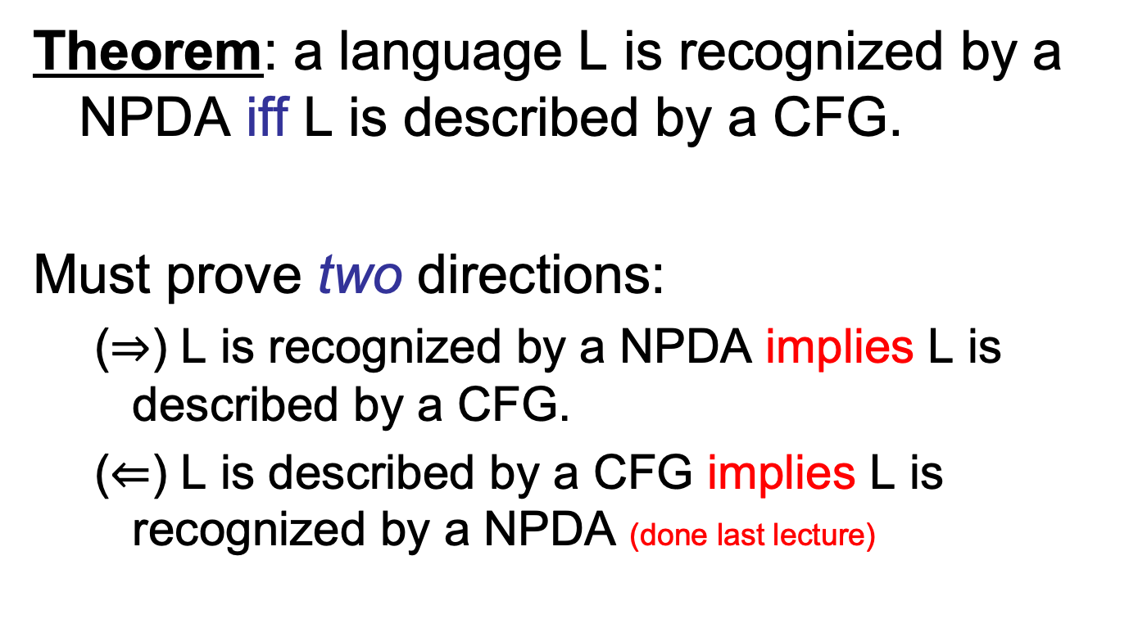
NPDA, CFG equivalence
Theorem: a language L is recognized by a NPDA iff L is described by a CFG.
Must prove two directions:
  ($⇒$) L is recognized by a NPDA implies L is described by a CFG.
  ($⇐$) L is described by a CFG implies L is recognized by a NPDA (done last lecture)

Slide 3
NPDA, CFG equivalence
Proof of ($⇒$): L is recognized by a NPDA implies L is described by a CFG.
  harder direction
  first step: convert NPDA into “normal form”:
    single accept state
    empties stack before accepting
    each transition either pushes or pops a symbol

Slide 4
NPDA, CFG equivalence
  main idea: non-terminal A_{p,q} generates exactly the strings that take the NPDA from state p (w/ empty stack) to state q (w/ empty stack)
  then A_{start, accept} generates all of the strings in the language recognized by the NPDA.

Slide 5
NPDA, CFG equivalence
Two possibilities to get from state p to q:
generated by A_{p,r}
generated by A_{r,q}
stack height
p
r
q
abcabbacacbacbacabacabbabbabaacabbbababaacaccaccccc
input
string taking NPDA from p to q

Slide 6
NPDA, CFG equivalence
NPDA P = (Q, Σ, $Γ$, δ, start, {accept})
CFG G:
  non-terminals V = {A_{p,q} : p, q $∈$ Q}
  start variable A_{start, accept}
  productions:
    for every p, r, q $∈$Q, add the rule
    A_{p,q} → A_{p,r}A_{r,q}

Slide 7
NPDA, CFG equivalence
Two possibilities to get from state p to q:
generated by A_{r,s}
stack height
r
s
p
pop d
push d
q
abcabbacacbacbacabacabbabbabaacabbbababaacaccaccccc
input
string taking NPDA from p to q

Slide 8
NPDA, CFG equivalence
from state p, read a, push d, move to state r
NPDA P = (Q, Σ, $Γ$, δ, start, {accept})
CFG G:
  non-terminals V = {A_{p,q} : p, q $∈$ Q}
  start variable A_{start, accept}
  productions:
    for every p, r, s, q $∈$ Q, d $∈Γ$and a, b $∈$ (Σ $∪$ {ε})
    if (r, d) $∈$ δ(p, a, ε), and
    (q, ε) $∈$ δ(s, b, d), add the rule
    A_{p,q} → aA_{r,s}b
from state s, read b, pop d, move to state q

Slide 9
NPDA, CFG equivalence
NPDA P = (Q, Σ, $Γ,$ δ, start, {accept})
CFG G:
  non-terminals V = {A_{p,q} : p, q $∈$ Q}
  start variable A_{start, accept}
  productions:
    for every p $∈$Q, add the rule
    A_{p,p} → ε

Slide 10
NPDA, CFG equivalence
two claims to verify correctness:
if A_{p,q} generates string x, then x can take NPDA P from state p (w/ empty stack) to q (w/ empty stack)
if x can take NPDA P from state p (w/ empty stack) to q (w/ empty stack), then A_{p,q} generates string x

Slide 11
NPDA, CFG equivalence
1. if A_{p,q} generates string x, then x can take NPDA P from state p (w/ empty stack) to q (w/ empty stack)
  induction on length of derivation of x.
  base case: 1 step derivation. must have only terminals on rhs. In G, must be production of form A_{p,p} → ε.

Slide 12
NPDA, CFG equivalence
1. if A_{p,q} generates string x, then x can take NPDA P from state p (w/ empty stack) to q (w/ empty stack)
  assume true for derivations of length at most k, prove for length k+1.
  verify case: A_{p,q} → A_{p,r}A_{r,q} →^{k} x = yz
  verify case: A_{p,q} → aA_{r,s}b →^{k} x = ayb

Slide 13
NPDA, CFG equivalence
2. if x can take NPDA P from state p (w/ empty stack) to q (w/ empty stack), then A_{p,q} generates string x
  induction on # of steps in P’s computation
  base case: 0 steps. starts and ends at same state p. only has time to read empty string ε.
  G contains A_{p,p} → ε.

Slide 14
NPDA, CFG equivalence
2. if x can take NPDA P from state p (w/ empty stack) to q (w/ empty stack), then A_{p,q} generates string x
  induction step. assume true for computations of length at most k, prove for length k+1.
  if stack becomes empty sometime in the middle of the computation (at state r)
    y is read going from state p to r (A_{p,r}→* y)
    z is read going from state r to q (A_{r,q}→* z)
    conclude: A_{p,q} → A_{p,r}A_{r,q} →* yz = x

Slide 15
NPDA, CFG equivalence
2. if x can take NPDA P from state p (w/ empty stack) to q (w/ empty stack), then A_{p,q} generates string x
  if stack becomes empty only at beginning and end of computation.
    first step: state p to r, read a, push d
    go from state r to s, read string y (A_{r,s}→* y)
    last step: state s to q, read b, pop d
    conclude: A_{p,q} → aA_{r,s}b →* ayb = x

Slide 16
NPDA, CFG equivalence
2. if x can take NPDA P from state p (w/ empty stack) to q (w/ empty stack), then A_{p,q} generates string x
  if stack becomes empty only at beginning and end of computation.
    first step: state p to r, read a, push d
    go from state r to s, read string y (A_{r,s}→* y)
    last step: state s to q, read b, pop d
    conclude: A_{p,q} → aA_{r,s}b →* ayb = x

Slide 17
Pumping Lemma for CFLs
CFL Pumping Lemma: Let L be a CFL. There exists an integer p (“pumping length”) for which every w $∈$L with |w| $≥$p can be written as
w = uvxyz such that
  for every i $≥$0, uv^{i}xy^{i}z $∈$L , and
  |vy| > 0, and
  |vxy| $≤$p.

Slide 18
CFL Pumping Lemma Example
Theorem: the following language is not context-free:
L = {a^{n}b^{n}c^{n} : n ≥ 0}.
Proof:
  let p be the pumping length for L
  choose w = a^{p}b^{p}c^{p}
  w = aaaa…abbbb…bcccc…c
  w = uvxyz, with |vy| > 0 and |vxy| $≤$p.

Slide 19
CFL Pumping Lemma Example
  possibilities:
w = aaaa…aaabbb…bbcccc…c
  (if v, y each contain only one type of symbol, then pumping on them produces a string not in the language)
u
v
x
y
z

Slide 20
CFL Pumping Lemma Example
  possibilities:
w = aaaa…abbbb…bccccc…c
  (if v or y contain more than one type of symbol, then pumping on them might produce a string with equal numbers of a’s, b’s, and c’s – if vy contains equal numbers of a’s, b’s, and c’s. But they will be out of order.)
u
v
x
y
z

Slide 21
CFL Pumping Lemma Example
Theorem: the following language is not context-free:
L = {xx : x $∈${0,1}*}.
Proof:
  let p be the pumping length for L
  try w = 0^{p}10^{p}1
  can this be pumped?

Slide 22
CFL Pumping Lemma Example
L = {xx : x $∈${0,1}*}.
  try w = 0^{2p}1^{2p}0^{2p}1^{2p}
  w = uvxyz, with |vy| > 0 and |vxy| $≤$p.
  case: vxy in first half.
    then uv²xy²z = 0??...?1??...?
  case: vxy in second half.
    then uv²xy²z = ??...?0??...?1
  case: vxy straddles midpoint
    then uv⁰xy⁰z = uxz = 0^{2p}1^{i}0^{j}1^{2p} with i ≠ 2p or j ≠ 2p

Slide 23
Pumping Lemma for CFLs
CFL Pumping Lemma: Let L be a CFL. There exists an integer p (“pumping length”) for which every w $∈$L with |w| $≥$p can be written as
w = uvxyz such that
  for every i $≥$0, uv^{i}xy^{i}z $∈$L , and
  |vy| > 0, and
  |vxy| $≤$p.

Slide 24
CFL Pumping Lemma
Proof: consider a parse tree for a very long string w $∈$ L:
S
long path
. . .
A
B
C
. . .
. . .
A
D
S
C
S
A
A
B
a
A
C
b
A
D
D
C
B
A
a
b
b
S
S
b
b
B
A
b
b
b
some non-terminal must repeat on long path
a
a
b
a

Slide 25
CFL Pumping Lemma
S
Schematic proof:
S
A
S
A
A
A
u
v
y
z
A
u
v
x
y
z
A
u
v
A
y
z
v
x
y

Slide 26
CFL Pumping Lemma
S
Schematic proof:
S
A
S
A
A
u
z
A
u
v
x
y
z
x
u
z

Slide 27
CFL Pumping Lemma
  how large should pumping length p be?
  need to ensure other conditions:
  |vy| > 0 |vxy| ≤ p
  b = max # symbols on rhs of any production (assume b ≥ 2)
  if parse tree has height ≤ h, then string generated has length ≤ b^{h} (so length > b^{h} implies height > h)

Slide 28
CFL Pumping Lemma
  let m be the # of nonterminals in the grammar
  to ensure path of length at least m+2, require
  |w| ≥ p = b^{m+2}
  since |w| > b^{m+1}, any parse tree for w has height > m+1
  let T be the smallest parse tree for w
  longest root-leaf path must consist of ≥ m+1 non-terminals and 1 terminal.

Slide 29
CFL Pumping Lemma
  must be a repeated non-terminal A on long path
  select a repetition among the lowest m+1 non-terminals on path.
  pictures show that for every i $≥$ 0, uv^{i}xy^{i}z $∈$ L
S
A
A
u
v
x
y
z
  is |vy| > 0 ?
    smallest parse tree T ensures
  is |vxy| ≤ p?
    red path has length ≤ m+2, so ≤ b^{m+2} = p leaves

