Slide 1
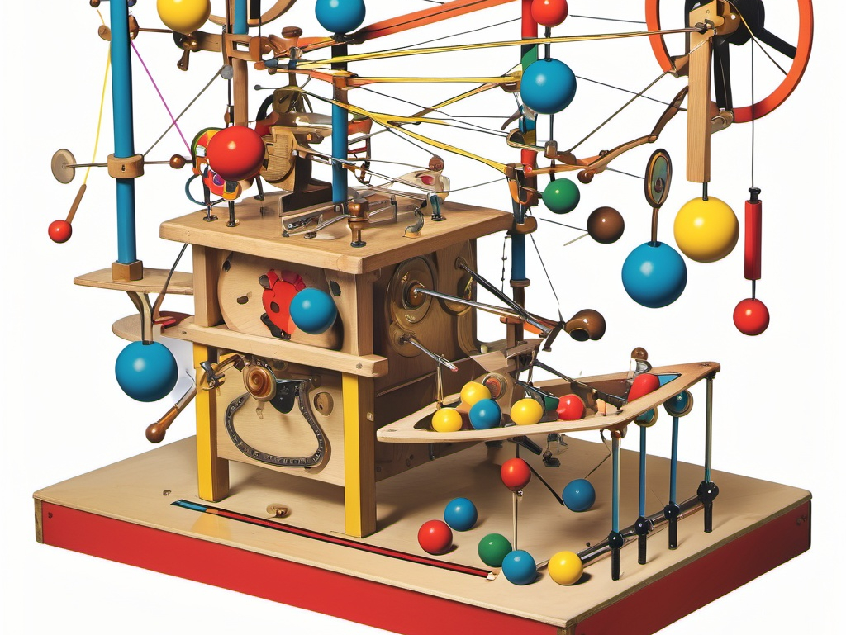
CS21 Decidability and Tractability
Lecture 5
January 15, 2025

Slide 2
Non-regular languages
Pumping Lemma: Let L be a regular language. There exists an integer p (“pumping length”) for which every w $∈$L with |w| $≥$p can be written as
w = xyz such that
for every i $≥$0, xy^{i}z $∈$L , and
|y| > 0, and
|xy| $≤$p.

Slide 3
Non-regular languages
Using the Pumping Lemma to prove L is not regular:
assume L is regular
then there exists a pumping length p
select a string w $∈$ L of length at least p
argue that for every way of writing w = xyz that satisfies (2) and (3) of the Lemma, pumping on y yields a string not in L.
contradiction.

Slide 4
Proof of the Pumping Lemma
Let M be a FA that recognizes L.
Set p = number of states of M.
Consider w $∈$L with |w| $≥$p. On input w, M must go through at least p+1 states. There must be a repeated state (among first p+1).
y
x
z
M

Slide 5
FA Summary
A “problem” is a language
A “computation” receives an input and either accepts, rejects, or loops forever.
A “computation” recognizes a language (it may also decide the language).
Finite Automata perform simple computations that read the input from left to right and employ a finite memory.

Slide 6
FA Summary
The languages recognized by FA are the regular languages.
The regular languages are closed under union, concatenation, and star.
Nondeterministic Finite Automata may have several choices at each step.
NFAs recognize exactly the same languages that FAs do.

Slide 7
FA Summary
Regular expressions are languages built up from the operations union, concatenation, and star.
Regular expressions describe exactly the same languages that FAs (and NFAs) recognize.
Some languages are not regular. This can be proved using the Pumping Lemma.

Slide 8
Machine view of FA
input tape
0
1
1
0
0
1
1
1
0
1
0
0
1
0
1
q₀
finite control

Slide 9
Machine view of FA
input tape
0
1
1
0
0
1
1
1
0
1
0
0
1
0
1
q₃
finite control

Slide 10
Machine view of FA
input tape
0
1
1
0
0
1
1
1
0
1
0
0
1
0
1
q₁
finite control

Slide 11
Machine view of FA
input tape
0
1
1
0
0
1
1
1
0
1
0
0
1
0
1
q₂
finite control
etc…

Slide 12
A more powerful machine
limitation of FA related to fact that they can only “remember” a bounded amount of information
What is the simplest alteration that adds unbounded “memory” to our machine?
Should be able to recognize, e.g., {0^{n}1^{n}: n ≥ 0}

Slide 13
Pushdown Automata
input tape
finite control
0
1
1
0
0
1
1
1
0
1
0
0
1
0
1
q₀
New capabilities:
can push symbol onto stack
can pop symbol off of stack
0
(infinite) stack
1
1
0
:

Slide 14
Pushdown Automata
input tape
finite control
0
0
1
1
0
1
1
1
0
1
0
0
1
0
1
q₀
$
(infinite) stack
:

Slide 15
Pushdown Automata
input tape
finite control
0
0
1
1
0
1
1
1
0
1
0
0
1
0
1
q₁
0
(infinite) stack
$
:

Slide 16
Pushdown Automata
input tape
finite control
0
0
1
1
0
1
1
1
0
1
0
0
1
0
1
q₁
0
(infinite) stack
0
$
:

Slide 17
Pushdown Automata
input tape
finite control
0
0
1
1
0
1
1
1
0
1
0
0
1
0
1
q₂
0
(infinite) stack
$
:

Slide 18
Pushdown Automata
input tape
finite control
0
0
1
1
0
1
1
1
0
1
0
0
1
0
1
q₂
Note: often start by pushing $ marker onto stack so that we can detect “empty stack”
$
(infinite) stack
:

Slide 19
Pushdown Automata (PDA)
We will define nondeterministic pushdown automata immediately
potentially several choices of “next step”
Deterministic PDA defined later
weaker than NPDA
Two ways to describe NPDA
diagram
formal definition

Slide 20
NPDA diagram
tape alphabet Σ
stack alphabet $Γ$
transition label: (tape symbol read, stack symbol popped → stack symbol pushed)
0, ε → 0
ε, ε → $
start state
1, 0 → ε
states
accept states
ε, $ → ε
1, 0 → ε
transitions

Slide 21
NPDA operation
Taking a transition labeled:
a, b → c
a $∈$(Σ $∪$ {ε})
b,c $∈$($Γ∪$ {ε})
read a from tape, or don’t read from tape if a = ε
pop b from stack, or don’t pop from stack if b = ε
push c onto stack, or don’t push onto stack if c = ε

Slide 22
Example NPDA
Σ = {0, 1}
$Γ$= {0, 1, $}
0, ε → 0
ε, ε → $
1, 0 → ε
ε, $ → ε
1, 0 → ε
tape:
Stack contents:
0
0
1
1
$

Slide 23
Example NPDA
Σ = {0, 1}
$Γ$= {0, 1, $}
0, ε → 0
ε, ε → $
1, 0 → ε
ε, $ → ε
1, 0 → ε
tape:
Stack contents:
0
0
1
1
0
$

Slide 24
Example NPDA
Σ = {0, 1}
$Γ$= {0, 1, $}
0, ε → 0
ε, ε → $
1, 0 → ε
ε, $ → ε
1, 0 → ε
tape:
Stack contents:
0
0
1
1
0
0
$

Slide 25
Example NPDA
Σ = {0, 1}
$Γ$= {0, 1, $}
0, ε → 0
ε, ε → $
1, 0 → ε
ε, $ → ε
1, 0 → ε
tape:
Stack contents:
0
0
1
1
0
0
$

Slide 26
Example NPDA
Σ = {0, 1}
$Γ$= {0, 1, $}
0, ε → 0
ε, ε → $
1, 0 → ε
ε, $ → ε
1, 0 → ε
tape:
Stack contents:
0
0
1
1
0
$

Slide 27
Example NPDA
Σ = {0, 1}
$Γ$= {0, 1, $}
0, ε → 0
ε, ε → $
1, 0 → ε
ε, $ → ε
1, 0 → ε
tape:
Stack contents:
0
0
1
1
$
accepted

Slide 28
Example NPDA
Σ = {0, 1}
$Γ$= {0, 1, $}
0, ε → 0
ε, ε → $
1, 0 → ε
ε, $ → ε
1, 0 → ε
tape:
Stack contents:
0
0
1
$

Slide 29
Example NPDA
Σ = {0, 1}
$Γ$= {0, 1, $}
0, ε → 0
ε, ε → $
1, 0 → ε
ε, $ → ε
1, 0 → ε
tape:
Stack contents:
0
0
1
0
$

Slide 30
Example NPDA
Σ = {0, 1}
$Γ$= {0, 1, $}
0, ε → 0
ε, ε → $
1, 0 → ε
ε, $ → ε
1, 0 → ε
tape:
Stack contents:
0
0
1
0
0
$

Slide 31
Example NPDA
Σ = {0, 1}
$Γ$= {0, 1, $}
0, ε → 0
ε, ε → $
1, 0 → ε
ε, $ → ε
1, 0 → ε
tape:
Stack contents:
0
0
1
0
0
$

Slide 32
Example NPDA
Σ = {0, 1}
$Γ$= {0, 1, $}
0, ε → 0
ε, ε → $
1, 0 → ε
ε, $ → ε
1, 0 → ε
tape:
Stack contents:
0
0
1
0
$
not accepted

Slide 33
Example NPDA
Σ = {0, 1}
$Γ$= {0, 1, $}
0, ε → 0
ε, ε → $
1, 0 → ε
ε, $ → ε
1, 0 → ε
What language does this NPDA accept?

Slide 34
Formal definition of NPDA
A NPDA is a 6-tuple (Q, Σ, $Γ,$ δ, q₀, F) where:
Q is a finite set called the states
Σ is a finite set called the tape alphabet
$Γ$is a finite set called the stack alphabet
δ:Q x (Σ $∪$ {ε}) x ($Γ∪$ {ε}) → P(Q x ($Γ∪$ {ε})) is a function called the transition function
q₀ is an element of Q called the start state
F is a subset of Q called the accept states

Slide 35
Formal definition of NPDA
NPDA M = (Q, Σ, $Γ,$ δ, q₀, F) accepts string w $∈$Σ* if w can be written as
w₁w₂w₃…w_{m} $∈$(Σ $∪$ {ε})*, and
there exist states r₀, r₁, r₂, …, r_{m}, and
there exist strings s₀, s₁, …, s_{m} in ($Γ∪${ε})*
r₀ = q₀ and s₀ = ε
(r_{i+1}, b) $∈$δ(r_{i}, w_{i+1}, a), where s_{i} = at, s_{i+1} = bt for some t $∈$ $Γ^{∗}$
r_{m} $∈$F

Slide 36
Example of formal definition
0, ε → 0
ε, ε → $
q₀
q₁
1, 0 → ε
q₃
ε, $ → ε
q₂
1, 0 → ε
Q = {q₀, q₁, q₂, q₃}
Σ = {0,1}
$Γ$= {0, 1, $}
F = {q₀, q₃}
δ(q₀, ε, ε) = {(q₁, $)}
δ(q₁, 0, ε) = {(q₁, 0)}
δ(q₁, 1, 0) = {(q₂, ε)}
δ(q₂, 1, 0) = {(q₂, ε)}
δ(q₂, ε, $) = {(q₃, ε)}
other values of
δ(•, •, •) equal {}

Slide 37
Exercise
Design a NPDA for the language
{a^{i}b^{j}c^{k} : i, j, k ≥ 0 and i = j or i = k}

Slide 38
Context-free grammars and languages
languages recognized by a (N)FA are exactly the languages described by regular expressions, and they are called the regular languages
languages recognized by a NPDA are exactly the languages described by context-free grammars, and they are called the context-free languages

Slide 39
Context-Free Grammars
A → 0A1
A → B
B → #
start symbol
terminal symbols
non-terminal symbols
production

Slide 40
Context-Free Grammars
generate strings by repeated replacement of non-terminals with string of terminals and non-terminals
write down start symbol (non-terminal)
replace a non-terminal with the right-hand-side of a rule that has that non-terminal as its left-hand-side.
repeat above until no more non-terminals

Slide 41
Context-Free Grammars
A → 0A1
A → B
B → #
Example:
A $⇒$ 0A1 $⇒$ 00A11 $⇒$
000A111 $⇒$ 000B111 $⇒$
000#111
a derivation of the string 000#111
set of all strings generated in this way is the language of the grammar L(G)
called a Context-Free Language

Slide 42
Context-Free Grammars
shorthand for multiple rules with same lhs
Natural languages (e.g. English) have this sort of structure:
<sentence> → <noun-phrase><verb-phrase>
<noun-phrase> → <cpx-noun> | <cpx-noun><prep-phrase>
<verb-phrase> → <cpx-verb> | <cpx-verb><prep-phrase>
<prep-phrase> → <prep><cpx-noun>
<cpx-noun> → <article><noun>
<cpx-verb> → <verb>|<verb><noun-phrase>
<article> → a | the
<noun> → dog | cat | flower
<verb> → eats | sees
<prep> → with
Generate a string in the language of this grammar.

Slide 43
Context-Free Grammars
CFGs don’t capture natural languages completely
computer languages often defined by CFG
hierarchical structure
slightly different notation often used “Backus-Naur form”
see next slide for example

Slide 44
Example CFG
<stmt> → <if-stmt> | <while-stmt> | <begin-stmt>
| <asgn-stmt>
<if-stmt> → IF <bool-expr> THEN <stmt> ELSE <stmt>
<while-stmt> → WHILE <bool-expr> DO <stmt>
<begin-stmt> → BEGIN <stmt-list> END
<stmt-list> → <stmt> | <stmt>; <stmt-list>
<asgn-stmt> → <var> := <arith-expr>
<bool-expr> → <arith-expr><compare-op><arith-expr>
<compare-op> → < | > | ≤ | ≥ | =
<arith-expr> → <var> | <const>
| (<arith-expr><arith-op><arith-expr>)
<arith-op> → + | - | * | /
<const> → 0 | 1 | 2 | 3 | 4 | 5 | 6 | 7 | 8 | 9
<var> → a | b | c | … | x | y | z

Slide 45
CFG formal definition
A context-free grammar is a 4-tuple
(V, Σ, R, S)
where
V is a finite set called the non-terminals
Σ is a finite set (disjoint from V) called the terminals
R is a finite set of productions where each production is a non-terminal and a string of terminals and non-terminals.
S $∈$V is the start variable (or start non-terminal)

Slide 46
CFG formal definition
u, v, w are strings of non-terminals and terminals, and A → w is a production:
“uAv yields uwv” notation: uAv $⇒$ uwv
also: “yields in 1 step” notation: uAv $⇒^{1}$ uwv
in general:
“yields in k steps” notation: u $⇒^{k}$ v
meaning: there exists strings u₁,u₂,…u_{k-1} for which u $⇒^{1}$u₁ $⇒^{1}$u₂ $⇒^{1}$… $⇒^{1}$u_{k-1} $⇒^{1}$v

Slide 47
CFG formal definition
notation: u $⇒^{∗}$v
meaning: $∃$k ≥ 0 and strings u₁,…,u_{k-1} for which u $⇒^{1}$u₁ $⇒^{1}$u₂ $⇒^{1}$… $⇒^{1}$u_{k-1} $⇒^{1}$v
if u = start symbol, this is a derivation of v
The language of G, denoted L(G) is:
{w $∈$Σ* : S $⇒^{∗}$ w}

