Slide 1

CS21
Decidability and Tractability
Lecture 3-4
January 14, 2025

Slide 2
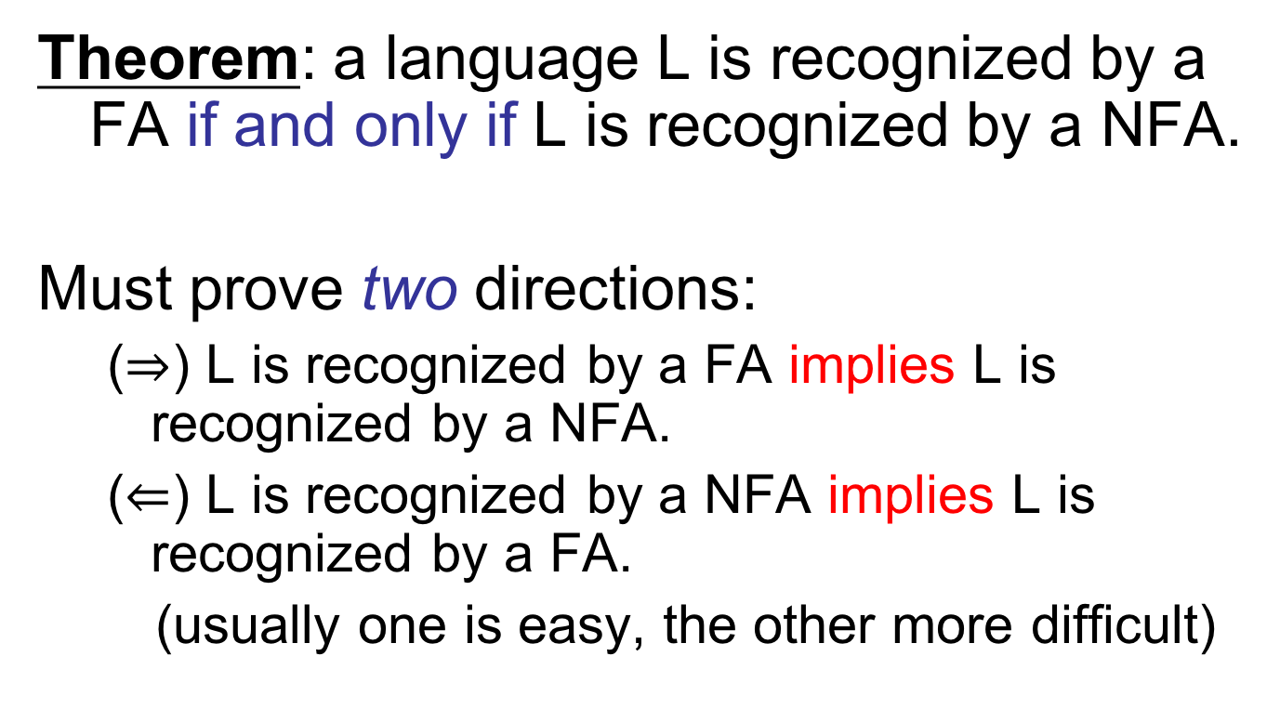
NFA, FA equivalence
Theorem: a language L is recognized by a FA if and only if L is recognized by a NFA.
Must prove two directions:
  ($⇒$) L is recognized by a FA implies L is recognized by a NFA.
  ($⇐$) L is recognized by a NFA implies L is recognized by a FA.
  (usually one is easy, the other more difficult)

Slide 3
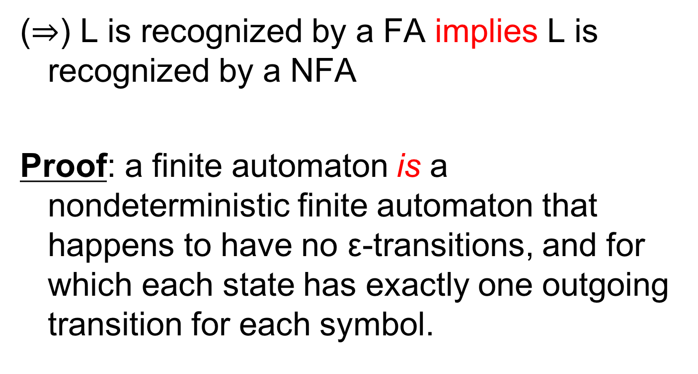
NFA, FA equivalence
($⇒$) L is recognized by a FA implies L is recognized by a NFA
Proof: a finite automaton is a nondeterministic finite automaton that happens to have no ε-transitions, and for which each state has exactly one outgoing transition for each symbol.

Slide 4
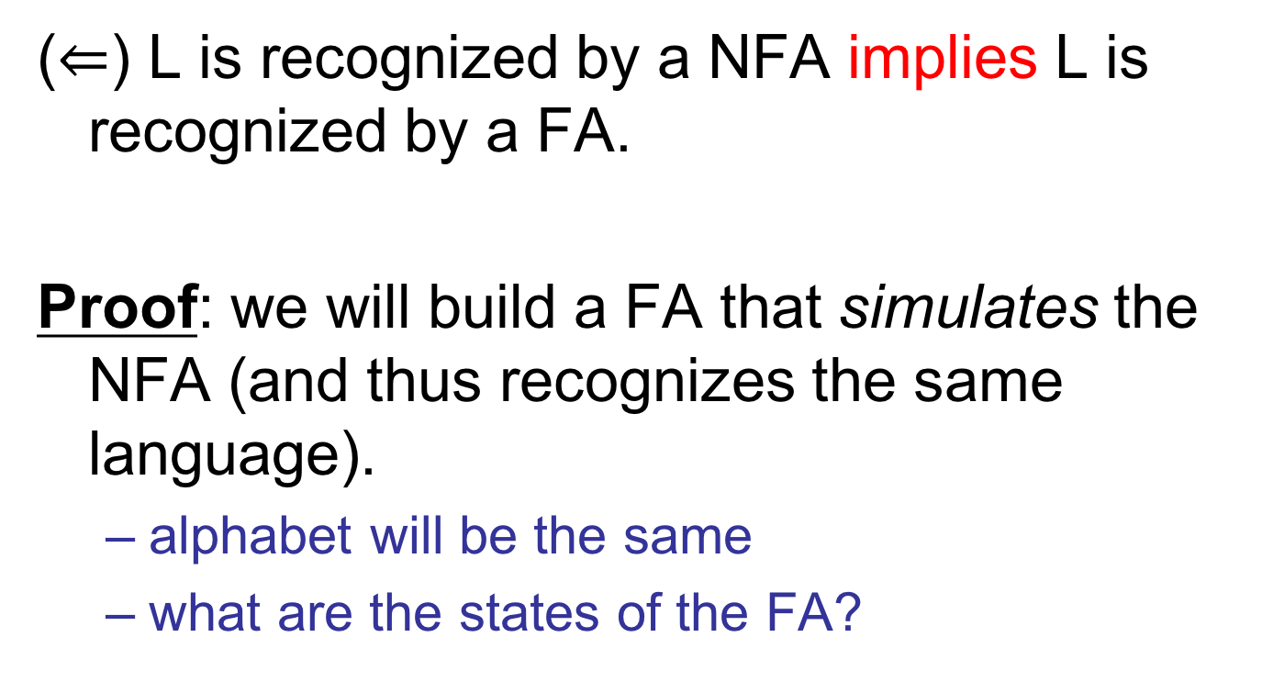
NFA, FA equivalence
($⇐$) L is recognized by a NFA implies L is recognized by a FA.
Proof: we will build a FA that simulates the NFA (and thus recognizes the same language).
  alphabet will be the same
  what are the states of the FA?

Slide 5
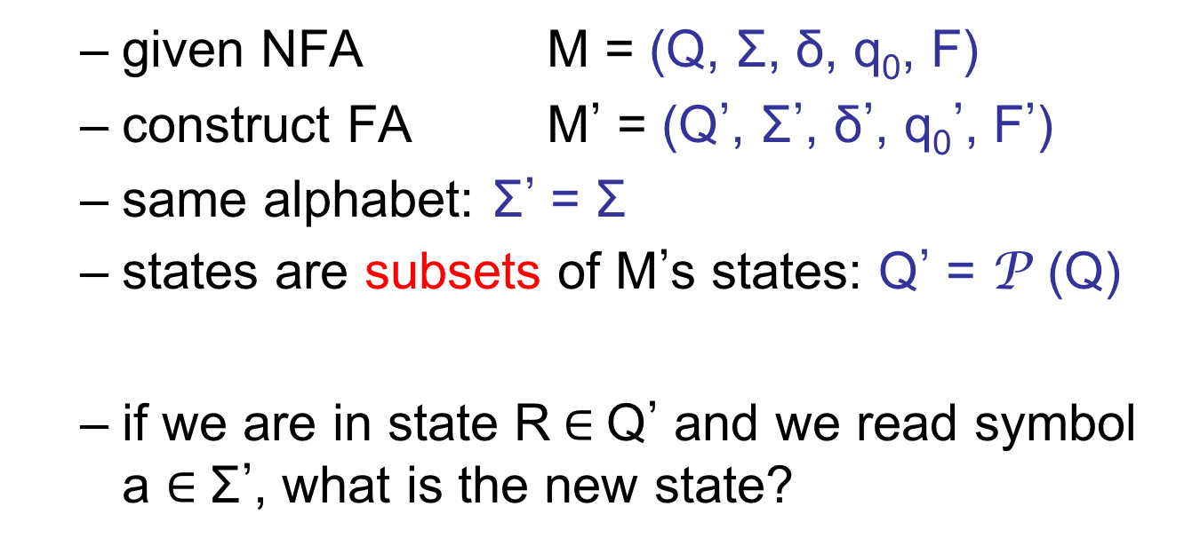
NFA, FA equivalence
1
0,ε
1
0,1
0,1
  given NFA M = (Q, Σ, δ, q₀, F)
  construct FA M’ = (Q’, Σ’, δ’, q₀’, F’)
  same alphabet: Σ’ = Σ
  states are subsets of M’s states: Q’ = P (Q)
  if we are in state R$∈$Q’ and we read symbol a $∈$Σ’, what is the new state?

Slide 6
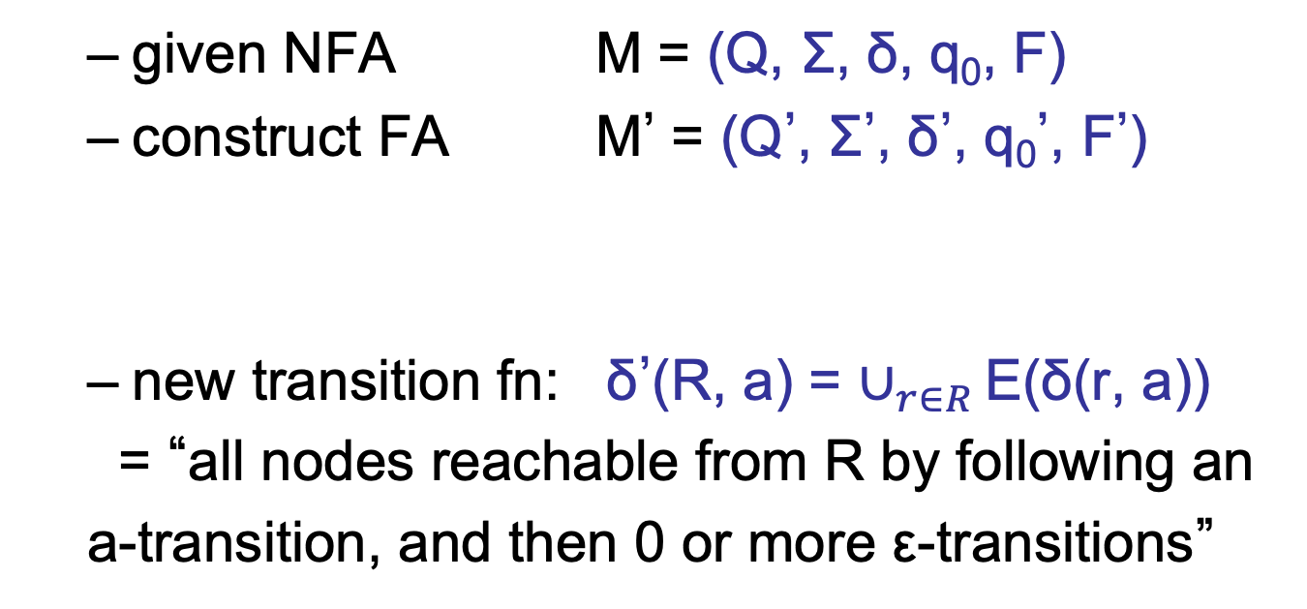
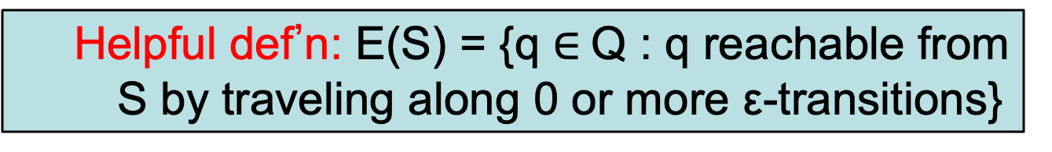
NFA, FA equivalence
1
0,ε
1
0,1
0,1
  given NFA M = (Q, Σ, δ, q₀, F)
  construct FA M’ = (Q’, Σ’, δ’, q₀’, F’)
  new transition fn: δ’(R, a) = $∪_{r∈R }$E(δ(r, a))
  = “all nodes reachable from R by following an
  a-transition, and then 0 or more ε-transitions”
  Helpful def’n: E(S) = {q $∈$Q : q reachable from S by traveling along 0 or more ε-transitions}

Slide 7
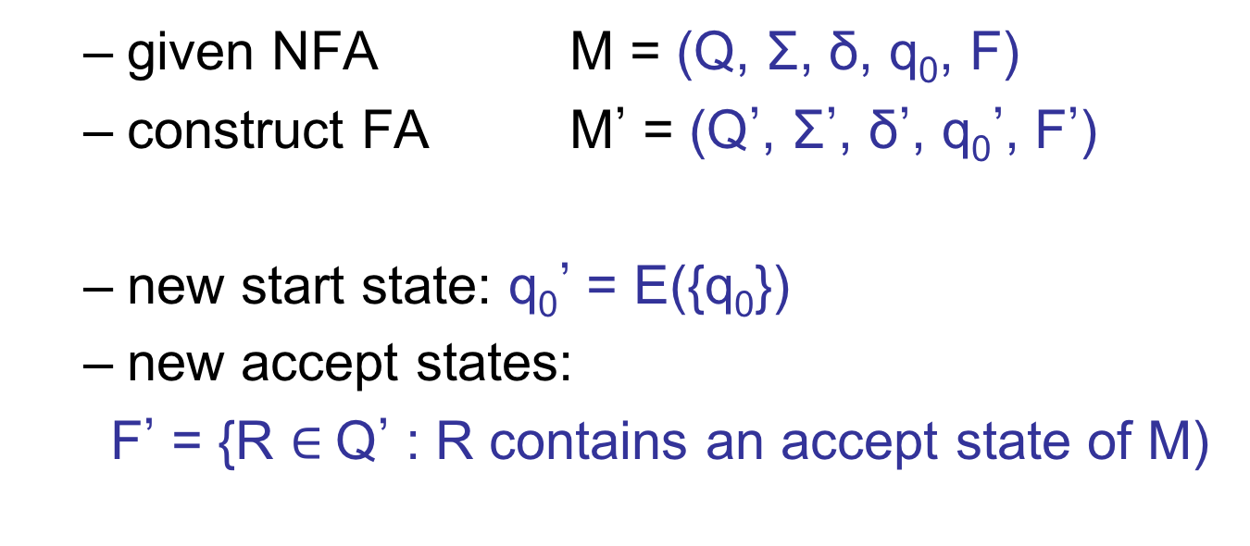
NFA, FA equivalence
1
0,ε
1
0,1
0,1
  given NFA M = (Q, Σ, δ, q₀, F)
  construct FA M’ = (Q’, Σ’, δ’, q₀’, F’)
  new start state: q₀’ = E({q₀})
  new accept states:
  F’ = {R $∈$Q’ : R contains an accept state of M)

Slide 8
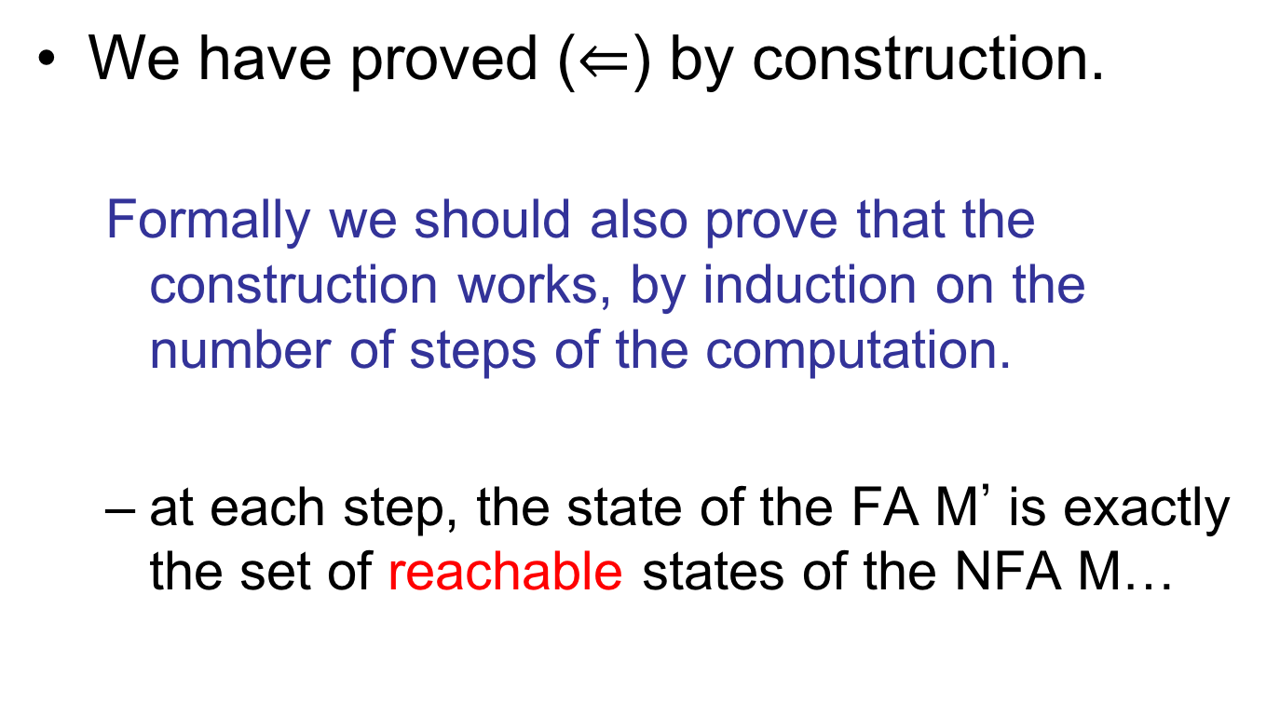
NFA, FA equivalence
We have proved ($⇐$) by construction.
  Formally we should also prove that the construction works, by induction on the number of steps of the computation.
  at each step, the state of the FA M’ is exactly the set of reachable states of the NFA M…

Slide 9
So far…
Theorem: the set of languages recognized by NFA is closed under union, concatenation, and star.
Theorem: a language L is recognized by a FA if and only if L is recognized by a NFA.
Theorem: the set of languages recognized by FA is closed under union, concatenation, and star.

Slide 10
Next…
Describe the set of languages that can be built up from:
  unions
  concatenations
  star operations
Called “patterns” or regular expressions
Theorem: a language L is recognized by a FA if and only if L is described by a regular expression.

Slide 11
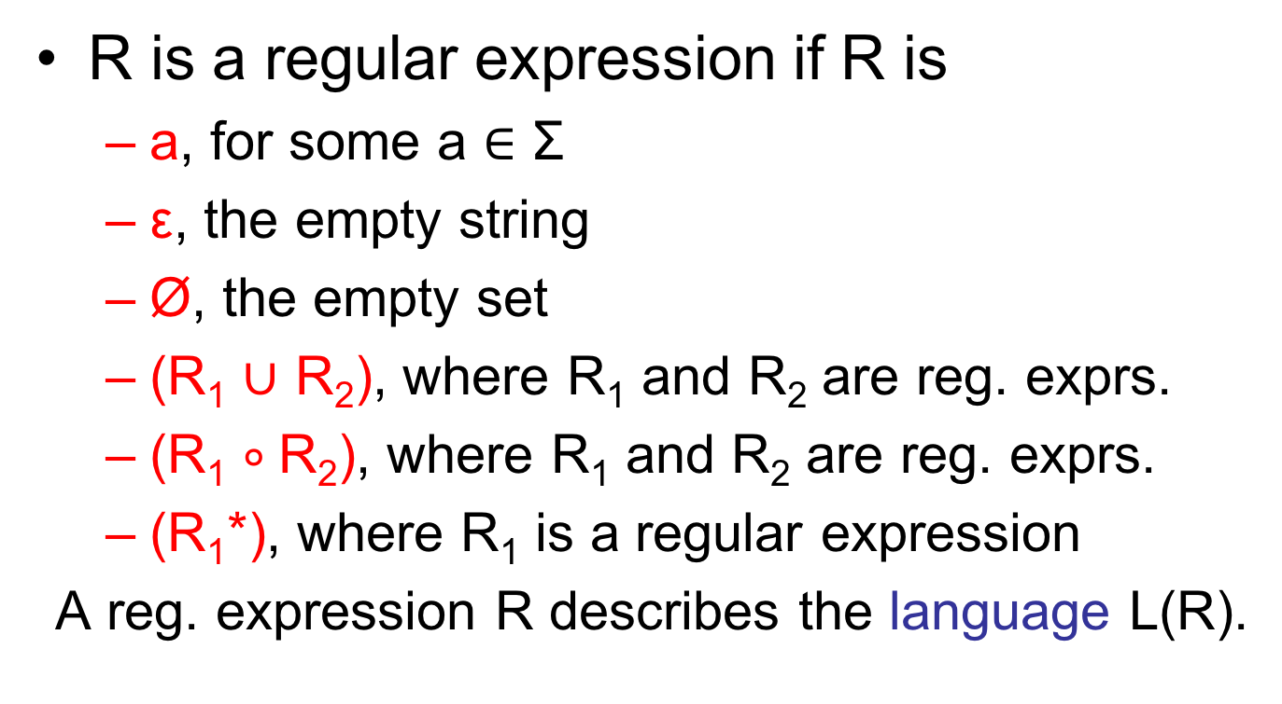
Regular expressions
R is a regular expression if R is
  a, for some a $∈$ Σ
  ε, the empty string
  Ø, the empty set
  (R₁ $∪$ R₂), where R₁ and R₂ are reg. exprs.
  (R₁ $∘$R₂), where R₁ and R₂ are reg. exprs.
  (R₁*), where R₁ is a regular expression
A reg. expression R describes the language L(R).

Slide 12
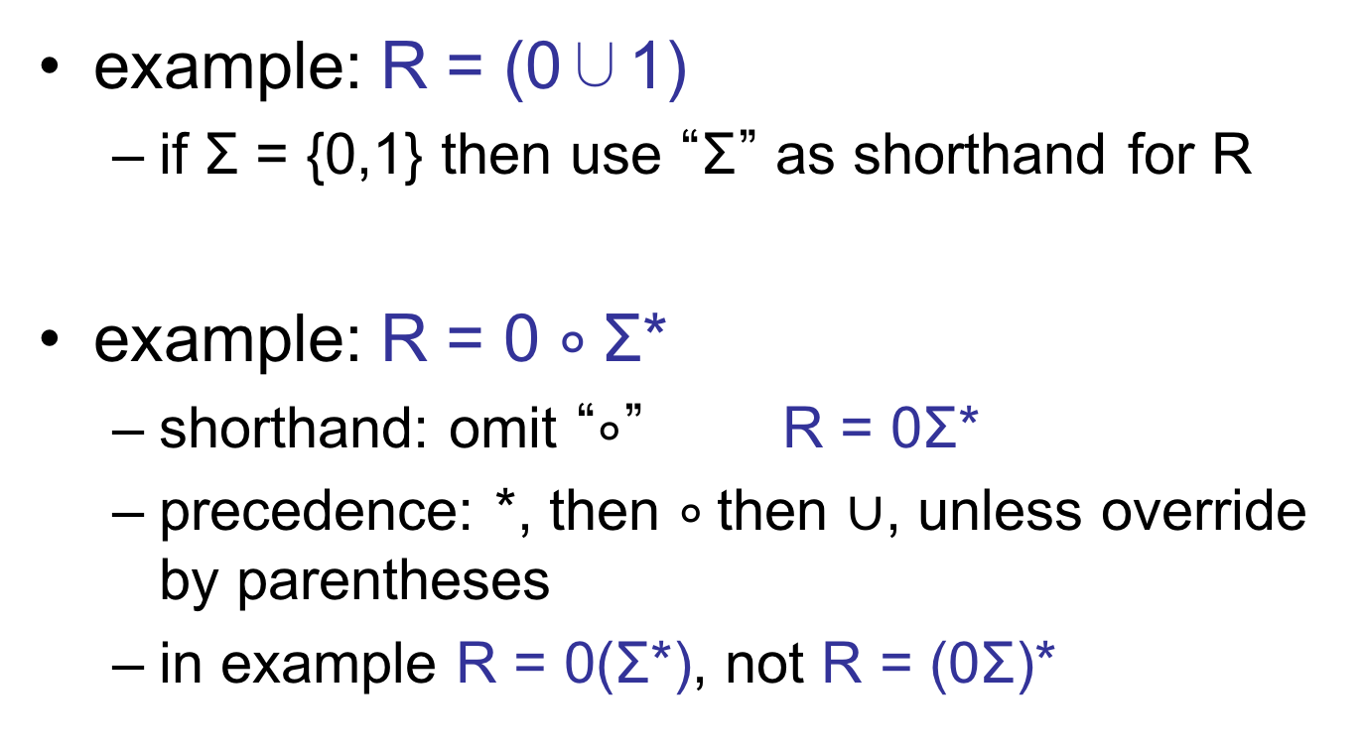
Regular expressions
example: R = (0∪1)
  if Σ = {0,1} then use “Σ” as shorthand for R
example: R = 0 $∘$Σ*
  shorthand: omit “$∘$” R = 0Σ*
  precedence: *, then $∘$then $∪$, unless override by parentheses
  in example R = 0(Σ*), not R = (0Σ)*

Slide 13
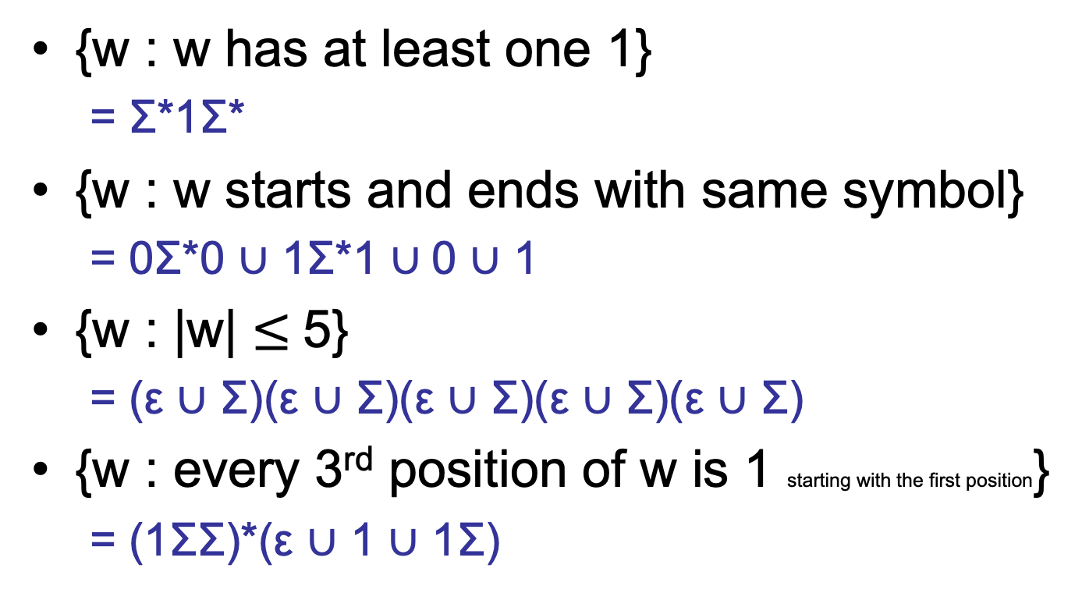
Some examples
alphabet Σ = {0,1}
{w : w has at least one 1}
  = Σ*1Σ*
{w : w starts and ends with same symbol}
  = 0Σ*0 $∪$ 1Σ*1 $∪$0 $∪$ 1
{w : |w| $≤$5}
  = (ε $∪$ Σ)(ε $∪$ Σ)(ε $∪$ Σ)(ε $∪$ Σ)(ε $∪$ Σ)
{w : every 3rd position of w is 1 starting with the first position}
  = (1ΣΣ)*(ε $∪$ 1 $∪$ 1Σ)

Slide 14
Manipulating regular expressions
The empty set and the empty string:
  R $∪$ Ø = R
  Rε = εR = R
  RØ = ØR = Ø
  $∪$ and $∘$behave like +, x; Ø, ε behave like 0,1
additional identities:
  R $∪$ R = R (here + and $∪$ differ)
  (R₁*R₂)*R₁* = (R₁$∪$ R₂)*
  R₁(R₂R₁)* = (R₁R₂)*R₁

Slide 15
Regular expressions and FA
Theorem: a language L is recognized by a FA if and only if L is described by a regular expression.
Must prove two directions:
  ($⇒$) L is recognized by a FA implies L is described by a regular expression
  ($⇐$) L is described by a regular expression implies L is recognized by a FA.

Slide 16
Regular expressions and FA
  ($⇐$) L is described by a regular expression implies L is recognized by a FA
Proof: given regular expression R we will build a NFA that recognizes L(R).
  then NFA, FA equivalence implies a FA for L(R).

Slide 17
Regular expressions and FA
R is a regular expression if R is
  a, for some a $∈$Σ
  ε, the empty string
  Ø, the empty set
a

Slide 18
Regular expressions and FA
  (R₁ $∪$R₂), where R₁ and R₂ are reg. exprs.
  (R₁ $∘$R₂), where R₁ and R₂ are reg. exprs.
  (R₁*), where R₁ is a regular expression
ε
ε
ε
ε
ε
ε
ε

Slide 19
Regular expressions and FA
Theorem: a language L is recognized by a FA if and only if L is described by a regular expression.
Must prove two directions:
  ($⇒$) L is recognized by a FA implies L is described by a regular expression
  ($⇐$) L is described by a regular expression implies L is recognized by a FA.

Slide 20
Regular expressions and FA
  ($⇒$) L is recognized by a FA implies L is described by a regular expression
Proof: given FA M that recognizes L, we will
  build an equivalent machine “Generalized Nondeterministic Finite Automaton” (GNFA)
  convert the GNFA into a regular expression

Slide 21
Regular expressions and FA
GNFA definition:
  it is a NFA, but may have regular expressions labeling its transitions
  GNFA accepts string w $∈$Σ* if can be written
  w = w₁w₂w₃… w_{k}
  where each w_{i} $∈$Σ*, and there is a path from the start state to an accept state in which the i^{th} transition traversed is labeled with R for which w_{i} $∈$L(R)

Slide 22
Regular expressions and FA
Recall step 1: build an equivalent GNFA
Our FA M is a GNFA.
We will require “normal form” for GNFA to make the proof easier:
  single accept state q_{accept} that has all possible incoming arrows
  every state has all possible outgoing arrows; exception: start state q₀ has no self-loop

Slide 23
Regular expressions and FA
converting our FA M into GNFA in normal form:
0,1
0 $∪$ 1
ε
ε
Ø
Ø
Ø
ε
Ø
Ø
M
Ø
Ø

Slide 24
Regular expressions and FA
On to step 2: convert the GNFA into a regular expression
  if normal-form GNFA has two states:
  the regular expression R labeling the single transition describes the language recognized by the GNFA
R

Slide 25
Regular expressions and FA
  if GNFA has more than 2 states:
  select one “q_{rip}”; delete it; repair transitions so that machine still recognizes same language.
  repeat until only 2 states.
q_{rip}

Slide 26
Regular expressions and FA
  how to repair the transitions:
  for every pair of states q_{i} and q_{j} do
R₄
q_{i}
q_{j}
(R₁ )(R₂ )*(R₃) $∪$ (R₄)
R₃
R₁
q_{i}
q_{j}
q_{rip}
R₂

Slide 27
Regular expressions and FA
  summary:
  FA M → k-state GNFA → (k-1)-state GNFA
  → (k-2)-state GNFA →…→ 2-state GNFA → R
  want to prove that this procedure is correct, i.e. L(R) = language recognized by M
    FA M equivalent to k-state GNFA
    i-state GNFA equivalent to (i-1)-state GNFA
    (we will prove…)
    2-state GFNA equivalent to R

Slide 28
Regular expressions and FA
  Claim: i-state GNFA G equivalent to (i-1)-state GNFA G’ (obtained by removing q_{rip})
  Proof:
    if G accepts string w, then it does so by entering states: q₀, q₁, q₂, q₃, … , q_{accept}
    if none are q_{rip} then G’ accepts w (see slide)
    else, break state sequence into runs of q_{rip}:
    q₀q₁…q_{i}q_{rip}q_{rip}…q_{rip}q_{j}…q_{accept}
    transition from q_{i} to q_{j} in G’ allows all strings taking G from q_{i} to q_{j} using q_{rip} (see slide)
    thus G’ accepts w

Slide 29
Regular expressions and FA
R₄
q_{i}
q_{j}
(R₁ )(R₂ )*(R₃) $∪$ (R₄)
R₃
R₁
q_{i}
q_{j}
q_{rip}
R₂

Slide 30
Regular expressions and FA
R₄
q_{i}
q_{j}
(R₁ )(R₂ )*(R₃) $∪$ (R₄)
R₃
R₁
q_{i}
q_{j}
q_{rip}
R₂

Slide 31
Regular expressions and FA
  Proof (continued):
    if G’ accepts string w, then every transition from q_{i} to q_{j} traversed in G’ corresponds to
    either
    a transition from q_{i} to q_{j} in G
    or
    transitions from q_{i} to q_{j} via q_{rip} in G
    In both cases G accepts w.
    Conclude: G and G’ recognize the same language.

Slide 32
Regular expressions and FA
Theorem: a language L is recognized by a FA iff L is described by a regular expr.
Languages recognized by a FA are called regular languages.
Rephrasing what we know so far:
  regular languages closed under 3 operations
  NFA recognize exactly the regular languages
  regular expressions describe exactly the regular languages

Slide 33
Limits on the power of FA
Is every language describable by a sufficiently complex regular expression?
If someone asks you to design a FA for a language that seems hard, how do you know when to give up?
Is this language regular?
{w : w has an equal # of “01” and “10” substrings}

Slide 34
Limits on the power of FA
Intuition:
  FA can only remember finite amount of information. They cannot count
  languages that “entail counting” should be non-regular…
Intuition not enough:
{w : w has an equal # of “01” and “10” substrings}
= 0Σ*0 $∪$ 1Σ*1
but {w: w has an equal # of “0” and “1” substrings} is not regular!

Slide 35
Limits on the power of FA
How do you prove that there is no Finite Automaton recognizing a given language?

Slide 36
Non-regular languages
Pumping Lemma: Let L be a regular language. There exists an integer p (“pumping length”) for which every w $∈$L with |w| $≥$p can be written as
w = xyz such that
  for every i $≥$0, xy^{i}z $∈$L , and
  |y| > 0, and
  |xy| $≤$p.

Slide 37
Non-regular languages
Using the Pumping Lemma to prove L is not regular:
  assume L is regular
  then there exists a pumping length p
  select a string w $∈$ L of length at least p
  argue that for every way of writing w = xyz that satisfies (2) and (3) of the Lemma, pumping on y yields a string not in L.
  contradiction.

Slide 38
Pumping Lemma Examples
Theorem: L = {0^{n}1^{n} : n $≥$0} is not regular.
Proof:
  let p be the pumping length for L
  choose w = 0^{p}1^{p}
  w = 000000000…0111111111…1
  w = xyz, with |y| > 0 and |xy| $≤$p.
p
p

Slide 39
Pumping Lemma Examples
  3 possibilities:
  w = 000000000…0111111111…1
  w = 000000000…0111111111…1
  w = 000000000…0111111111…1
  in each case, pumping on y gives a string not in language L.
x
y
z
x
y
z
x
y
z

Slide 40
Pumping Lemma Examples
Theorem: L = {w: w has an equal # of 0s and 1s} is not regular.
Proof:
  let p be the pumping length for L
  choose w = 0^{p}1^{p}
  w = 000000000…0111111111…1
  w = xyz, with |y| > 0 and |xy| $≤$p.
p
p

Slide 41
Pumping Lemma Examples
  3 possibilities:
  w = 000000000…0111111111…1
  w = 000000000…0111111111…1
  w = 000000000…0111111111…1
  first 2 cases, pumping on y gives a string not in language L; 3rd case a problem!
x
y
z
x
y
z
x
y
z

Slide 42
Pumping Lemma Examples
  recall condition 3: |xy| $≤$p
  since w = 0^{p}1^{p} we know more about how it can be divided, and this case cannot arise:
  w = 000000000…0111111111…1
  so we do get a contradiction.
  conclude that L is not regular.
x
y
z

Slide 43
Pumping Lemma Examples
Theorem: L = {0^{i}1^{j}: i > j} is not regular.
Proof:
  let p be the pumping length for L
  choose w = 0^{p+1}1^{p}
  w = 000000000…01111111…1
  w = xyz, with |y| > 0 and |xy| $≤$p.
p+1
p

Slide 44
Pumping Lemma Examples
  1 possibility:
  w = 000000000…0111111111…1
  pumping on y gives strings in the language (?)
  this seems like a problem…
  Lemma states that for every i $≥$0, xy^{i}z $∈$ L
  xy⁰z not in L. So L not regular.
x
y
z

