Slide 1
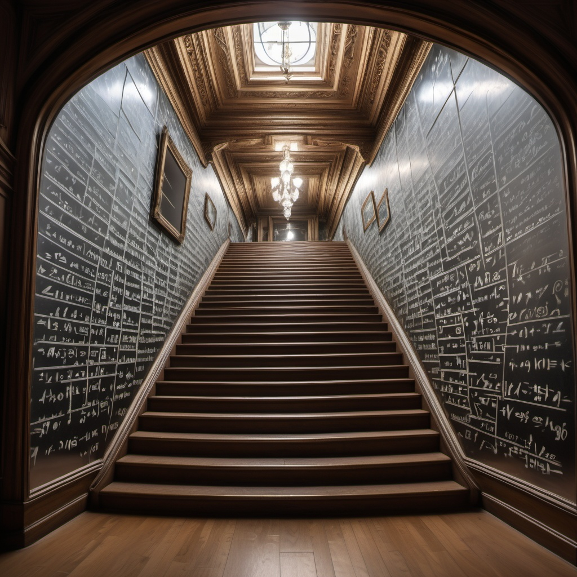
CS21
Decidability and Tractability
Lecture 19
February 21, 2025

Slide 2
Grades so far
An idea of eventual scale:
2025 so far: mean 87.4
2024 mean: 85.5; median 87.0
2023 mean 80.5; median 81.36
2022: mean 80.9; median 83.6
2021: mean 85.7; median 86.9
min | max | grade
97.0 | 100.0 | A+
93.0 | 97.0 | A
88.0 | 93.0 | A-
85.0 | 88.0 | B+
81.0 | 85.0 | B
78.0 | 81.0 | B-
74.5 | 78.0 | C+
70.0 | 74.5 | C
65.0 | 70.0 | C-
60.0 | 65.0 | D+
55.0 | 60.0 | D
0.0 | 55.0 | E/F
min | max | grade
97.0 | 100.0 | A+
92.0 | 97.0 | A
87.0 | 92.0 | A-
84.0 | 87.0 | B+
80.5 | 84.0 | B
76.0 | 80.5 | B-
72.5 | 76.0 | C+
68.0 | 72.5 | C
62.5 | 68.0 | C-
59.0 | 62.5 | D+
52.5 | 59.0 | D
0.0 | 52.5 | E/F
min | max | grade
97.0 | 100.0 | A+
92.0 | 97.0 | A
87.0 | 92.0 | A-
84.0 | 87.0 | B+
80.5 | 84.0 | B
76.0 | 80.5 | B-
72.5 | 76.0 | C+
68.0 | 72.5 | C
62.5 | 68.0 | C-
59.0 | 62.5 | D+
54.0 | 59.0 | D
0.0 | 54.0 | E/F
min | max | grade
97.5 | 100.0 | A+
93.0 | 97.5 | A
88.5 | 93.0 | A-
85.0 | 88.5 | B+
81.5 | 85.0 | B
77.0 | 81.5 | B-
73.0 | 77.0 | C+
69.0 | 73.0 | C
65.0 | 69.0 | C-
60.5 | 65.0 | D+
55.5 | 60.5 | D
0.0 | 55.5 | E/F
2024
2023
2022
2021

Slide 3
Hardness and completeness
Reasonable that can efficiently transform one problem into another.
Surprising:
  can often find a special language L so that every language in a given complexity class reduces to L!
  powerful tool

Slide 4
Hardness and completeness
Recall:
  a language L is a set of strings
  a complexity class C is a set of languages
Definition: a language L is C-hard if for every language A $∈$ C, A poly-time reduces to L; i.e., A ≤_{P} L.
meaning: L is at least as “hard” as anything in C

Slide 5
Hardness and completeness
Recall:
  a language L is a set of strings
  a complexity class C is a set of languages
Definition: a language L is C-complete if L is C-hard and L $∈$ C
meaning: L is a “hardest” problem in C

Slide 6
An EXP-complete problem
Version of A_{TM} with a time bound:
ATM_{B} = {<M, x, m> : M is a TM that accepts x within at most m steps}
Theorem: ATM_{B} is EXP-complete.
Proof:
  what do we need to show?

Slide 7
An EXP-complete problem
ATM_{B} = {<M, x, m> : M is a TM that accepts x within at most m steps}
Proof that ATM_{B} is EXP-complete:
  Part 1. Need to show ATM_{B} $∈$ EXP.
    simulate M on x for m steps; accept if simulation accepts; reject if simulation doesn’t accept.
    running time m^{O(1)}.
    n = length of input ≥ log₂m
    running time ≤ m^{k} = 2^{(log m)k} ≤ 2^{(kn)}

Slide 8
An EXP-complete problem
ATM_{B} = {<M, x, m> : M is a TM that accepts x within at most m steps}
Proof that ATM_{B} is EXP-complete:
  Part 2. For each language A $∈$ EXP, need to give poly-time reduction from A to ATM_{B}.
  for a given language A $∈$ EXP, we know there is a TM M_{A} that decides A in time g(n) ≤ 2^{nk} for some k.
  what should reduction f(w) produce?

Slide 9
An EXP-complete problem
ATM_{B} = {<M, x, m> : M is a TM that accepts x within at most m steps}
Proof that ATM_{B} is EXP-complete:
  f(w) = <M_{A}, w, m> where m = 2^{|w|k}
  is f(w) poly-time computable?
    hardcode M_{A} and k…
  YES maps to YES?
    w $∈$A $⇒$ <M_{A}, w, m> $∈$ATM_{B}
  NO maps to NO?
    w $∉$ A $⇒$ <M_{A}, w, m> $∉$ ATM_{B}

Slide 10
An EXP-complete problem
A C-complete problem is a surrogate for the entire class C.
For example: if you can find a poly-time algorithm for ATM_{B} then there is automatically a poly-time algorithm for every problem in EXP (i.e., EXP = P).
Can you find a poly-time alg for ATM_{B}?

Slide 11
An EXP-complete problem
Can you find a poly-time alg for ATM_{B}?
NO! we showed that P $⊆$EXP.
ATM_{B} is not tractable (intractable).
P
ATM_{B}
decidable languages
regular languages
context free languages
EXP

Slide 12
Back to 3SAT
Remember 3SAT $∈$ EXP
3SAT = {formulas in CNF with 3 literals per clause for which there exists a satisfying truth assignment}
It seems hard. Can we show it is intractable?
  formally, can we show 3SAT is EXP-complete?

Slide 13
Back to 3SAT
can we show 3SAT is EXP-complete?
Don’t know how to. Believed unlikely.
One reason: there is an important positive feature of 3SAT that doesn’t seem to hold for problems in EXP (e.g. ATM_{B}):
3SAT is decidable in polynomial time by a nondeterministic TM

Slide 14
Nondeterministic TMs
Recall: nondeterministic TM
informally, TM with several possible next configurations at each step
formally, A NTM is a 7-tuple
(Q, Σ, $Γ,$ δ, q₀, q_{accept}, q_{reject}) where:
  everything is the same as a TM except the transition function:
  δ:Q x $Γ$→ P(Q x $Γ$ x {L, R})

Slide 15
Nondeterministic TMs
visualize computation of a NTM M as a tree
C_{start}
nodes are configurations
leaves are accept/reject configurations
M accepts if and only if there exists an accept leaf
M is a decider, so no paths go on forever
running time is max. path length
rej
acc

Slide 16
The class NP
Definition: TIME(t(n)) = {L : there exists a TM M that decides L in time O(t(n))}
P = $∪$_{k ≥ 1} TIME(n^{k})
Definition: NTIME(t(n)) = {L : there exists a NTM M that decides L in time O(t(n))}
NP = $∪$_{k ≥ 1} NTIME(n^{k})

Slide 17
NP in relation to P and EXP
regular languages
decidable languages
context free languages
EXP
NP
P
P$⊆$ NP (poly-time TM is a poly-time NTM)
NP$⊆$ EXP
  configuration tree of n^{k}-time NTM has ≤ b^{nk} nodes
  can traverse entire tree in O(b^{nk}) time
we do not know if either inclusion is proper

Slide 18
Poly-time verifiers
NP = {L : L decided by poly-time NTM}
Very useful alternate definition of NP:
Theorem: language L is in NP if and only if it is expressible as:
L = { x | $∃$ y, |y| ≤ |x|^{k}, (x, y) $∈$ R }
where R is a language in P.
poly-time TM M_{R} deciding R is a “verifier”
“witness” or “certificate”
efficiently verifiable

Slide 19
Poly-time verifiers
Example: 3SAT expressible as
3SAT = {φ : φ is a 3-CNF formula for which $∃$assignment A for which (φ, A) $∈$ R}
R = {(φ, A) : A is a sat. assign. for φ}
  satisfying assignment A is a “witness” of the satisfiability of φ (it “certifies” satisfiability of φ)
  R is decidable in poly-time

Slide 20
Poly-time verifiers
L = { x | $∃$ y, |y| ≤ |x|^{k}, (x, y) $∈$ R }
Proof: ($⇐$) give poly-time NTM deciding L
phase 1: “guess” y with |x|^{k} nondeterministic steps
phase 2: decide if
(x, y) $∈$R

Slide 21
Poly-time verifiers
Proof: ($⇒$) given L $∈$ NP, describe L as:
L = { x | $∃$ y, |y| ≤ |x|^{k}, (x, y) $∈$ R }
  L is decided by NTM M running in time n^{k}
  define the language
  R = { (x, y) : y is an accepting computation history of M on input x}
  check: accepting history has length ≤ |x|^{k}
  check: M accepts x iff $∃$y, |y| ≤ |x|^{k}, (x, y) $∈$R

Slide 22
Cook-Levin Theorem
Gateway to proving lots of natural, important problems NP-complete is:
Theorem (Cook, Levin): 3SAT is NP-complete.
Recall: 3SAT = {φ : φ is a CNF formula with 3 literals per clause for which there exists a satisfying truth assignment}

Slide 23
Cook-Levin Theorem
Proof outline
  show CIRCUIT-SAT is NP-complete
  CIRCUIT-SAT = {C : C is a Boolean circuit for which there exists a satisfying truth assignment}
  show 3SAT is NP-complete (reduce from CIRCUIT SAT)

Slide 24
Boolean Circuits
$$∧$$
Boolean circuit C
  directed acyclic graph
  nodes: AND ($∧$); OR ($∨$); NOT ($¬$); variables x_{i}
$$∨$$
$$∧$$
$$∧$$
$$∨$$
$$¬$$
x₁
x₂
x₃
…
x_{n}
C computes function f:{0,1}^{n} $→$ {0,1} in natural way
  identify C with function f it computes
size = # nodes

Slide 25
Boolean Circuits
every function f:{0,1}^{n} $→$ {0,1} computable by a circuit of size at most O(n2^{n})
  AND of n literals for each x such that f(x) = 1
  OR of up to 2^{n} such terms

Slide 26
CIRCUIT-SAT is NP-complete
Theorem: CIRCUIT-SAT is NP-complete
CIRCUIT-SAT = {C : C is a Boolean circuit for which there exists a satisfying truth assignment}
Proof:
  Part 1: need to show CIRCUIT-SAT $∈$ NP.
    can express CIRCUIT-SAT as:
CIRCUIT-SAT = {C : C is a Boolean circuit for which $∃$x such that (C, x) $∈$ R}
R = {(C, x) : C is a Boolean circuit and C(x) = 1}

Slide 27
CIRCUIT-SAT is NP-complete
CIRCUIT-SAT = {C : C is a Boolean circuit for which there exists a satisfying truth assignment}
Proof:
  Part 2: for each language A $∈$ NP, need to give poly-time reduction from A to CIRCUIT-SAT
  for a given language A $∈$ NP, we know
A = {x | $∃$ y, |y| ≤ |x|^{k}, (x, y) $∈$ R }
  and there is a (deterministic) TM M_{R} that decides R in time g(n) ≤ n^{c} for some c.

Slide 28
CIRCUIT-SAT is NP-complete
Tableau (configurations written in an array) for machine M_{R} on input w = (x, y):
w₁/q_{s}
w₂
…
w_{n}
…
_
height = time taken = |w|^{c}
width = space used ≤ |w|^{c}
w₁
w₂/q₁
…
w_{n}
…
_
w₁/q₁
a
…
w_{n}
…
_
...
...
_/q_{a}
_
…
_
…
_

Slide 29
CIRCUIT-SAT is NP-complete
Important observation: contents of cell in tableau determined by 3 others above it:
a/q₁
b
a
a
b/q₁
a
b/q₁
a
a
b
a
b

Slide 30
CIRCUIT-SAT is NP-complete
Can build Boolean circuit STEP
  input (binary encoding of) 3 cells
  output (binary encoding of) 1 cell
a
b/q₁
a
each output bit is some function of inputs
can build circuit for each
size is independent of size of tableau
STEP
a

Slide 31
CIRCUIT-SAT is NP-complete
Tableau for M_{R} on input w = (x, y)
w₁/q_{s}
w₂
…
w_{n}
…
_
w₁
w₂/q₁
…
w_{n}
…
_
...
...
|w|^{c} copies of STEP compute row i from i-1
…
STEP
STEP
STEP
STEP
STEP
…

Slide 32
CIRCUIT-SAT is NP-complete
w₁
w₂
w_{n}
w_{1/}q_{s}
w₂
…
w_{n}
…
_
This circuit C_{MR, w} has inputs w₁w₂…w_{n}
and C(w) = 1 iff M_{R} accepts input w.
Size = O(|w|^{2c})
STEP
STEP
STEP
STEP
STEP
STEP
STEP
STEP
STEP
STEP
...
...
STEP
STEP
STEP
STEP
STEP
ignore these
1 iff cell contains q_{accept}

Slide 33
CIRCUIT-SAT is NP-complete
  recall: we are reducing language A:
A = { x | $∃$ y, |y| ≤ |x|^{k}, (x, y) $∈$ R }
  to CIRCUIT-SAT.
  f(x) produces the following circuit:
x₁
x₂
…
x_{n}
y₁
y₂
…
y_{m}
hardwire input x
leave y as variables
1 iff (x,y) $∈$R
Circuit C_{MR, w}

Slide 34
CIRCUIT-SAT is NP-complete
  is f(x) poly-time computable?
    hardcode M_{R}, k and c
    circuit has size O(|w|^{2c}); |w| = |(x,y)| ≤ n + n^{k}
    each component easy to describe efficiently from description of M_{R}
  YES maps to YES?
    x $∈$ A $⇒$ $∃$ y, M_{R} accepts (x, y) $⇒$ f(x) $∈$CIRCUIT-SAT
  NO maps to NO?
    x $∉$ A $⇒$ $∀$ y, M_{R} rejects (x, y) $⇒$ f(x) $∉$ CIRCUIT-SAT

Slide 35
3SAT is NP-complete
Theorem: 3SAT is NP-complete
3SAT = {φ : φ is a 3-CNF formula for which there exists a satisfying truth assignment}
Proof:
  Part 1: need to show 3-SAT $∈$ NP
    already done
  Part 2: need to show 3-SAT is NP-hard
    we will give a poly-time reduction from CIRCUIT-SAT to 3-SAT

Slide 36
3SAT is NP-complete
  given a circuit C
    variables x₁, x₂, …, x_{n}
    AND ($∧$), OR ($∨$), NOT ($¬$) gates g₁, g₂, …, g_{m}
  reduction f(C) produces these clauses for φ on variables x₁, x₂, …, x_{n}, g₁, g₂, …, g_{m}:
$$¬$$
g_{i}
(g_{i} $∨$ z)
($¬$z $∨$ $¬$g_{i})
(z $⇔$ $¬$g_{i})
z

Slide 37
3SAT is NP-complete
  given a circuit C
    variables x₁, x₂, …, x_{n}
    AND ($∧$), OR ($∨$), NOT ($¬$) gates g₁, g₂, …, g_{m}
  reduction f(C) produces these clauses for φ on variables x₁, x₂, …, x_{n}, g₁, g₂, …, g_{m}:
$$∨$$
($¬$z₁ $∨$ g_{i})
($¬$z₂ $∨$ g_{i})
($¬$g_{i} $∨$ z₁ $∨$z₂)
g_{i}
(z₁$∨$z₂ $⇔$g_{i})
z₁
z₂

Slide 38
3SAT is NP-complete
  given a circuit C
    variables x₁, x₂, …, x_{n}
    AND ($∧$), OR ($∨$), NOT ($¬$) gates g₁, g₂, …, g_{m}
  reduction f(C) produces these clauses for φ on variables x₁, x₂, …, x_{n}, g₁, g₂, …, g_{m}:
$$∧$$
($¬$g_{i} $∨$ z₁)
($¬$g_{i} $∨$ z₂)
($¬$z₁ $∨$ $¬$z₂ $∨$g_{i})
g_{i}
(z₁ $∧$z₂ $⇔$ g_{i})
z₁
z₂

Slide 39
3SAT is NP-complete
  finally, reduction f(C) produces single clause (g_{m}) where g_{m} is the output gate.
  f(C) computable in poly-time?
    yes, simple transformation
  YES maps to YES?
    if C(x) = 1, then assigning x-values to x-variables of φ and gate values of C when evaluating x to the g-variables of φ gives satsifying assignment.

Slide 40
3SAT is NP-complete
  NO maps to NO?
    show that φ satisfiable implies C satisfiable
    satisfying assignment to φ assigns values to x-variables and g-variables
    output gate g_{m} must be assigned 1
    every other gate must be assigned value it would take given values of its inputs.
    the assignment to the x-variables must be a satisfying assignment for C.

