Slide 1
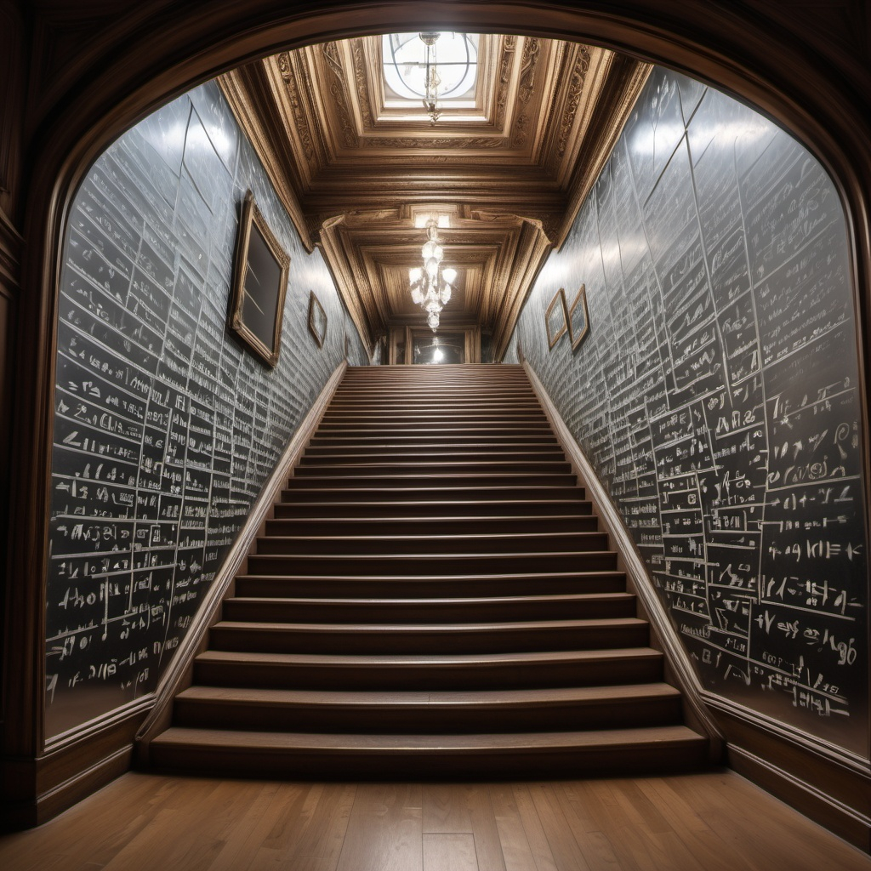
CS21
Decidability and Tractability
Lecture 18
February 19, 2025

Slide 2
A puzzle
Find an efficient algorithm to solve the following problem:
Input: sequence of pairs of symbols
e.g. (A, b), (E, D), (d, C), (B, a)
Goal: determine if it is possible to circle at least one symbol in each pair without circling upper and lower case of same symbol.

Slide 3
A puzzle
Find an efficient algorithm to solve the following problem.
Input: sequence of pairs of symbols
e.g. (A, b), (E, D), (d, C), (b, a)
Goal: determine if it is possible to circle at least one symbol in each pair without circling upper and lower case of same symbol.

Slide 4
2SAT
This is a disguised version of the language
2SAT = {formulas in Conjunctive Normal Form with 2 literals per clause for which there exists a satisfying truth assignment}
  CNF = “AND of ORs”
(A, b), (E, D), (d, C), (b, a)
(x₁ $∨¬$x₂)$∧$(x₅ $∨$x₄)$∧$($¬$x₄ $∨$x₃)$∧$($¬$x₂ $∨¬$x₁)
  satisfying truth assignment = assignment of TRUE/FALSE to each variable so that whole formula is TRUE

Slide 5
2SAT
Theorem: There is a polynomial-time algorithm deciding 2SAT (“2SAT $∈$P”).
Proof: algorithm described on next slides.

Slide 6
Algorithm for 2SAT
Build a graph with separate nodes for each literal.
  add directed edge (x, y) iff formula includes clause ($¬$x$∨$ y) (equiv. to x $⇒$ y)
x₄
$¬$x₄
x₂
$¬$x₁
$¬$x₃
$¬$x₅
x₃
x₁
$¬$x₂
x₅
e.g. (x₁ $∨¬$x₂)$∧$(x₅ $∨$x₄)$∧$($¬$x₄ $∨$x₃)$∧$($¬$x₂ $∨¬$x₁)

Slide 7
Algorithm for 2SAT
Claim: formula is unsatisfiable iff there is some variable x with a path from x to $¬$x and a path from $¬$x to x in derived graph.
Proof ($⇐$)
  edges represent implication $⇒$. By transitivity of $⇒$, a path from x to $¬$x means x $⇒$ $¬$x, and a path from $¬$x to x means $¬$x $⇒$ x.

Slide 8
Algorithm for 2SAT
Proof ($⇒$)
  to construct a satisfying assign. (if no x with a path from x to $¬$x and a path from $¬$x to x):
    pick unassigned literal s with no path from s to $¬$s
    assign it TRUE, as well as all nodes reachable from it; assign negations of these literals FALSE
    note: path from s to t and s to $¬$t implies path from $¬$t to $¬$s and t to $¬$s, implies path from s to $¬$s
    note: path s to t (assigned FALSE) implies path from $¬$t (assigned TRUE) to $¬$s, so s already assigned at that point.

Slide 9
Algorithm for 2SAT
Algorithm:
  build derived graph
  for every pair x, $¬$x check if there is a path from x to $¬$x and from $¬$x to x in the graph
Running time of algorithm (input length n):
  O(n) to build graph
  O(n) to perform each check
  O(n) checks
  running time O(n²). 2SAT $∈$ P.

Slide 10
Another puzzle
Find an efficient algorithm to solve the following problem.
Input: sequence of triples of symbols
e.g. (A, b, C), (E, D, b), (d, A, C), (c, b, a)
Goal: determine if it is possible to circle at least one symbol in each triple without circling upper and lower case of same symbol.

Slide 11
3SAT
This is a disguised version of the language
3SAT = {formulas in Conjunctive Normal Form with 3 literals per clause for which there exists a satisfying truth assignment}
e.g. (A, b, C), (E, D, b), (d, A, C), (c, b, a)
(x₁$∨¬$x₂$∨$x₃) $∧$( x₅$∨$x₄$∨¬$x₂)$∧$($¬$x₄$∨$x₁$∨$x₃)$∧$($¬$x₃$∨¬$x₂ $∨¬$x₁)
observe that this language is in TIME(2^{n})

Slide 12
Time Complexity
Key definition: “P” or “polynomial-time” is
P = $∪$_{k ≥ 1} TIME(n^{k})
Definition: “EXP” or “exponential-time” is
EXP = $∪$_{k ≥ 1} TIME(2^{nk})
P
EXP
decidable languages

Slide 13
EXP
P = $∪$_{k ≥ 1} TIME(n^{k})
EXP = $∪$_{k ≥ 1} TIME(2^{nk})
Note: P $⊆$ EXP.
We have seen 3SAT $∈$ EXP.
  does not rule out possibility that it is in P
Is P different from EXP?

Slide 14
Time Hierarchy Theorem
Theorem: for every proper complexity function f(n) $≥$ n:
TIME(f(n)) $⊆$ TIME(f(2n)³).
Note: P $⊆$TIME(2^{n}) $⊆$TIME(2^{(2n)3}) $⊆$EXP
Most natural functions (and 2^{n} in particular) are proper complexity functions. We will ignore this detail in this class.

Slide 15
Time Hierarchy Theorem
Theorem: for every proper complexity function f(n) $≥$ n:
TIME(f(n)) $⊆$ TIME(f(2n)³).
Proof idea:
  use diagonalization to construct a language that is not in TIME(f(n)).
  constructed language comes with a TM that decides it and runs in time f(2n)³.

Slide 16
Recall proof for Halting Problem
box (M, x): does M halt on x?
inputs
Y
Turing Machines
n
Y
n
The existence of H which tells us yes/no for each box allows us to construct a TM H’ that cannot be in the table.
n
Y
n
H’ :
n
Y
n
Y
Y
n
Y

Slide 17
Proof of Time Hierarchy Theorem
box (M, x): does M accept x in time f(n)?
inputs
Y
Turing Machines
n
TM SIM tells us yes/no for each box in time g(n)
rows include all of TIME(f(n))
construct TM D running in time g(2n) that is not in table
Y
n
n
Y
n
D :
n
Y
n
Y
Y
n
Y

Slide 18
Proof of Time Hierarchy Theorem
Proof:
  SIM is TM deciding language
{ <M, x> : M accepts x in ≤ f(|x|) steps }
  Claim: SIM runs in time g(n) = f(n)³.
  define new TM D: on input <M>
    if SIM accepts <M, <M>>, reject
    if SIM rejects <M, <M>>, accept
  D runs in time g(2n)

Slide 19
Proof of Time Hierarchy Theorem
Proof (continued):
  suppose M in TIME(f(n)) decides L(D)
    M(<M>) = SIM(<M, <M>>) ≠ D(<M>)
    but M(<M>) = D(<M>)
  contradiction.

Slide 20
Proof of Time Hierarchy Theorem
Claim: there is a TM SIM that decides
{<M, x> : M accepts x in ≤ f(|x|) steps}
and runs in time g(n) = f(n)³.
Proof sketch: SIM has 4 work tapes
    contents and “virtual head” positions for M’s tapes
    M’s transition function and state
    f(|x|) “+”s used as a clock
    scratch space

Slide 21
Proof of Time Hierarchy Theorem
Proof sketch (continued): 4 work tapes
    contents and “virtual head” positions for M’s tapes
    M’s transition function and state
    f(|x|) “+”s used as a clock
    scratch space
  initialize tapes
  simulate step of M, advance head on tape 3; repeat.
  can check running time is as claimed.

Slide 22
So far…
We have defined the complexity classes P (polynomial time), EXP (exponential time)
some language
P
decidable languages
regular languages
context free languages
EXP

Slide 23
Poly-time reductions
Type of reduction we will use:
  “many-one” poly-time reduction (commonly)
  “mapping” poly-time reduction (book)
A
B
f
yes
yes
reduction from language A to language B
f
no
no

Slide 24
Poly-time reductions
A
B
f
yes
yes
f
no
no
function f should be poly-time computable
Definition: f : Σ*→ Σ* is poly-time computable if for some g(n) = n^{O(1)} there exists a g(n)-time TM M_{f} such that on every w$∈$Σ*, M_{f} halts with f(w) on its tape.

Slide 25
Poly-time reductions
Definition: A ≤_{P} B (“A reduces to B”) if there is a poly-time computable function f such that for all w
  w $∈$ A $⇔$ f(w) $∈$B
as before, condition equivalent to:
  YES maps to YES and NO maps to NO
as before, meaning is:
  B is at least as “hard” (or expressive) as A

Slide 26
Poly-time reductions
Theorem: if A ≤_{P} B and B $∈$P then A $∈$P.
Proof:
  a poly-time algorithm for deciding A:
  on input w, compute f(w) in poly-time.
  run poly-time algorithm to decide if f(w) $∈$ B
  if it says “yes”, output “yes”
  if it says “no”, output “no”

Slide 27
Example
2SAT = {CNF formulas with 2 literals per clause for which there exists a satisfying truth assignment}
L = {directed graph G, and list of pairs of vertices (u₁, v₁), (u₂, v₂),…, (u_{k}, v_{k}), such that there is no i for which [u_{i} is reachable from v_{i} in G and v_{i} is reachable from u_{i} in G]}
We gave a poly-time reduction from 2SAT to L.
determined that 2SAT $∈$ P from fact that L $∈$ P

