Slide 1

CS21
Decidability and Tractability
Lecture 16
February 12, 2025

Slide 2
Outline
Gödel Incompleteness Theorem (finishing)
Complexity

Slide 3
Gödel Incompleteness Theorem

Slide 4
Incompleteness Theorem
Theorem: Peano Arithmetic is not complete.
(same holds for any reasonable proof system for number theory)
Proof outline:
  the set of theorems of PA is RE
  the set of true sentences (= Th(N)) is not RE

Slide 5
Incompleteness Theorem
Lemma: the set of theorems of PA is RE.
Proof:
  TM that recognizes the set of theorems of PA:
  systematically try all possible ways of writing down sequences of formulas
  accept if encounter a proof of input sentence
  (note: true for any reasonable proof system)

Slide 6
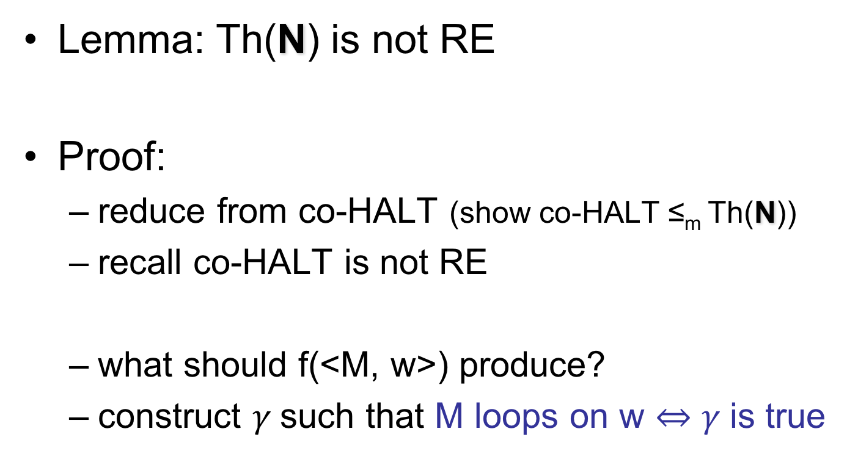
Incompleteness Theorem
Lemma: Th(N) is not RE
Proof:
  reduce from co-HALT (show co-HALT ≤_{m} Th(N))
  recall co-HALT is not RE
  what should f(<M, w>) produce?
  construct $γ$such that M loops on w $⇔γ$is true

Slide 7
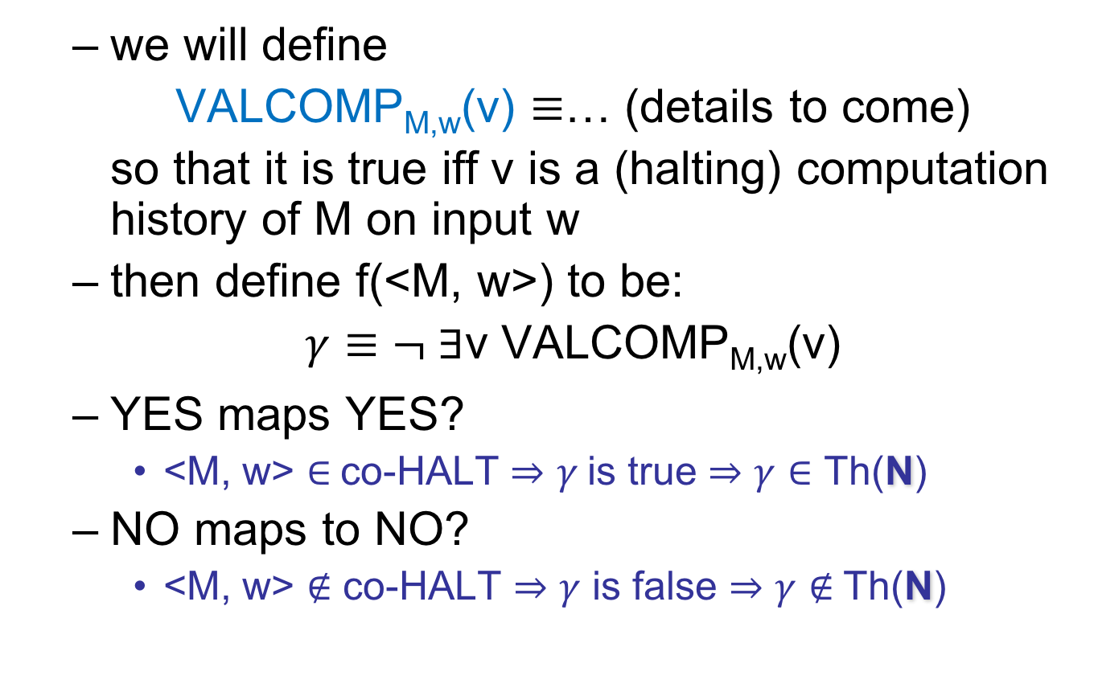
Incompleteness Theorem
  we will define
  VALCOMP_{M,w}(v) $≡$… (details to come)
  so that it is true iff v is a (halting) computation history of M on input w
  then define f(<M, w>) to be:
  $γ≡¬ ∃$v VALCOMP_{M,w}(v)
  YES maps YES?
    <M, w> $∈$co-HALT $⇒γ$is true $⇒γ∈$ Th(N)
  NO maps to NO?
    <M, w> $∉$ co-HALT $⇒γ$ is false $⇒γ∉$Th(N)

Slide 8
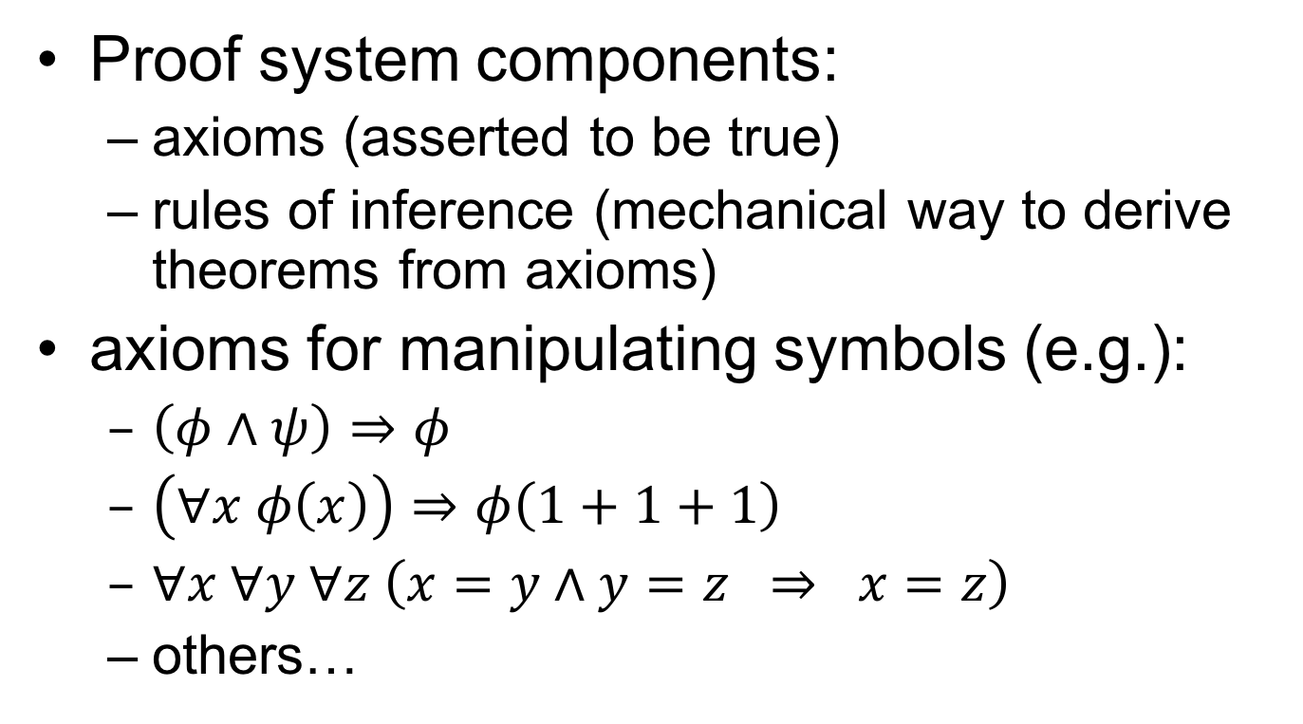
Expressing computation in the language of number theory
Recall: basic building blocks
  x < y $≡∃$z x + z = y $∧¬$(z = 0)
  INTDIV(x, y, q, r) $≡$x = qy + r $∧$ r < y
  DIV(y, x) $≡ ∃$q INTDIV(x,y,q,0)
  PRIME(x) $≡$
  x ≥ (1+1) $∧∀$y (DIV(y, x) $⇒$ (y = 1 $∨$ y = x))

Slide 9
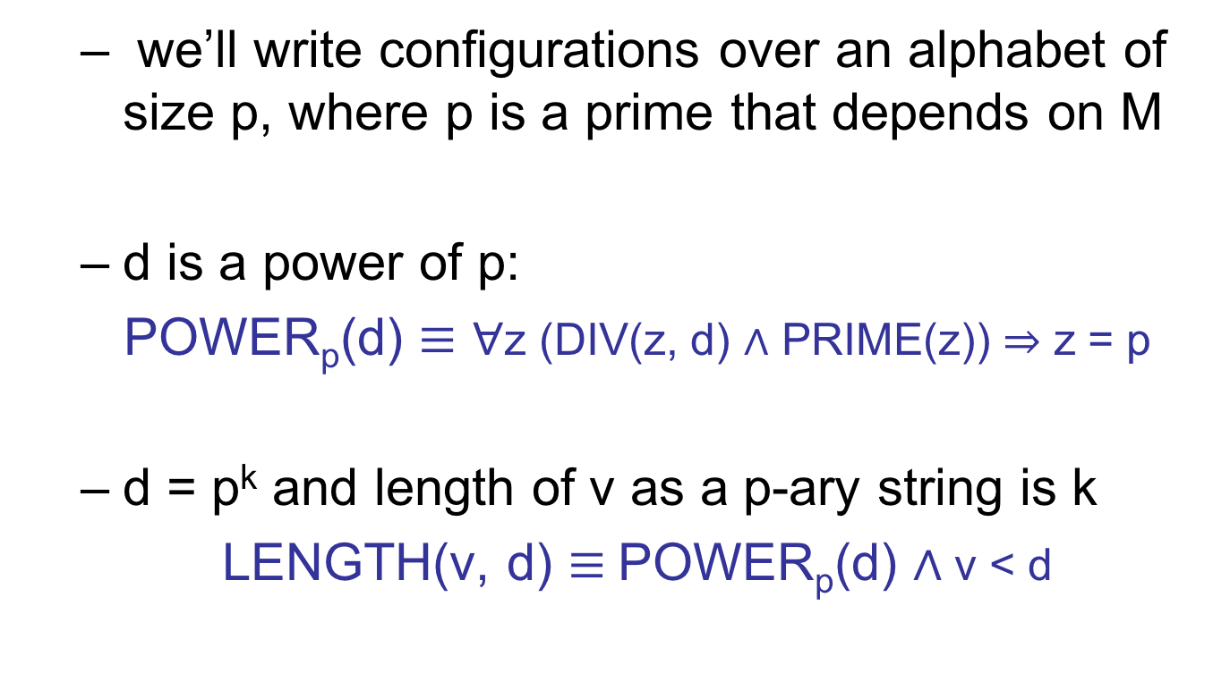
Expressing computation in the language of number theory
  we’ll write configurations over an alphabet of size p, where p is a prime that depends on M
  d is a power of p:
  POWER_{p}(d) $≡∀$z (DIV(z, d) $∧$ PRIME(z)) $⇒$ z = p
  d = p^{k} and length of v as a p-ary string is k
  LENGTH(v, d) $≡$POWER_{p}(d) $∧$v < d
Notes:
Explain what we’re shooting for: digits of v are symbols in string

Slide 10
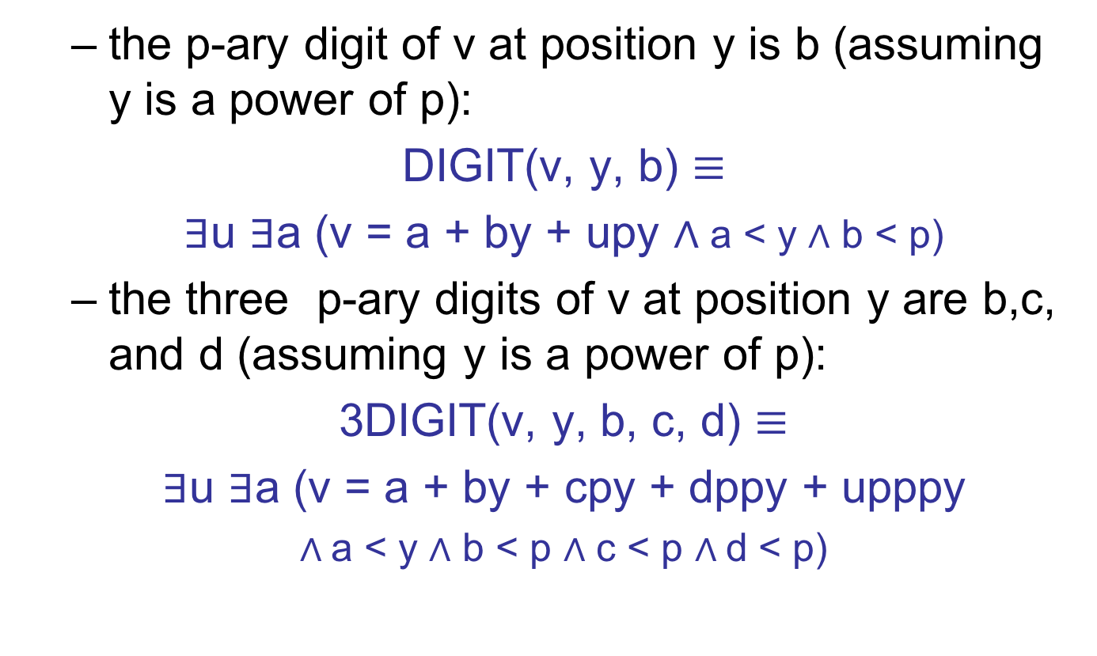
Expressing computation in the language of number theory
  the p-ary digit of v at position y is b (assuming y is a power of p):
  DIGIT(v, y, b) $≡$
  $∃$u $∃$a (v = a + by + upy $∧$a < y $∧$ b < p)
  the three p-ary digits of v at position y are b,c, and d (assuming y is a power of p):
  3DIGIT(v, y, b, c, d) $≡$
  $∃$u $∃$a (v = a + by + cpy + dppy + upppy
  $∧$a < y $∧$ b < p $∧$ c < p $∧$d < p)
Notes:
Clarify what “position y” means

Slide 11
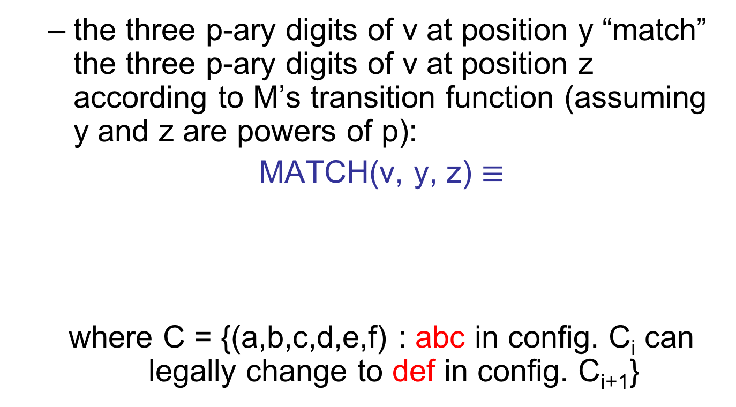
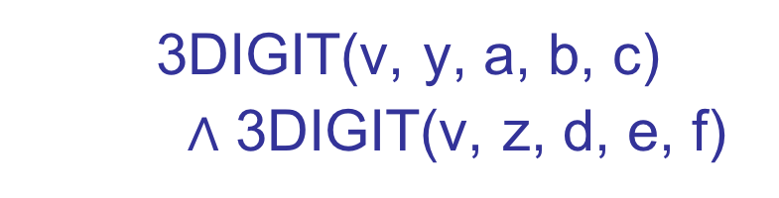

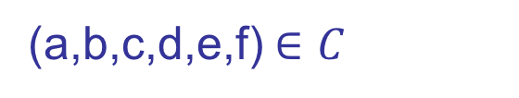
Expressing computation in the language of number theory
  the three p-ary digits of v at position y “match” the three p-ary digits of v at position z according to M’s transition function (assuming y and z are powers of p):
  MATCH(v, y, z) $≡$
  where C = {(a,b,c,d,e,f) : abc in config. C_{i} can legally change to def in config. C_{i+1}}
$$⋁$$
  3DIGIT(v, y, a, b, c)
  $∧$ 3DIGIT(v, z, d, e, f)
(a,b,c,d,e,f) $∈C$
Notes:
Ask students to justify the non-binary OR

Slide 12
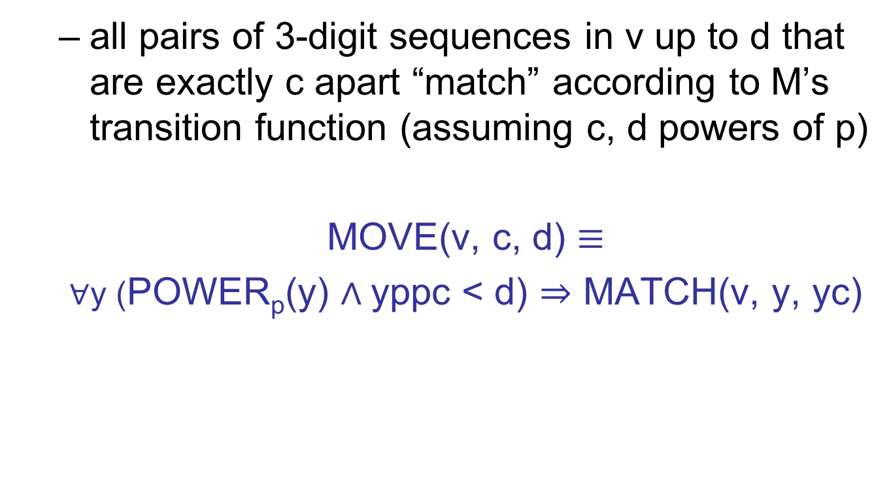
Expressing computation in the language of number theory
  all pairs of 3-digit sequences in v up to d that are exactly c apart “match” according to M’s transition function (assuming c, d powers of p)
  MOVE(v, c, d) $≡$
  $∀$y (POWER_{p}(y) $∧$yppc < d) $⇒$ MATCH(v, y, yc)

Slide 13
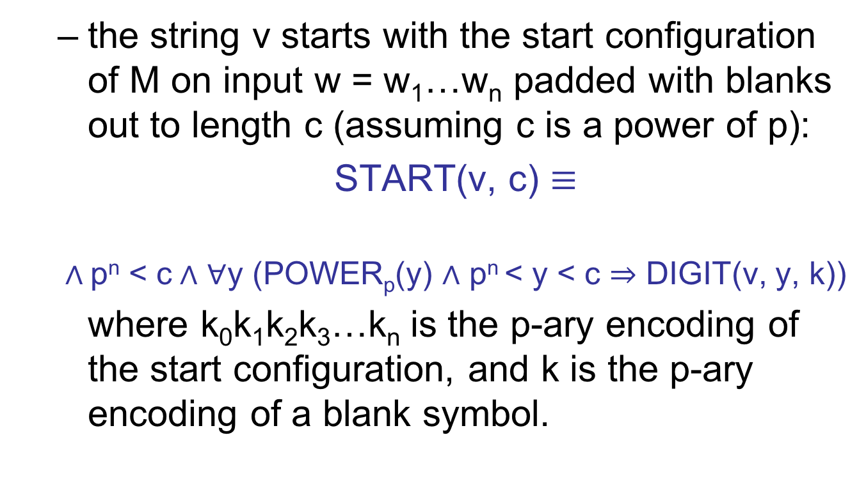

Expressing computation in the language of number theory
  the string v starts with the start configuration of M on input w = w₁…w_{n} padded with blanks out to length c (assuming c is a power of p):
  START(v, c) $≡$
  $∧$p^{n} < c$∧$ $∀$y (POWER_{p}(y) $∧$ p^{n} < y < c $⇒$ DIGIT(v, y, k))
  where k₀k₁k₂k₃…k_{n} is the p-ary encoding of the start configuration, and k is the p-ary encoding of a blank symbol.
$$∧$$
  DIGIT(v, p^{i}, k_{i})
i = 0,1,2,3, …, n

Slide 14
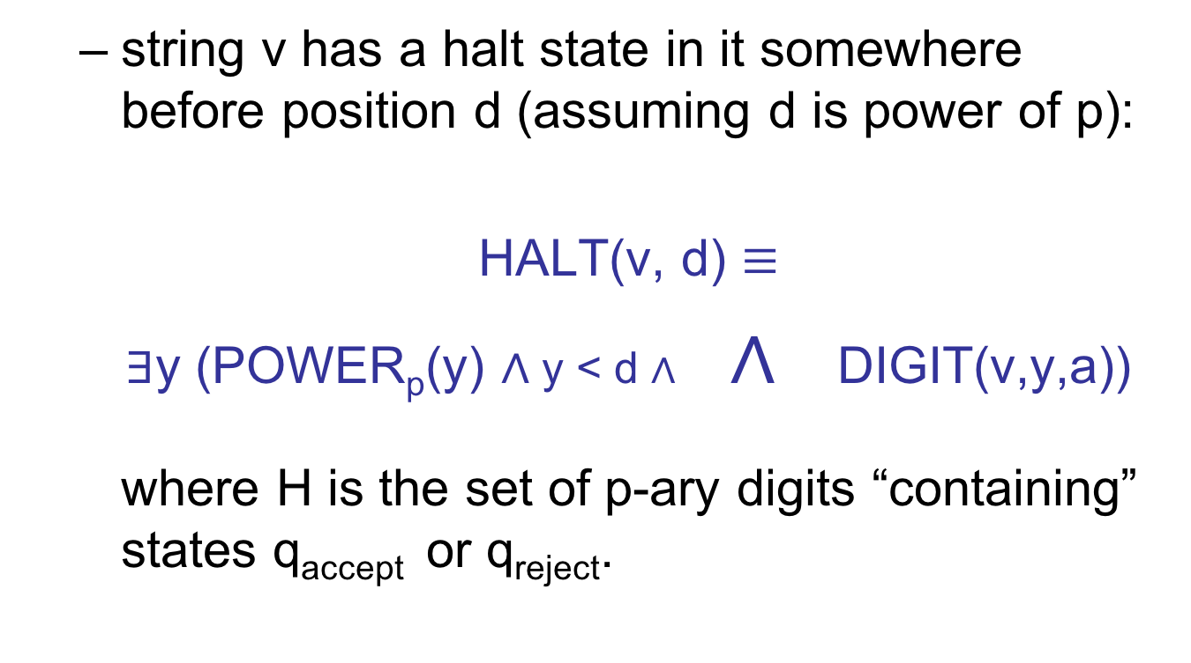

Expressing computation in the language of number theory
  string v has a halt state in it somewhere before position d (assuming d is power of p):
  HALT(v, d) $≡$
  $∃$y (POWER_{p}(y) $∧$y < d $∧$ $∧$ DIGIT(v,y,a))
  where H is the set of p-ary digits “containing” states q_{accept} or q_{reject}.
  a $∈H$

Slide 15
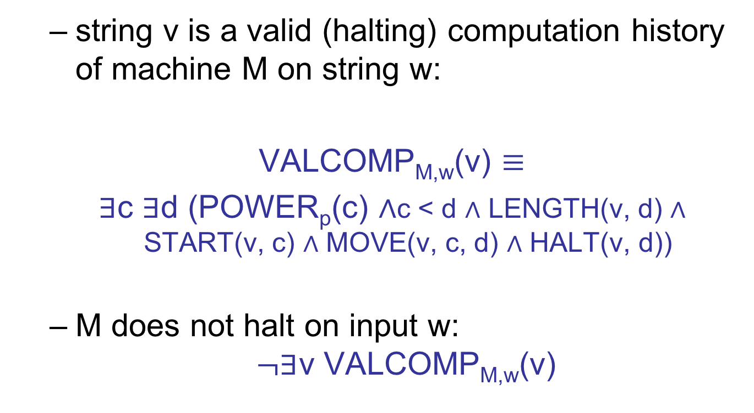
Expressing computation in the language of number theory
  string v is a valid (halting) computation history of machine M on string w:
  VALCOMP_{M,w}(v) $≡$
  $∃$c $∃$d (POWER_{p}(c) $∧$c < d $∧$ LENGTH(v, d) $∧$START(v, c) $∧$ MOVE(v, c, d) $∧$ HALT(v, d))
  M does not halt on input w: $¬∃$v VALCOMP_{M,w}(v)

Slide 16
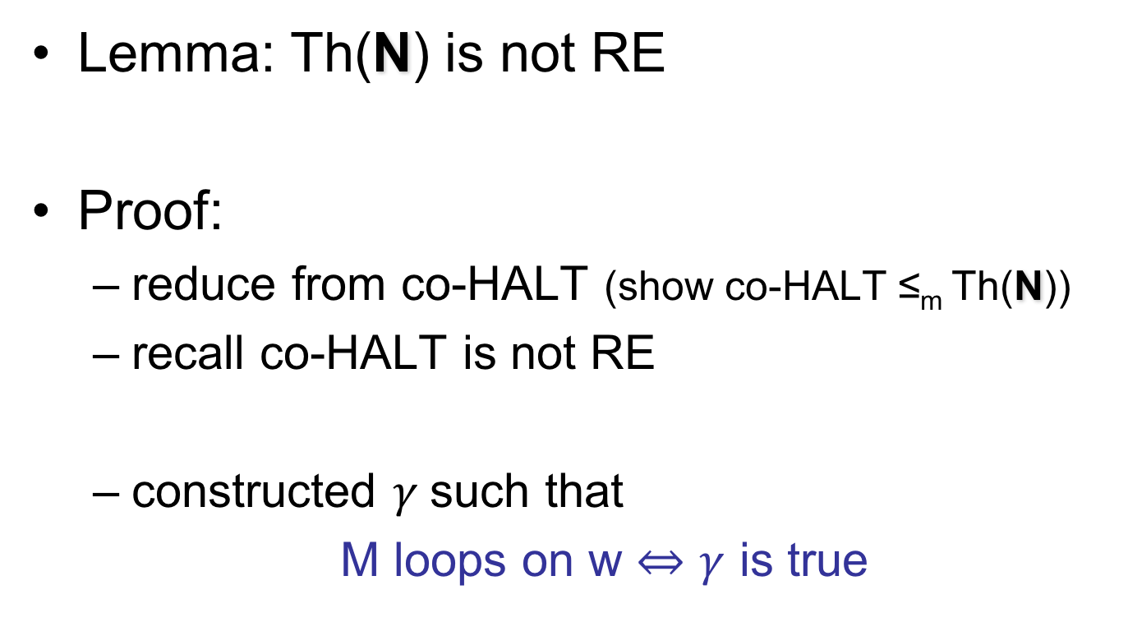
Incompleteness Theorem
Lemma: Th(N) is not RE
Proof:
  reduce from co-HALT (show co-HALT ≤_{m} Th(N))
  recall co-HALT is not RE
  constructed $γ$such that
  M loops on w $⇔γ$ is true

Slide 17
Summary
full-fledged model of computation: TM
many equivalent models
Church-Turing Thesis
encoding of inputs
Universal TM

Slide 18
Summary
classes of problems:
  decidable (“solvable by algorithms”)
  recursively enumerable (RE)
  co-RE
counting:
  not all problems are decidable
  not all problems are RE

Slide 19
Summary
diagonalization: HALT is undecidable
reductions: other problems undecidable
  many examples
  Rice’s Theorem
natural problems that are not RE
Recursion Theorem: non-obvious capability of TMs: printing out own description
Incompleteness Theorem

Slide 20
Complexity
So far we have classified problems by whether they have an algorithm at all.
In real world, we have limited resources with which to run an algorithm:
  one resource: time
  another: storage space
need to further classify decidable problems according to resources they require

Slide 21
Complexity
Complexity Theory = study of what is computationally feasible (or tractable) with limited resources:
  running time
  storage space
  number of random bits
  degree of parallelism
  rounds of interaction
  others…
main focus
not in this course

Slide 22
Worst-case analysis
Always measure resource (e.g. running time) in the following way:
  as a function of the input length
  value of the fn. is the maximum quantity of resource used over all inputs of given length
  called “worst-case analysis”
“input length” is the length of input string, which might encode another object with a separate notion of size

Slide 23
Time complexity
Definition: the running time (“time complexity”) of a TM M is a function
f:N → N
where f(n) is the maximum number of steps M uses on any input of length n.
“M runs in time f(n),” “M is a f(n) time TM”

Slide 24
Time complexity
Example: TM M deciding L = {0^{k}1^{k} : k ≥ 0}.
On input x:
scan tape left-to-right, reject if 0 to right of 1
repeat while 0’s, 1’s on tape:
  scan, crossing off one 0, one 1
if only 0’s or only 1’s remain, reject; if neither 0’s nor 1’s remain, accept
# steps?
# steps?
# steps?

Slide 25
Time complexity
We do not care about fine distinctions
  e.g. how many additional steps M takes to check that it is at the left of tape
We care about the behavior on large inputs
  general-purpose algorithm should be “scalable”
  overhead for e.g. initialization shouldn’t matter in big picture

