Slide 1

CS151
Complexity Theory
Lecture 5
April 18, 2023

Slide 2
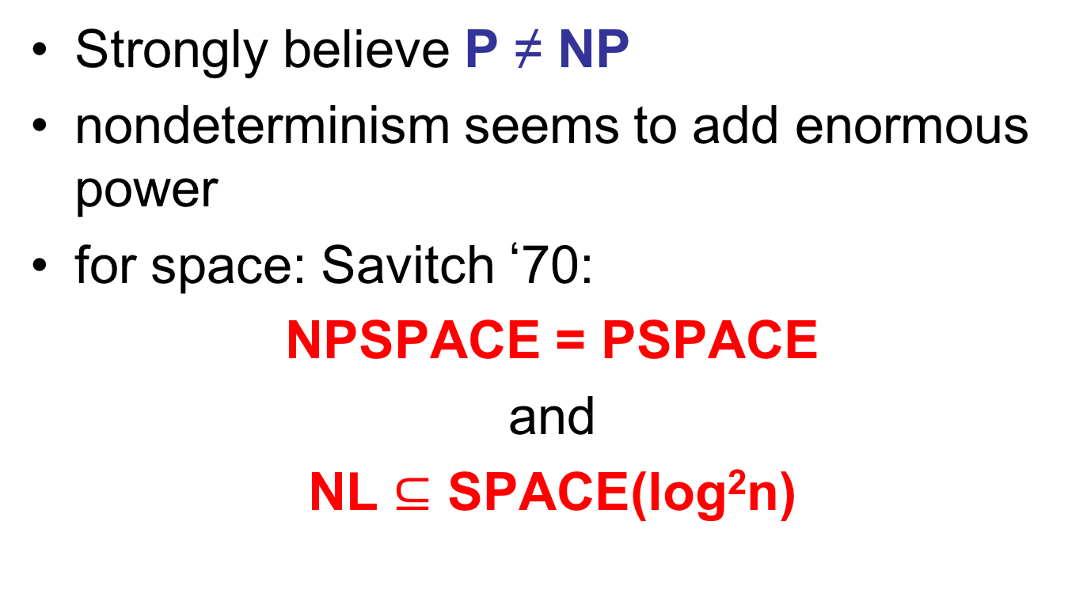
Two startling theorems
Strongly believe P ≠ NP
nondeterminism seems to add enormous power
for space: Savitch ‘70:
NPSPACE = PSPACE
and
NL $⊆$ SPACE(log²n)

Slide 3
Two startling theorems
Strongly believe NP ≠ coNP
seems impossible to convert existential into universal
for space: Immerman/Szelepscényi ’87/’88:
NL = coNL

Slide 4
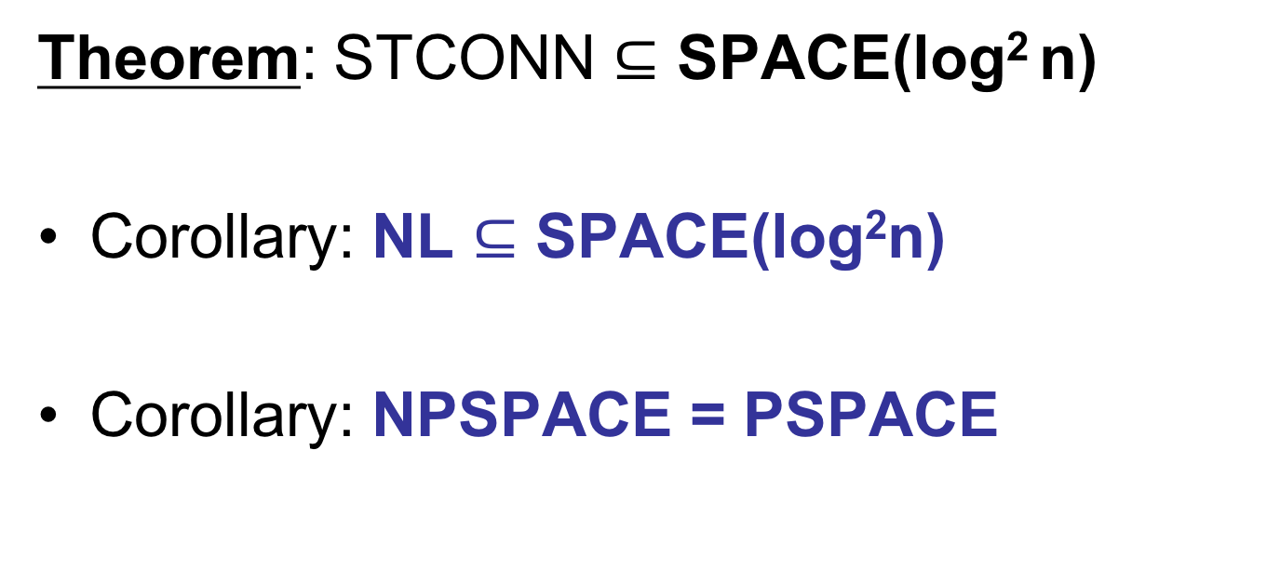
Savitch’s Theorem
Theorem: STCONN $⊆$ SPACE(log² n)
Corollary: NL $⊆$ SPACE(log²n)
Corollary: NPSPACE = PSPACE

Slide 5
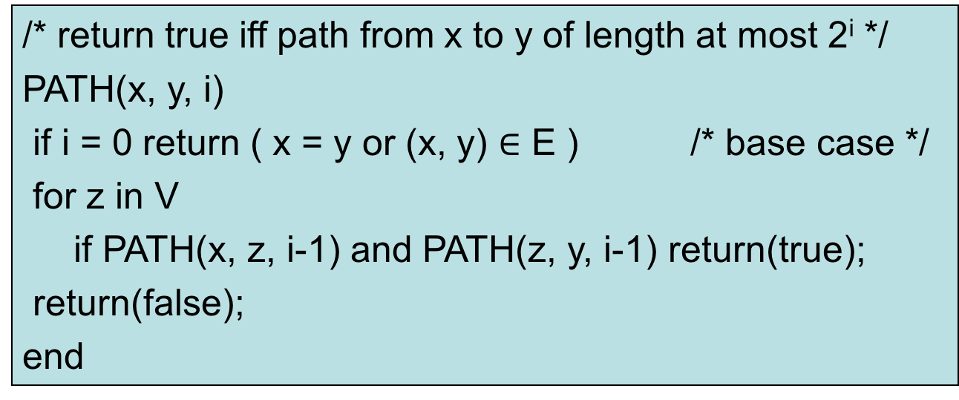
Proof of Theorem
  input: G = (V, E), two nodes s and t
  recursive algorithm:
/* return true iff path from x to y of length at most 2^{i} */
PATH(x, y, i)
if i = 0 return ( x = y or (x, y) $∈$ E ) /* base case */
for z in V
if PATH(x, z, i-1) and PATH(z, y, i-1) return(true);
return(false);
end

Slide 6
Proof of Theorem
  answer to STCONN: PATH(s, t, log n)
  space used:
    (depth of recursion) x (size of “stack record”)
  depth = log n
  claim stack record: “(x, y, i)” sufficient
    size O(log n)
  when return from PATH(a, b, i) can figure out what to do next from record (a, b, i) and previous record

Slide 7
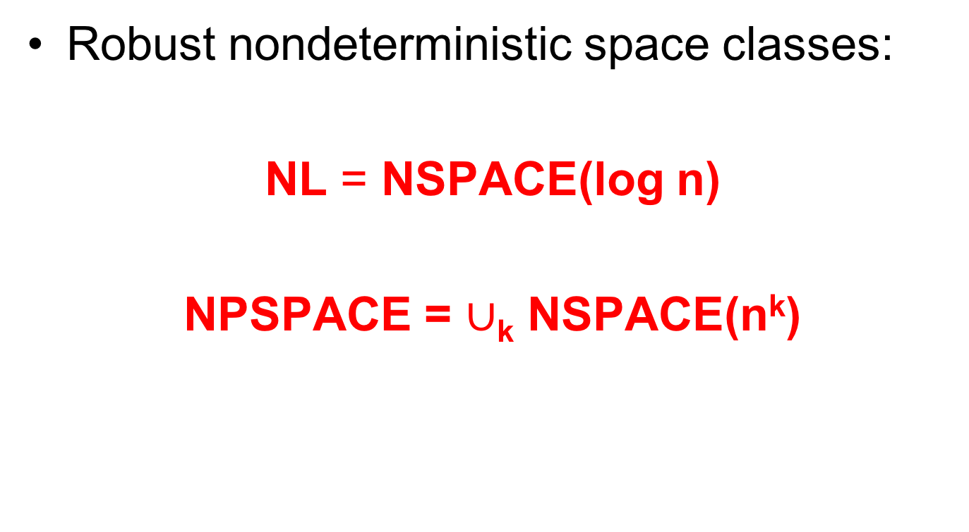
Nondeterministic space
Robust nondeterministic space classes:
NL = NSPACE(log n)
NPSPACE = $∪$_{k} NSPACE(n^{k})

Slide 8
Second startling theorem
Strongly believe NP ≠ coNP
seems impossible to convert existential into universal
for space: Immerman/Szelepscényi ’87/’88:
NL = coNL

Slide 9

I-S Theorem
Theorem: ST-NON-CONN $∈$ NL
Proof: slightly tricky setup:
  input: G = (V, E), two nodes s, t
s
s
“yes”
“no”
t
t

Slide 10
I-S Theorem
  want nondeterministic procedure using only O(log n) space with behavior:
s
s
“yes” input
“no” input
t
t
q_{accept}
q_{reject}
q_{accept}
q_{reject}

Slide 11
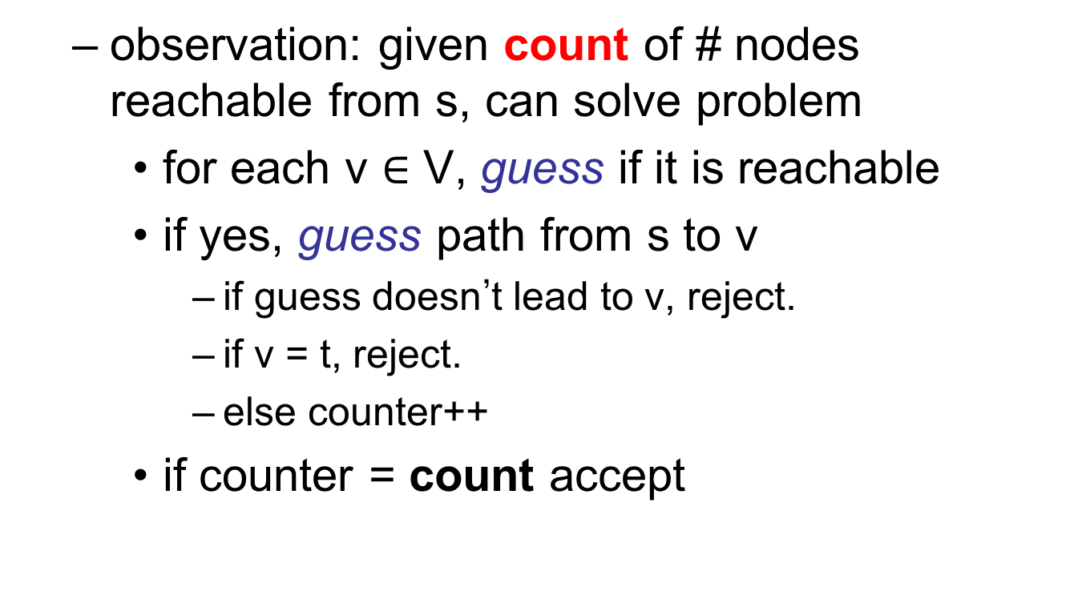
I-S Theorem
  observation: given count of # nodes reachable from s, can solve problem
    for each v $∈$ V, guess if it is reachable
    if yes, guess path from s to v
      if guess doesn’t lead to v, reject.
      if v = t, reject.
      else counter++
    if counter = count accept

Slide 12
I-S Theorem
  every computation path has sequence of guesses…
  only way computation path can lead to accept:
    correctly guessed reachable/unreachable for each node v
    correctly guessed path from s to v for each reachable node v
    saw all reachable nodes
    t not among reachable nodes

Slide 13
I-S Theorem
  R(i) = # nodes reachable from s in at most i steps
  R(0) = 1: node s
  we will compute R(i+1) from R(i) using O(log n) space and nondeterminism
  computation paths with “bad guesses” all lead to reject

Slide 14
I-S Theorem
  Outline: in n phases, compute
  R(1), R(2), R(3), … R(n)
  only O(log n) bits of storage between phases
  in end, lots of computation paths that lead to reject
  only computation paths that survive have computed correct value of R(n)
  apply observation.

Slide 15

I-S Theorem
  computing R(i+1) from R(i):
  Initialize R(i+1) = 0
  For each v $∈$V, guess if v reachable from s in at most i+1 steps
R(i) = R(2) = 6

Slide 16
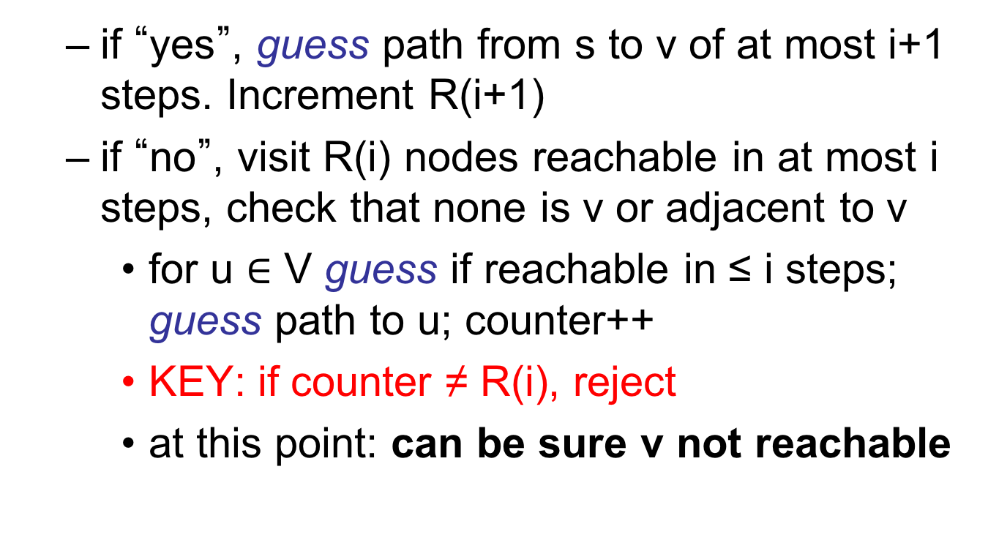
I-S Theorem
  if “yes”, guess path from s to v of at most i+1 steps. Increment R(i+1)
  if “no”, visit R(i) nodes reachable in at most i steps, check that none is v or adjacent to v
    for u $∈$ V guess if reachable in ≤ i steps; guess path to u; counter++
    KEY: if counter ≠ R(i), reject
    at this point: can be sure v not reachable

Slide 17
I-S Theorem
correctness of procedure:
two types of errors we can make
(1) might guess v is reachable in at most i+1 steps when it is not
  won’t be able to guess path from s to v of correct length, so we will reject.
“easy” type of error

Slide 18
I-S Theorem
(2) might guess v is not reachable in at most i+1 steps when it is
  then must not see v or neighbor of v while visiting nodes reachable in i steps.
  but forced to visit R(i) distinct nodes
  therefore must try to visit node v that is not reachable in ≤ i steps
  won’t be able to guess path from s to v of correct length, so we will reject.
“easy” type of error

Slide 19
Summary
nondeterministic space classes
NL and NPSPACE
ST-CONN NL-complete

Slide 20
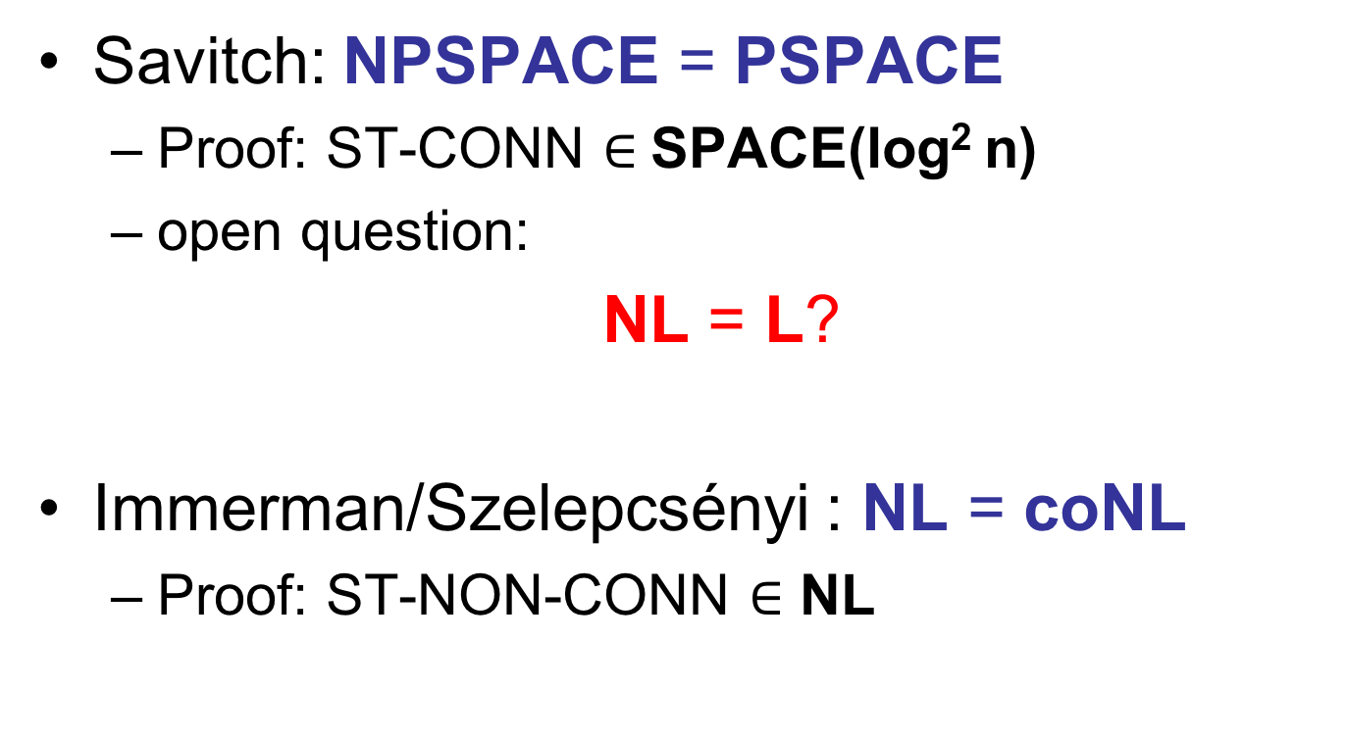
Summary
Savitch: NPSPACE = PSPACE
  Proof: ST-CONN $∈$SPACE(log² n)
  open question:
  NL = L?
Immerman/Szelepcsényi : NL = coNL
  Proof: ST-NON-CONN $∈$ NL

Slide 22
Introduction
Power from an unexpected source?
we know P ≠ EXP, which implies no poly-time algorithm for Succinct CVAL
poly-size Boolean circuits for Succinct CVAL ??
Does NP have linear-size, log-depth Boolean circuits ??

Slide 23
Outline
Boolean circuits and formulas
uniformity and advice
the NC hierarchy and parallel computation
the quest for circuit lower bounds
a lower bound for formulas

Slide 24

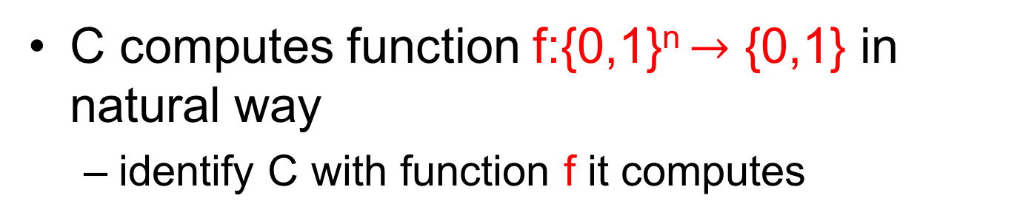




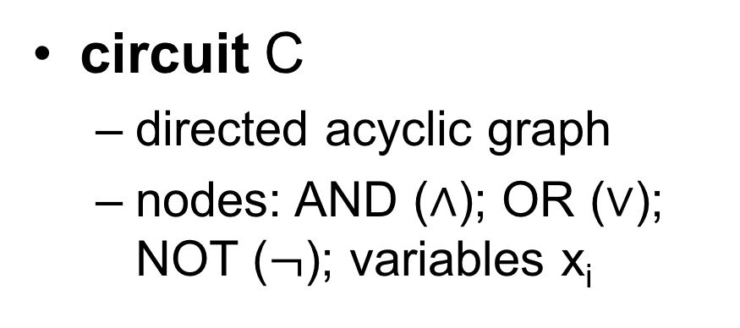

Boolean circuits
$$∧$$
circuit C
  directed acyclic graph
  nodes: AND ($∧$); OR ($∨$); NOT ($¬$); variables x_{i}
$$∨$$
$$∧$$
$$∧$$
$$∨$$
$$¬$$
x₁
x₂
x₃
…
x_{n}
C computes function f:{0,1}^{n} $→$ {0,1} in natural way
  identify C with function f it computes

Slide 25
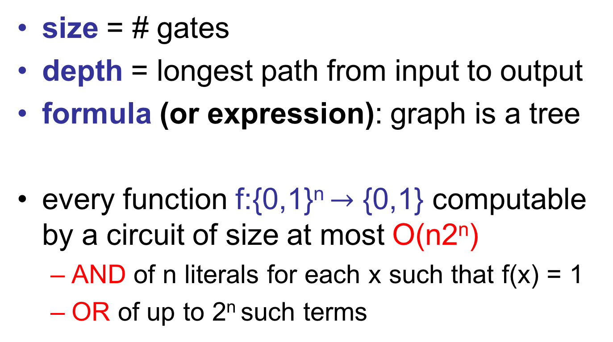
Boolean circuits
size = # gates
depth = longest path from input to output
formula (or expression): graph is a tree
every function f:{0,1}^{n} $→$ {0,1} computable by a circuit of size at most O(n2^{n})
  AND of n literals for each x such that f(x) = 1
  OR of up to 2^{n} such terms

Slide 26
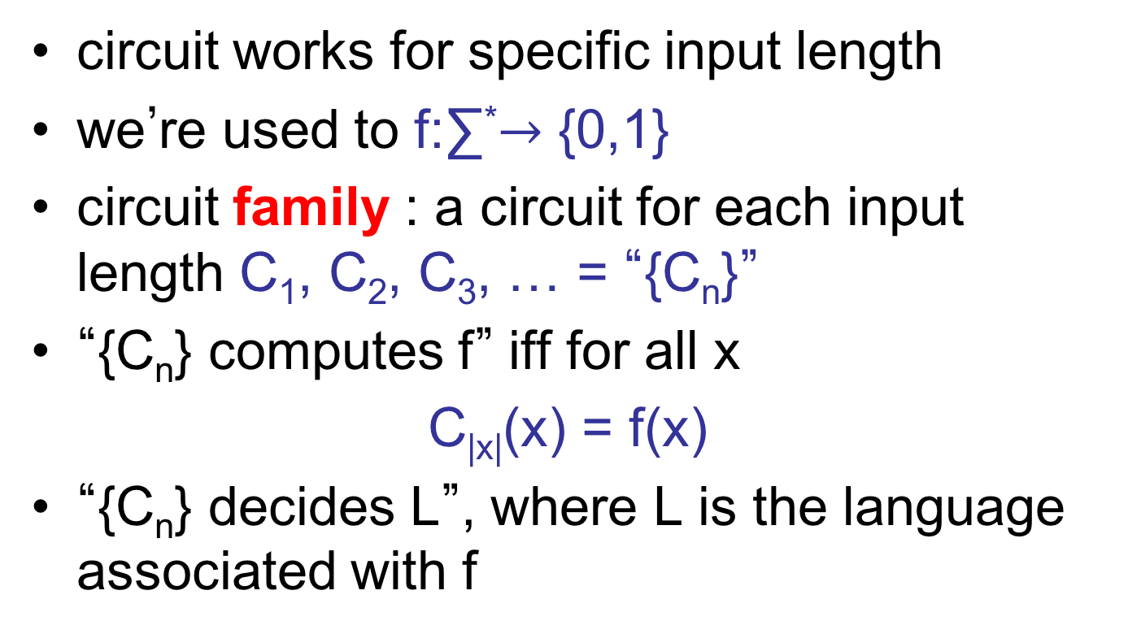
Circuit families
circuit works for specific input length
we’re used to f:∑*$→$ {0,1}
circuit family : a circuit for each input length C₁, C₂, C₃, … = “{C_{n}}”
“{C_{n}} computes f” iff for all x
C_{|x|}(x) = f(x)
“{C_{n}} decides L”, where L is the language associated with f

Slide 27
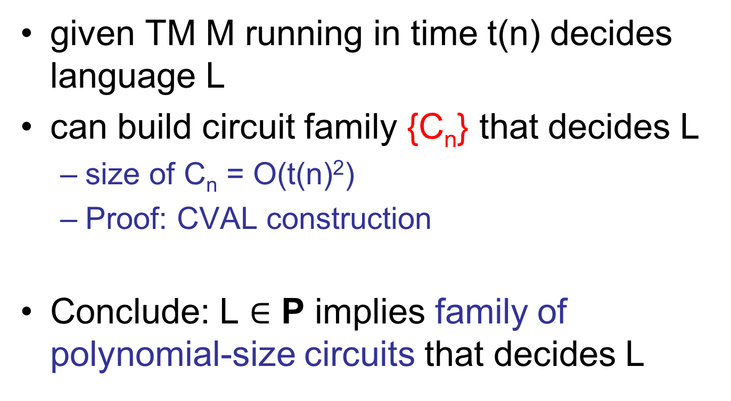
Connection to TMs
given TM M running in time t(n) decides language L
can build circuit family {C_{n}} that decides L
  size of C_{n} = O(t(n)²)
  Proof: CVAL construction
Conclude: L $∈$ P implies family of polynomial-size circuits that decides L

Slide 28
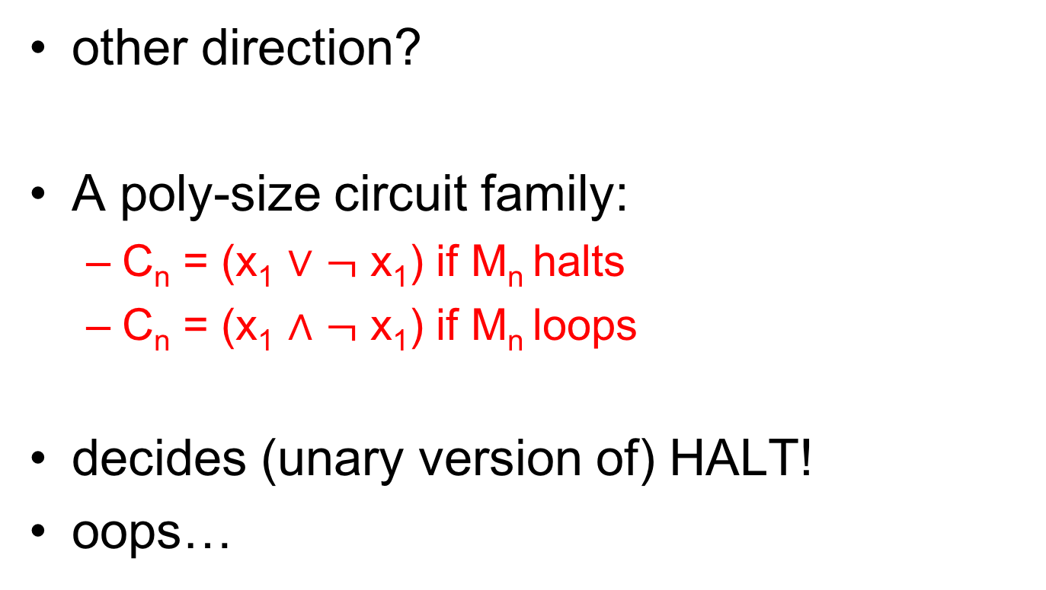
Connection to TMs
other direction?
A poly-size circuit family:
  C_{n} = (x₁ $∨$ $¬$ x₁) if M_{n} halts
  C_{n} = (x₁ $∧$ $¬$ x₁) if M_{n} loops
decides (unary version of) HALT!
oops…

Slide 29
Uniformity
Strange aspect of circuit family:
  can “encode” (potentially uncomputable) information in family specification
solution: uniformity – require specification is simple to compute
  Definition: circuit family {C_{n}} is logspace uniform iff TM M outputs C_{n} on input 1^{n} and runs in O(log n) space

Slide 30
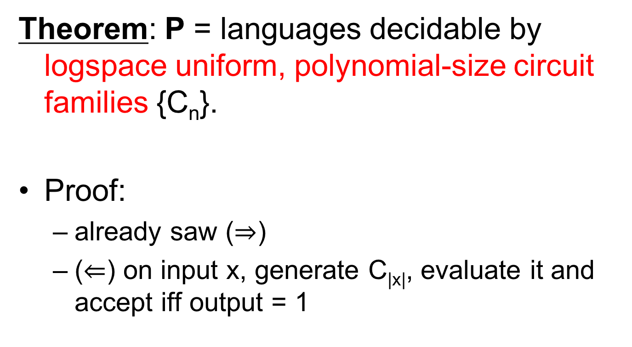
Uniformity
Theorem: P = languages decidable by logspace uniform, polynomial-size circuit families {C_{n}}.
Proof:
  already saw ($⇒$)
  ($⇐$) on input x, generate C_{|x|}, evaluate it and accept iff output = 1

Slide 31
TMs that take advice
family {C_{n}} without uniformity constraint is called “non-uniform”
regard “non-uniformity” as a limited resource just like time, space, as follows:
  add read-only “advice” tape to TM M
  M “decides L with advice A(n)” iff
  M(x, A(|x|)) accepts $⇔$ x $∈$ L
  note: A(n) depends only on |x|

Slide 32
TMs that take advice
Definition: TIME(t(n))/f(n) = the set of those languages L for which:
  there exists A(n) s.t. |A(n)| ≤ f(n)
  TM M decides L with advice A(n) in time t(n)
most important such class:
P/poly = $∪$_{k} TIME(n^{k})/n^{k}

Slide 33
TMs that take advice
Theorem: L $∈$ P/poly iff L decided by family of (non-uniform) polynomial size circuits.
Proof:
  ($⇒$) C_{n} from CVAL construction; hardwire advice A(n)
  ($⇐$) define A(n) = description of C_{n}; on input x, TM simulates C_{|x|}(x)

Slide 34
Approach to P/NP
Believe NP $≠$ P
  equivalent: “NP does not have uniform, polynomial-size circuits”
Even believe NP $⊂$ P/poly
  equivalent: “NP (or, e.g. SAT) does not have polynomial-size circuits”
  implies P ≠ NP
  many believe: best hope for P ≠ NP

Slide 35
Parallelism
uniform circuits allow refinement of polynomial time:
depth $≡$parallel time
circuit C
size $≡$ parallel work

Slide 36
Parallelism
the NC (“Nick’s Class”) Hierarchy (of logspace uniform circuits):
NC_{k} = O(log^{k} n) depth, poly(n) size
NC = $∪$_{k} NC_{k}
captures “efficiently parallelizable problems”
not realistic? overly generous
OK for proving non-parallelizable

Slide 37
Matrix Multiplication
n x n matrix A
n x n matrix B
n x n matrix AB
=
what is the parallel complexity of this problem?
  work = poly(n)
  time = log^{k}(n)? (which k?)

Slide 38
Matrix Multiplication
two details
  arithmetic matrix multiplication…
  A = (a_{i, k}) B = (b_{k, j}) (AB)_{i,j} = Σ_{k} (a_{i,k} x b_{k, j})
  … vs. Boolean matrix multiplication:
  A = (a_{i, k}) B = (b_{k, j}) (AB)_{i,j} = $∨$_{k} (a_{i,k} $∧$ b_{k, j})
  single output bit: to make matrix multiplication a language: on input A, B, (i, j) output (AB)_{i,j}

Slide 39
Matrix Multiplication
Boolean Matrix Multiplication is in NC₁
  level 1: compute n ANDS: a_{i,k} $∧$ b_{k, j}
  next log n levels: tree of ORS
  n² subtrees for all pairs (i, j)
  select correct one and output

Slide 40
Boolean formulas and NC₁
Previous circuit is actually a formula. This is no accident:
Theorem: L $∈$NC₁ iff decidable by polynomial-size uniform* family of Boolean formulas.
Note: we measure formula size by leaf-size.
* DSPACE(log² n)-uniform

Slide 41
Boolean formulas and NC₁
Proof:
  ($⇒$) convert NC₁ circuit into formula
    recursively:
    note: logspace transformation (stack depth log n, stack record 1 bit – “left” or “right”)
$$∧$$
$$∧$$
$$⇒$$

Slide 42
Boolean formulas and NC₁
  ($⇐$) convert formula of size n into formula of depth O(log n)
    note: size ≤ 2^{depth}, so new formula has poly(n) size
$$∨$$
key transformation
$$∧$$
$$∧$$
D
$$¬$$
C
C₁
C₀
D
1
D
0

Slide 43
Boolean formulas and NC₁
  D any minimal subtree with size at least n/3
    implies size(D) ≤ 2n/3
  define T(n) = maximum depth required for any size n formula
  C₁, C₀, D all size ≤ 2n/3
  T(n) ≤ T(2n/3) + 3
  implies T(n) ≤ O(log n)

Slide 44
Relation to other classes
Clearly NC $⊆$ P
  recall P $≡$ uniform poly-size circuits
NC₁ $⊆$ L
  on input x, compose logspace algorithms for:
    generating C_{|x|}
    converting to formula
    FVAL

Slide 45
Relation to other classes
NL $⊆$ NC₂: S-T-CONN $∈$ NC₂
  given G = (V, E), vertices s, t
  A = adjacency matrix (with self-loops)
  (A²)_{i, j} = 1 iff path of length ≤ 2 from node i to node j
  (A^{n})_{i, j} = 1 iff path of length ≤ n from node i to node j
  compute with depth log n tree of Boolean matrix multiplications, output entry s, t
  log² n depth total

Slide 46
NC vs. P
can every efficient algorithm be efficiently parallelized?
NC = P
P-complete problems least-likely to be parallelizable
  if P-complete problem is in NC, then P = NC
  Why?
  we use logspace reductions to show problem P-complete; L in NC
?

Slide 47
NC vs. P
can every uniform, poly-size Boolean circuit family be converted into a uniform, poly-size Boolean formula family?
NC₁ = P
?

