Slide 1

CS151
Complexity Theory
Lecture 3
April 11, 2023

Slide 2
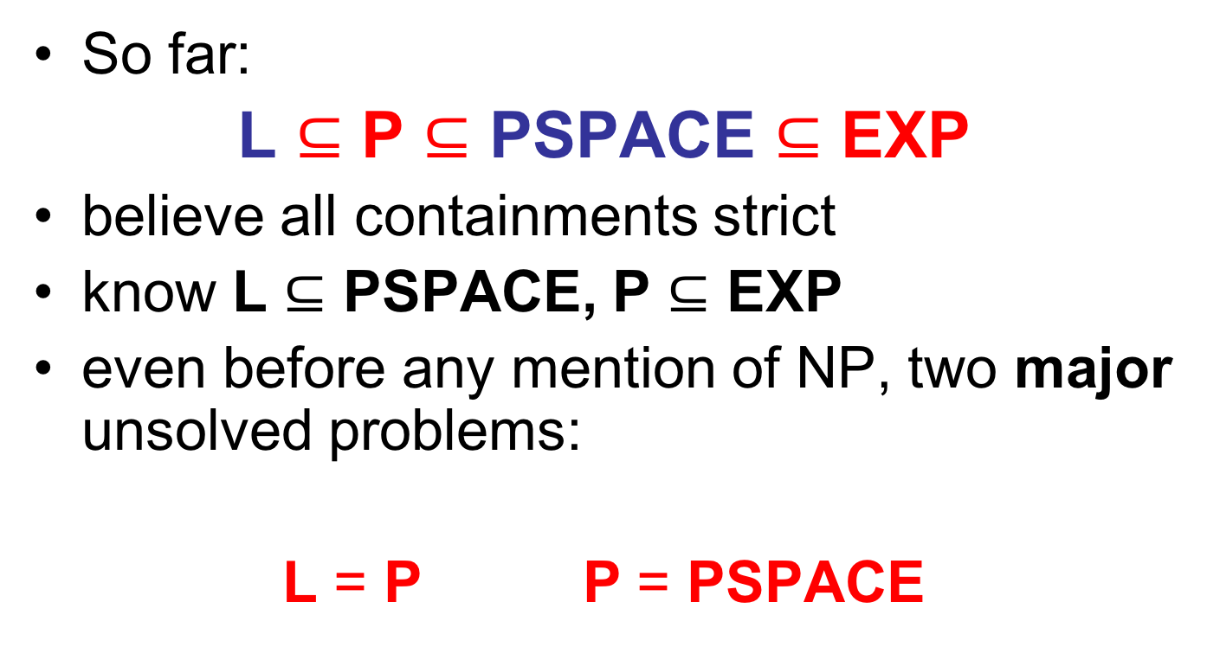
Relationships between classes
So far:
L $⊆$ P $⊆$ PSPACE $⊆$ EXP
believe all containments strict
know L $⊆$ PSPACE, P $⊆$ EXP
even before any mention of NP, two major unsolved problems:
L = P P = PSPACE
?
?

Slide 3
A P-complete problem
We don’t know how to prove L ≠ P
But, can identify problems in P least likely to be in L using P- completeness.
need stronger notion of reduction (why?)
f
yes
yes
f
L₁
no
no
L₂

Slide 4
A P-complete problem
logspace reduction: f computable by TM that uses O(log n) space
  denoted “L₁ ≤_{L} L₂”
If L₂ is P-complete, then L₂ in L implies L = P (homework problem)

Slide 5
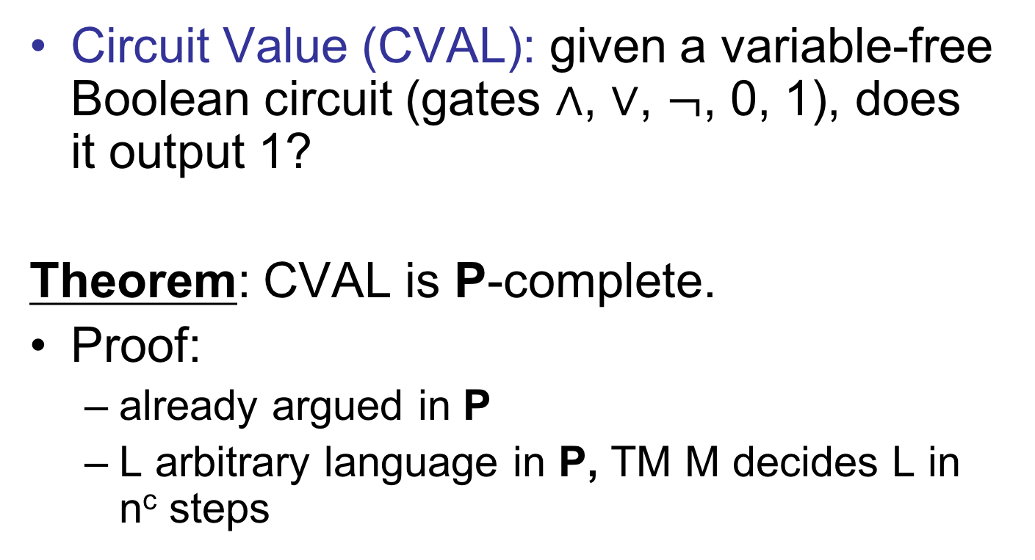
A P-complete problem
Circuit Value (CVAL): given a variable-free Boolean circuit (gates $∧$, $∨$, $¬$, 0, 1), does it output 1?
Theorem: CVAL is P-complete.
Proof:
  already argued in P
  L arbitrary language in P, TM M decides L in n^{c} steps

Slide 6
A P-complete problem
Tableau (configurations written in an array) for machine M on input w:
w₁/q_{s}
w₂
…
w_{n}
…
_
height = time taken = |w|^{c}
width = space used ≤ |w|^{c}
w₁
w₂/q₁
…
w_{n}
…
_
w₁/q₁
a
…
w_{n}
…
_
...
...
_/q_{a}
_
…
_
…
_

Slide 7
A P-complete problem
Important observation: contents of cell in tableau determined by 3 others above it:
a/q₁
b
a
a
b/q₁
a
b/q₁
a
a
b
a
b

Slide 8
A P-complete problem
Can build Boolean circuit STEP
  input (binary encoding of) 3 cells
  output (binary encoding of) 1 cell
a
b/q₁
a
each output bit is some function of inputs
can build circuit for each
size is independent of size of tableau
STEP
a

Slide 9
A P-complete problem
Tableau for M on input w
w₁/q_{s}
w₂
…
w_{n}
…
_
w₁
w₂/q₁
…
w_{n}
…
_
...
...
|w|^{c} copies of STEP compute row i from i-1
…
STEP
STEP
STEP
STEP
STEP
…

Slide 10
A P-complete problem
w₁
w₂
w_{n}
This circuit C_{M, w} has inputs w₁w₂…w_{n} and outputs 1 iff M accepts input w.
logspace reduction
Size = O(|w|^{2c})
w_{1/}q_{s}
w₂
…
w_{n}
…
_
STEP
STEP
STEP
STEP
STEP
STEP
STEP
STEP
STEP
STEP
...
...
STEP
STEP
STEP
STEP
STEP
ignore these
1 iff cell contains q_{accept}

Slide 11
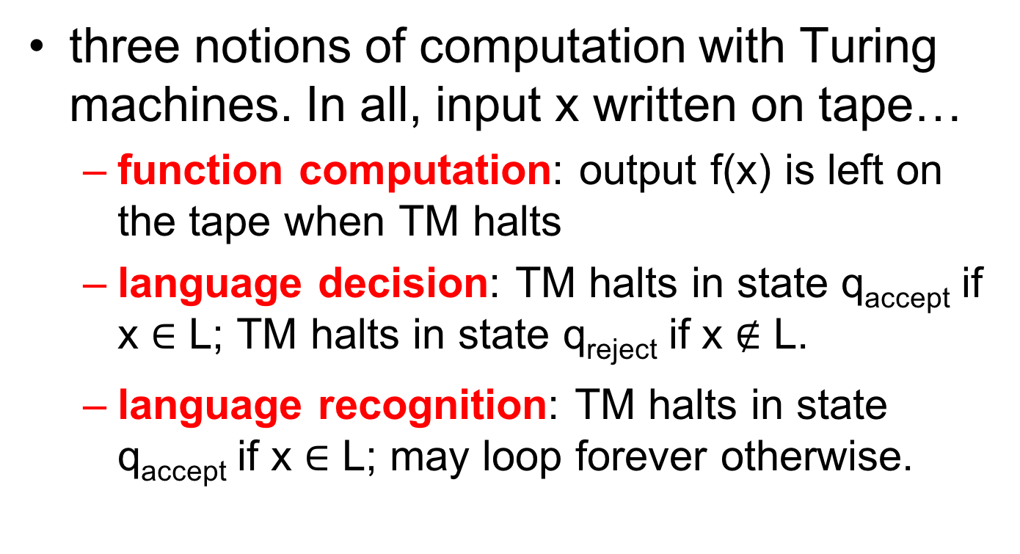

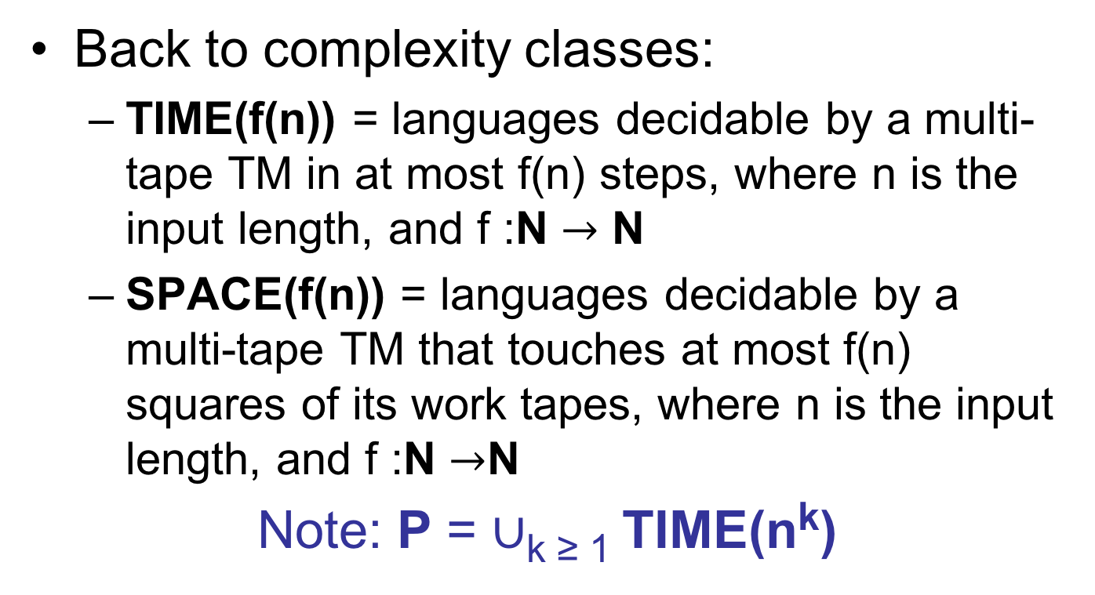

Answer to question
Can we evaluate an n node Boolean circuit using O(log n) space?
$$∧$$
NO! (probably)
CVAL in L if and only if L = P
$$∧$$
$$∨$$
$$∨$$
$$∧$$
$$¬$$
1
0
1
0
1

Slide 12
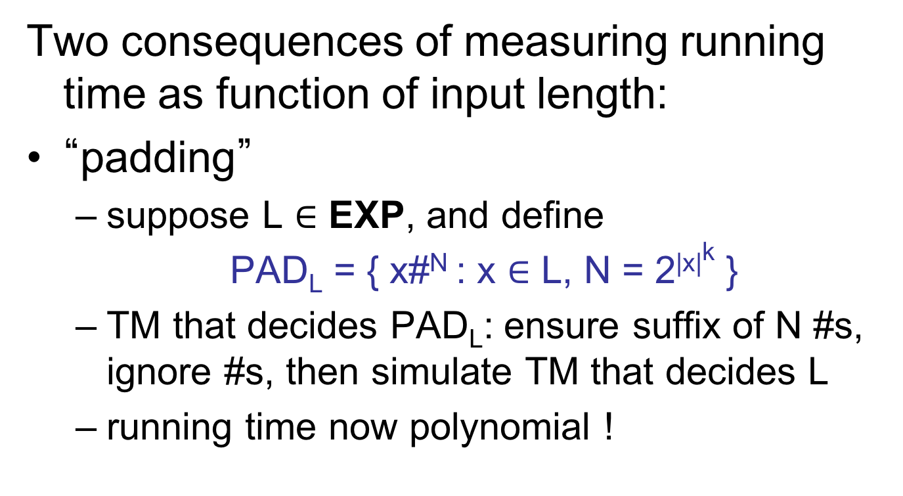
Padding and succinctness
Two consequences of measuring running time as function of input length:
“padding”
  suppose L $∈$ EXP, and define
  PAD_{L} = { x#^{N} : x $∈$ L, N = 2^{|x|k} }
  TM that decides PAD_{L}: ensure suffix of N #s, ignore #s, then simulate TM that decides L
  running time now polynomial !

Slide 13
Padding and succinctness
converse (intuition only): “succinctness”
  suppose L is P-complete
  intuitively, some inputs are “hard” -- require full power of P
  SUCCINCT_{L} has inputs encoded in different form than L, some exponentially shorter
  if “hard” inputs are exponentially shorter, then candidate to be EXP-complete

Slide 14

Succinct encodings
succinct encoding for a directed graph G= (V = {1,2,3,…}, E):
a succinct encoding for a variable-free Boolean circuit:
1 iff (i, j) $∈$ E
i
j
1 iff wire from gate i to gate j
type of gate i
type of gate j
i
j

Slide 15
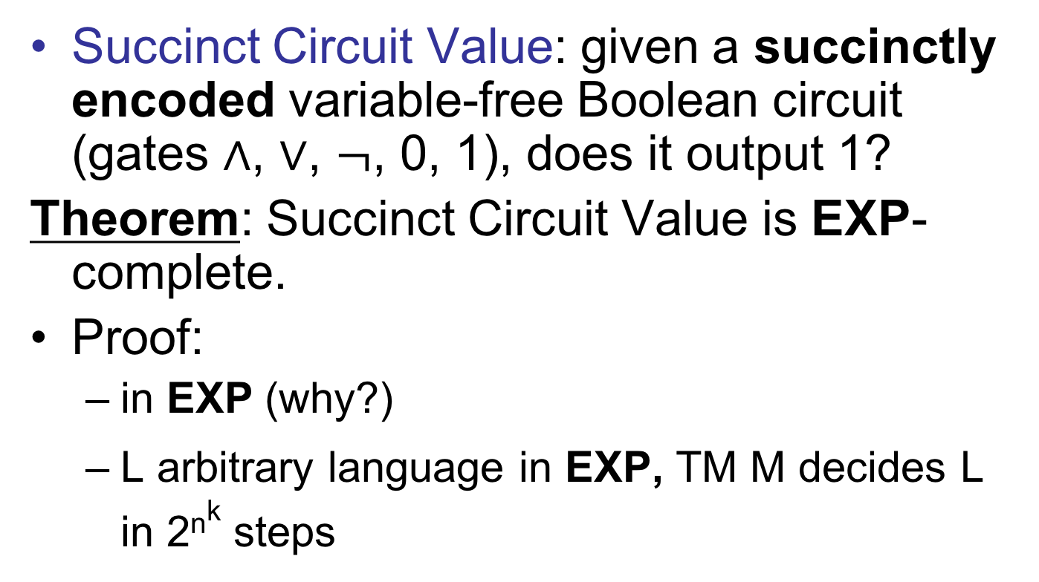
An EXP-complete problem
Succinct Circuit Value: given a succinctly encoded variable-free Boolean circuit (gates $∧$, $∨$, $¬$, 0, 1), does it output 1?
Theorem: Succinct Circuit Value is EXP-complete.
Proof:
  in EXP (why?)
  L arbitrary language in EXP, TM M decides L in 2^{nk} steps

Slide 16
An EXP-complete problem
  tableau for input x = x₁x₂x₃…x_{n}:
  Circuit C from CVAL reduction has size O(2^{2nk}).
  TM M accepts input x iff circuit outputs 1
x _ _ _ _ _
height, width 2^{nk}

Slide 17
An EXP-complete problem
  Can encode C succinctly:
    if i, j within single STEP circuit, easy to compute output
    if i, j between two STEP circuits, easy to compute output
    if one of i, j refers to input gates, consult x to compute output
1 iff wire from gate i to gate j
type of gate i
type of gate j
i
j

Slide 18
Summary
Remaining TM details: big-oh necessary.
First complexity classes:
L, P, PSPACE, EXP
First separations (via simulation and diagonalization):
P ≠ EXP, L ≠ PSPACE
First major open questions:
L = P P = PSPACE
First complete problems:
  CVAL is P-complete
  Succinct CVAL is EXP-complete
?
?

Slide 19
Summary
EXP
PSPACE
P
L

Slide 20
Nondeterminism: introduction
A motivating question:
Can computers replace mathematicians?
L = { (x, 1^{k}) : statement x has a proof of length at most k }

Slide 21
Nondeterminism: introduction
Outline:
  nondeterminism
  nondeterministic time classes
  NP, NP-completeness, P vs. NP
  coNP
  NTIME Hierarchy
  Ladner’s Theorem

Slide 22
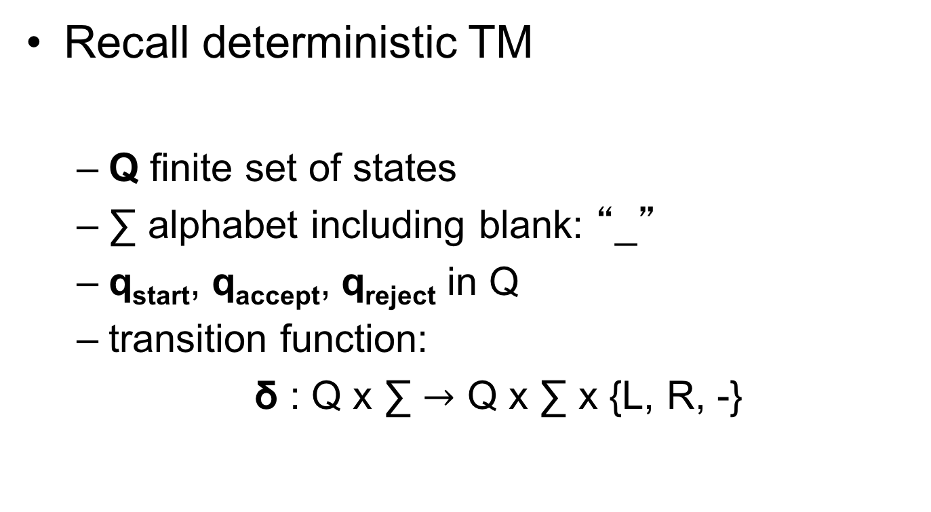
Nondeterminism
Recall deterministic TM
  Q finite set of states
  ∑ alphabet including blank: “_”
  q_{start}, q_{accept}, q_{reject} in Q
  transition function:
  δ : Q x ∑ $→$ Q x ∑ x {L, R, -}

Slide 23
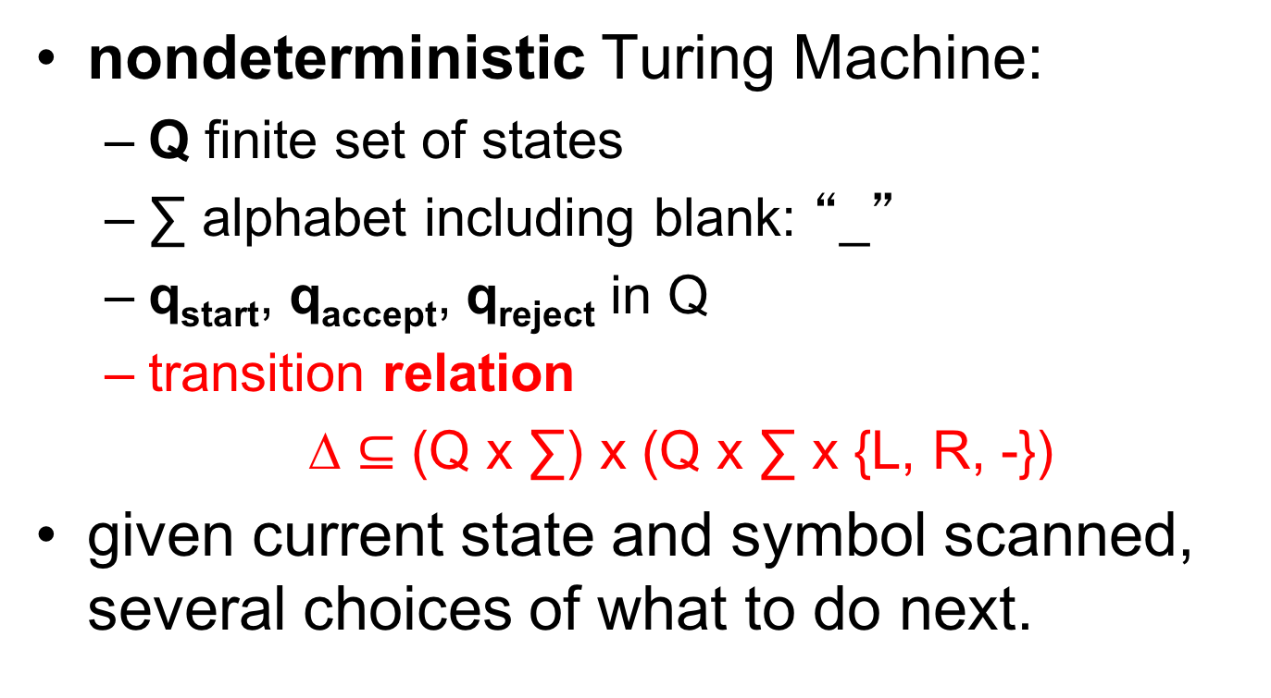
Nondeterminism
nondeterministic Turing Machine:
  Q finite set of states
  ∑ alphabet including blank: “_”
  q_{start}, q_{accept}, q_{reject} in Q
  transition relation
  ∆ $⊆$ (Q x ∑) x (Q x ∑ x {L, R, -})
given current state and symbol scanned, several choices of what to do next.

Slide 24


Nondeterminism
deterministic TM: given current configuration, unique next configuration
q_{start}x₁x₂x₃…x_{n}
q_{start}x₁x₂x₃…x_{n}
x$∈$L
x $∉$ L
q_{accept}
q_{reject}
nondeterministic TM: given current configuration, several possible next configurations

Slide 25


Nondeterminism
q_{start}x₁x₂x₃…x_{n}
q_{start}x₁x₂x₃…x_{n}
“computation path”
x $∈$ L
x $∉$ L
“guess”
q_{accept}
q_{reject}
asymmetric accept/reject criterion

Slide 26
Nondeterminism
all paths terminate
time used: maximum length of paths from root
space used: maximum # of work tape squares touched on any path from root

Slide 27
Nondeterminism
NTIME(f(n)) = languages decidable by a multi-tape NTM that runs for at most f(n) steps on any computation path, where n is the input length, and f :N $→$ N
NSPACE(f(n)) = languages decidable by a multi-tape NTM that touches at most f(n) squares of its work tapes along any computation path, where n is the input length, and f :N $→$ N

Slide 28
Nondeterminism
Focus on time classes first:
NP = $∪$_{k} NTIME(n^{k})
NEXP = $∪$_{k} NTIME(2^{nk})

Slide 29
Poly-time verifiers
“witness” or “certificate”
Very useful alternate definition of NP:
Theorem: language L is in NP if and only if it is expressible as:
L = { x| $∃$ y, |y| ≤ |x|^{k}, (x, y) $∈$ R }
where R is a language in P.
poly-time TM M_{R} deciding R is a “verifier”
efficiently verifiable

Slide 30
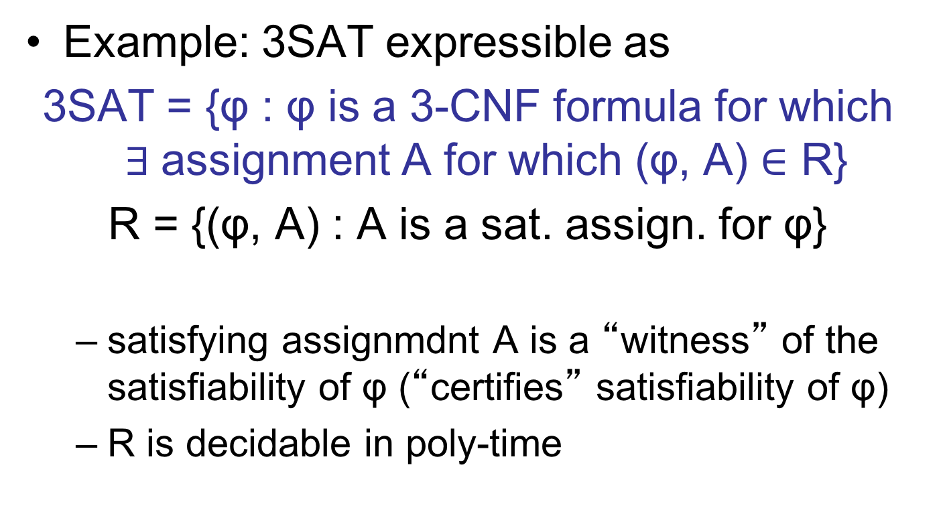
Poly-time verifiers
Example: 3SAT expressible as
3SAT = {φ : φ is a 3-CNF formula for which $∃$assignment A for which (φ, A) $∈$ R}
R = {(φ, A) : A is a sat. assign. for φ}
  satisfying assignmdnt A is a “witness” of the satisfiability of φ (“certifies” satisfiability of φ)
  R is decidable in poly-time

Slide 31
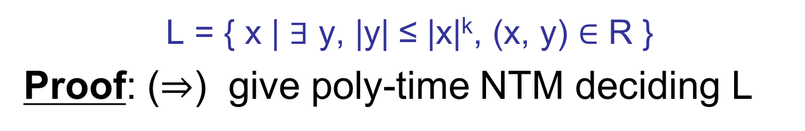
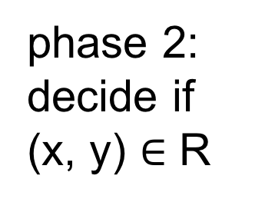
Poly-time verifiers
L = { x | $∃$ y, |y| ≤ |x|^{k}, (x, y) $∈$ R }
Proof: ($⇒$) give poly-time NTM deciding L
phase 1: “guess” y with |x|^{k} nondeterministic steps
phase 2: decide if
(x, y) $∈$ R

Slide 32
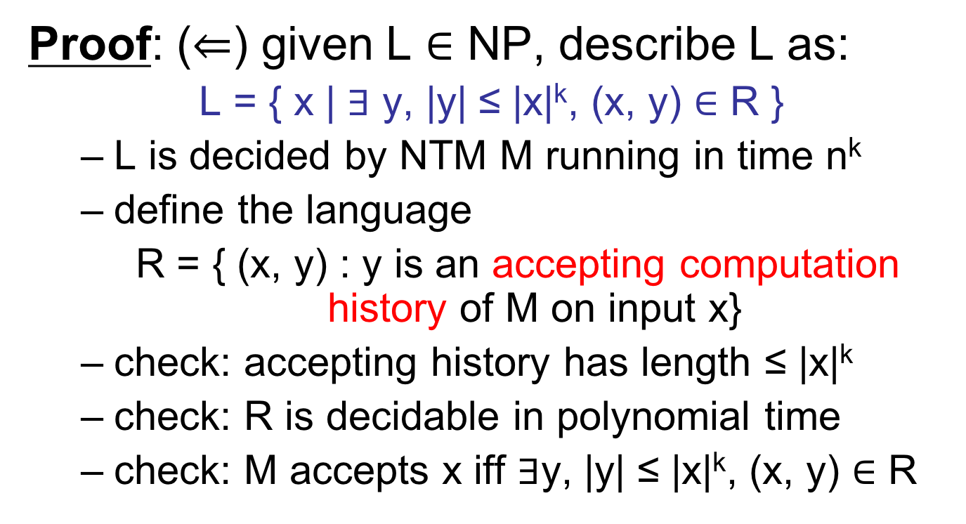
Poly-time verifiers
Proof: ($⇐$) given L $∈$ NP, describe L as:
L = { x | $∃$ y, |y| ≤ |x|^{k}, (x, y) $∈$ R }
  L is decided by NTM M running in time n^{k}
  define the language
  R = { (x, y) : y is an accepting computation history of M on input x}
  check: accepting history has length ≤ |x|^{k}
  check: R is decidable in polynomial time
  check: M accepts x iff $∃$y, |y| ≤ |x|^{k}, (x, y) $∈$ R

Slide 33
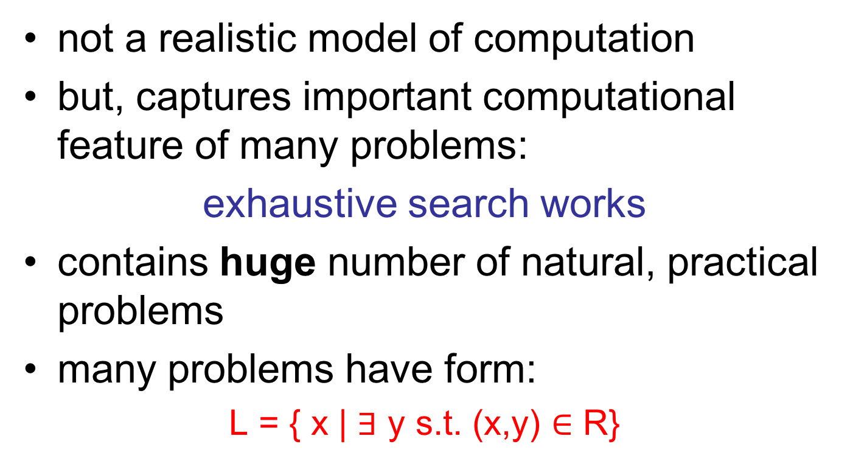
Why NP?
problem requirements
object we are seeking
not a realistic model of computation
but, captures important computational feature of many problems:
exhaustive search works
contains huge number of natural, practical problems
many problems have form:
L = { x | $∃$ y s.t. (x,y) $∈$ R}
efficient test: does y meet requirements?

Slide 34
Why NP?
Why not EXP?
  too strong!
  important problems not complete.

Slide 35
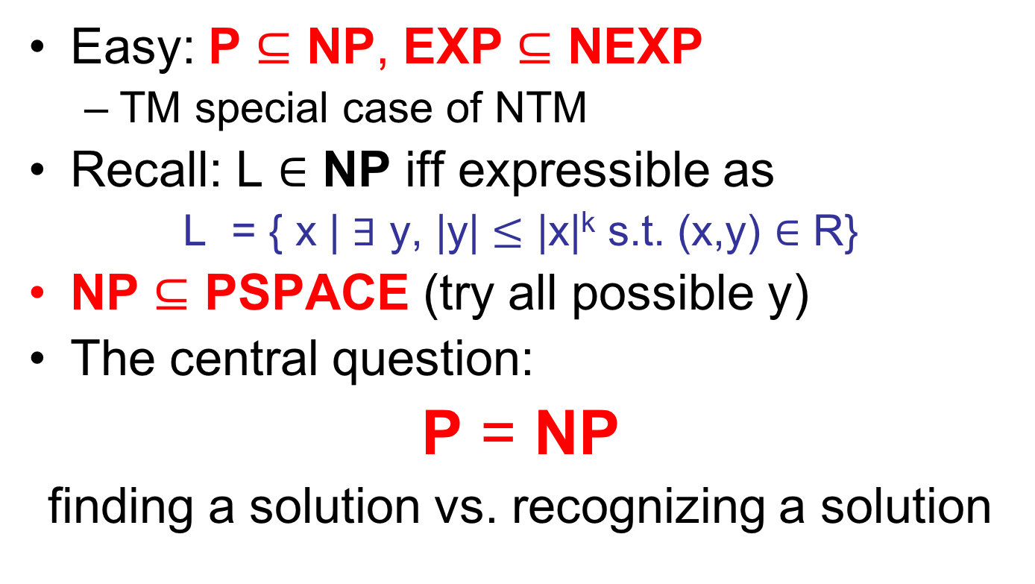
Relationships between classes
Easy: P $⊆$ NP, EXP $⊆$ NEXP
  TM special case of NTM
Recall: L $∈$ NP iff expressible as
L = { x | $∃$ y, |y| $≤$ |x|^{k} s.t. (x,y) $∈$ R}
NP $⊆$ PSPACE (try all possible y)
The central question:
P = NP
finding a solution vs. recognizing a solution
?

Slide 36
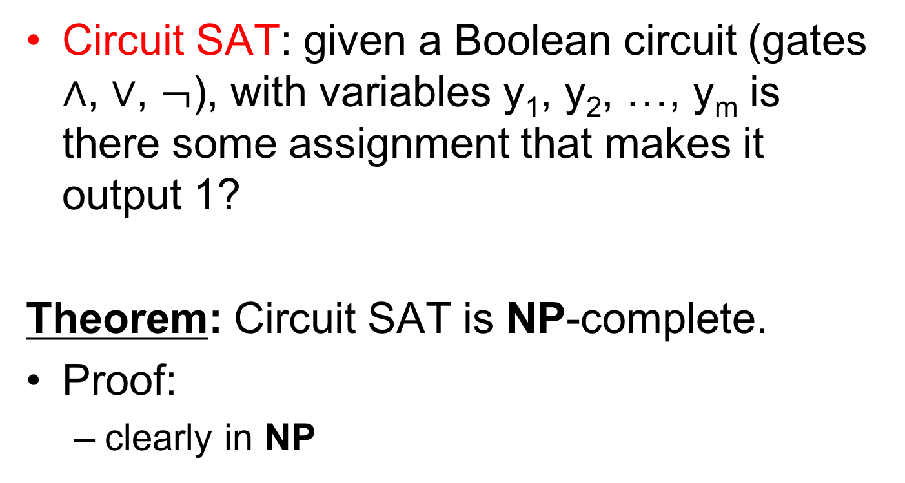
NP-completeness
Circuit SAT: given a Boolean circuit (gates $∧$, $∨$, $¬$), with variables y₁, y₂, …, y_{m} is there some assignment that makes it output 1?
Theorem: Circuit SAT is NP-complete.
Proof:
  clearly in NP

Slide 37

NP-completeness
  Given L $∈$ NP of form
L = { x | $∃$ y s.t. (x,y) $∈$ R}
x₁
x₂
…
x_{n}
y₁
y₂
…
y_{m}
1 iff (x,y) $∈$ R
CVAL reduction for R
  hardwire input x; leave y as variables

Slide 38
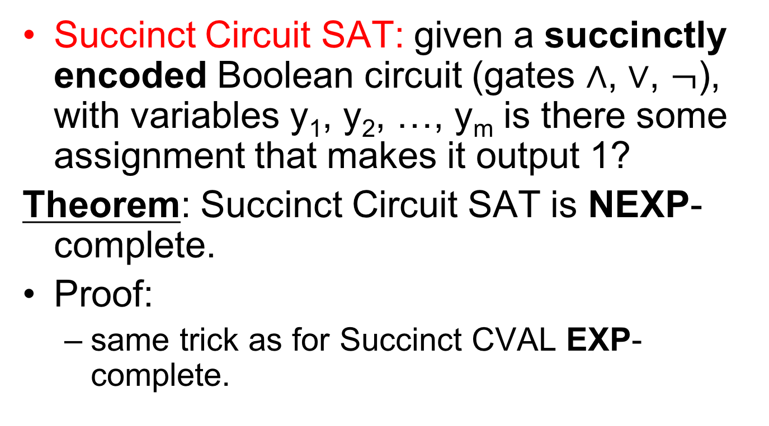
NEXP-completeness
Succinct Circuit SAT: given a succinctly encoded Boolean circuit (gates $∧$, $∨$, $¬$), with variables y₁, y₂, …, y_{m} is there some assignment that makes it output 1?
Theorem: Succinct Circuit SAT is NEXP-complete.
Proof:
  same trick as for Succinct CVAL EXP-complete.

Slide 39
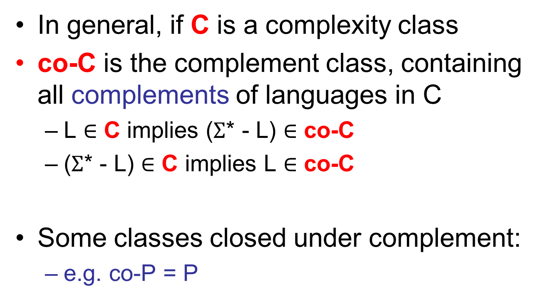
Complement classes
In general, if C is a complexity class
co-C is the complement class, containing all complements of languages in C
  L $∈$ C implies ($Σ$* - L) $∈$ co-C
  ($Σ$* - L) $∈$ C implies L $∈$ co-C
Some classes closed under complement:
  e.g. co-P = P

Slide 40

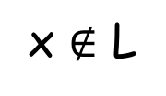
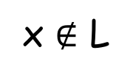
coNP
Is NP closed under complement?
Can we transform this machine:
x $∈$ L
x $∉$ L
x $∈$ L
x $∉$ L
q_{accept}
q_{reject}
into a machine with this behavior?
q_{accept}
q_{reject}

Slide 41
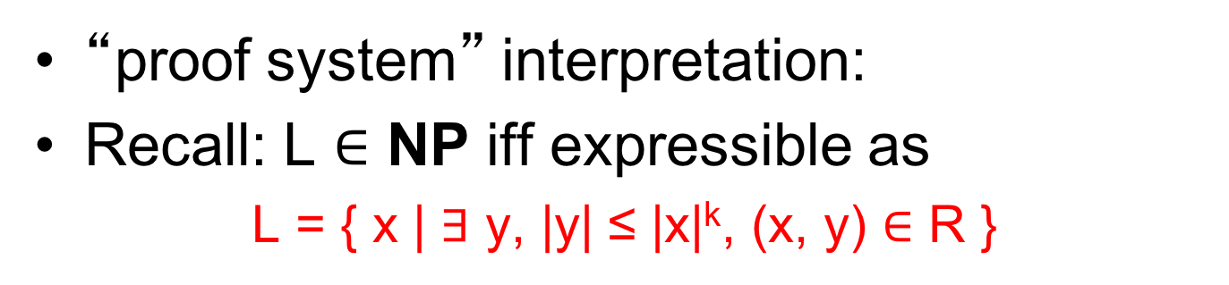
coNP
“proof system” interpretation:
Recall: L $∈$ NP iff expressible as
L = { x | $∃$ y, |y| ≤ |x|^{k}, (x, y) $∈$ R }
“proof verifier”
“proof”
languages in NP have “short proofs”
coNP captures (in its complete problems) problems least likely to have “short proofs”.
  e.g., UNSAT is coNP-complete

Slide 42
coNP
P = NP implies NP = coNP
Belief:
NP ≠ coNP
  another major open problem

Slide 43
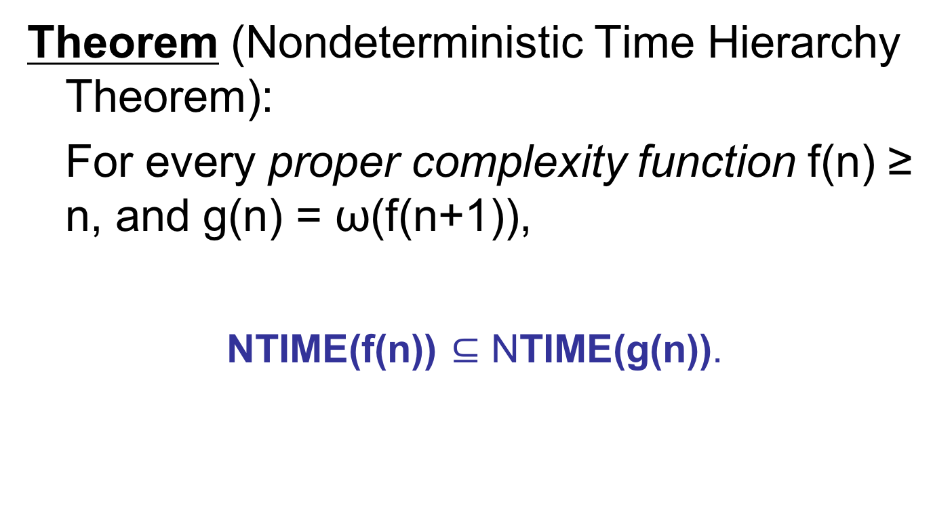
NTIME Hierarchy Theorem
Theorem (Nondeterministic Time Hierarchy Theorem):
For every proper complexity function f(n) ≥ n, and g(n) = ω(f(n+1)),
NTIME(f(n)) $⊆$ NTIME(g(n)).

Slide 44
NTIME Hierarchy Theorem
inputs
Proof attempt :
(what’s wrong?)
Y
Turing Machines
n
(M, x): does NTM M accept x in f(n) steps?
Y
n
n
Y
n
D :
n
Y
n
Y
Y
n
Y

Slide 45
NTIME Hierarchy Theorem
Let t(n) be large enough so that can decide if NTM M running in time f(n) accepts 1^{n}, in time t(n).
I’m responsible for dealing with NTM M_{i}
1^{n}
1^{t(n)}
M₁
y
n
y
?
?
?
. . .
?
...
...
M_{i-1}
n
y
n
?
?
?
?
M_{i}
n
y
y
?
?
?
?
D :
. . .

Slide 46
NTIME Hierarchy Theorem
Enough time on input 1^{t(n)} to do the opposite of M_{i}(1^{n}):
1^{n}
1^{t(n)}
M_{i}
y
?
?
?
. . .
?
D :
. . .
n

Slide 47
NTIME Hierarchy Theorem
For k in [n…t(n)] can to do same as M_{i}(1^{k+1}) on input 1^{k}
1^{n}
1^{t(n)}
M_{i}
y
?
?
?
. . .
?
D :
. . .
n

Slide 48
NTIME Hierarchy Theorem
Did we diagonalize against M_{i}?
  if L(M_{i}) = L(D) then:
  equality along all arrows.
  contradiction.
1^{n}
1^{t(n)}
M_{i}
y
?
?
?
. . .
?
D :
. . .
n

Slide 49
NTIME Hierarchy Theorem
General scheme:
  interval [1...t(1)] kills M₁
  interval [t(1)…t(t(1))] kills M₂
  interval [t^{i-1}(1)…t^{i}(1)] kills M_{i}
Running time of D on 1^{n}: f(n+1) + time to compute interval containing n
conclude D in NTIME(g(n)) (g(n) = ω(f(n+1)))

