Slide 1
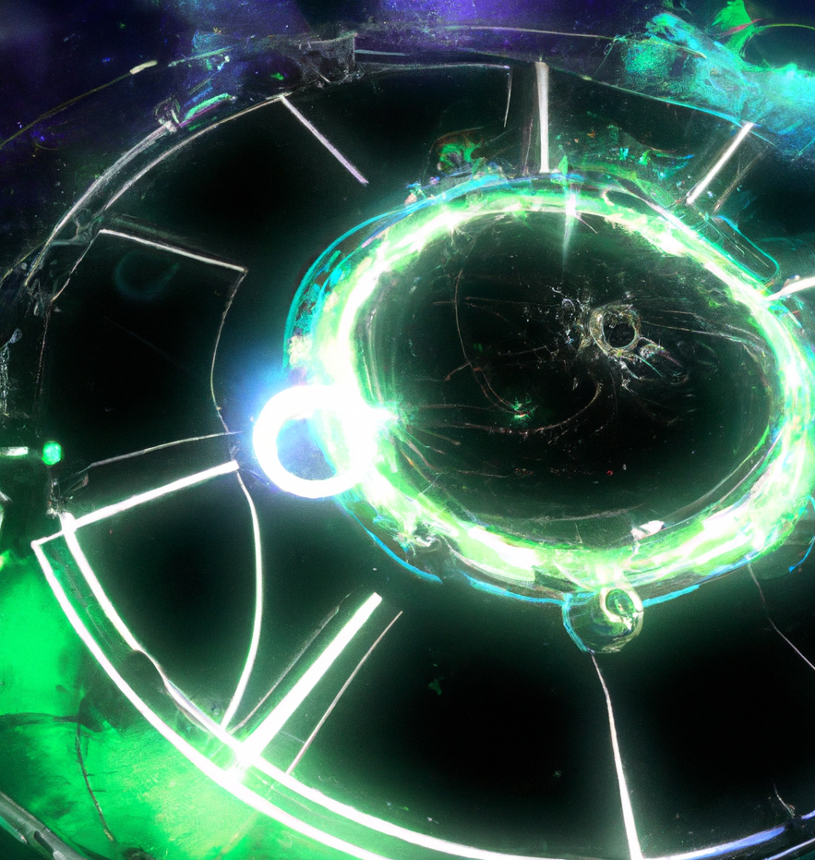
CS151 Complexity Theory
Lecture 2
April 6, 2023

Slide 2
Turing Machines
Amazing fact: there exist (natural) undecidable problems
HALT = { (M, x) : M halts on input x }
Theorem: HALT is undecidable.

Slide 3
Turing Machines
Proof:
Suppose TM H decides HALT
Define new TM H’: on input <M>
if H accepts (M, <M>) then loop
if H rejects (M, <M>) then halt
Consider H’ on input <H’>:
if it halts, then H rejects (H’, <H’>), which implies it cannot halt
if it loops, then H accepts (H’, <H’>) which implies it must halt
contradiction.

Slide 4
Diagonalization
box (M, x): does M halt on x?
inputs
Y
Turing Machines
n
Y
n
The existence of H which tells us yes/no for each box allows us to construct a TM H’ that cannot be in the table.
n
Y
n
H’ :
n
Y
n
Y
Y
n
Y

Slide 5
Turing Machines
Back to complexity classes:
TIME(f(n)) = languages decidable by a multi-tape TM in at most f(n) steps, where n is the input length, and f :N $→$ N
SPACE(f(n)) = languages decidable by a multi-tape TM that touches at most f(n) squares of its work tapes, where n is the input length, and f :N $→$N
Note: P = $∪$_{k ≥ 1} TIME(n^{k})

Slide 6
Interlude
In an ideal world, given language L
state an algorithm deciding L
prove that no algorithm does better
we are pretty good at part 1
we are currently completely helpless when it comes to part 2, for most problems that we care about

Slide 7
Interlude
in place of part 2 we can
relate the difficulty of problems to each other via reductions
prove that a problem is a “hardest” problem in a complexity class via completeness
powerful, successful surrogate for lower bounds

Slide 8
Reductions
reductions are the main tool for relating problems to each other
given two languages L₁ and L₂ we say “L₁ reduces to L₂” and we write “L₁ ≤ L₂” to mean:
there exists an efficient (for now, poly-time) algorithm that computes a function f s.t.
x $∈$L₁ implies f(x) $∈$ L₂
x $∉$ L₁ implies f(x) $∉$ L₂

Slide 9
Reductions
f
yes
yes
f
L₁
no
no
L₂
positive use: given new problem L₁ reduce it to L₂ that we know to be in P. Conclude L₁ in P (how?)
e.g. bipartite matching ≤ max flow
formalizes “L₁ as easy as L₂”

Slide 10
Reductions
f
yes
yes
f
L₁
no
no
L₂
negative use: given new problem L₂ reduce L₁ (that we believe not to be in P) to it. Conclude L₂ not in P if L₁ not in P (how?)
e.g. satisfiability ≤ graph 3-coloring
formalizes “L₂ as hard as L₁”

Slide 11
Reductions
Example reduction:
3SAT = { φ : φ is a 3-CNF Boolean formula that has a satisfying assignment }
(3-CNF = AND of OR of ≤ 3 literals)
IS = { (G, k) | G is a graph with an independent set V’ $⊆$ V of size ≥ k }
(ind. set = set of vertices no two of which are connected by an edge)

Slide 12
Ind. Set is NP-complete
The reduction f: given
φ = (x $∨$ y $∨¬$z) $∧$ ($¬$x $∨$ w $∨$ z) $∧$ … $∧$ (…)
we produce graph G_{φ}:
x
$¬$x
…
y
$¬$z
w
z
one triangle for each of m clauses
edge between every pair of contradictory literals
set k = m

Slide 13
Reductions
φ = (x $∨$ y $∨¬$z) $∧$ ($¬$x $∨$ w $∨$ z) $∧$ … $∧$ (…)
x
$¬$x
…
y
$¬$z
w
z
Claim: φ has a satisfying assignment if and only if G has an independent set of size at least k
proof?
Conclude that 3SAT ≤ IS.

Slide 14
Completeness
complexity class C
language L is C-complete if
L is in C
every language in C reduces to L
very important concept
formalizes “L is hardest problem in complexity class C”

Slide 15
Completeness
Completeness allows us to reason about the entire class by thinking about a single concrete problem
related concept: language L is C-hard if
every language in C reduces to L

Slide 16
Completeness
May ask: how to show every language in C reduces to L?
in practice, shown by reducing known C-complete problem to L
often not hard to find “1st” C-complete language, but it might not be “natural”

Slide 17
Completeness
Example:
NP = the set of languages L where
L = { x : $∃$ y, |y| $≤$|x|^{k}, (x, y) $∈$ R }
and R is a language in P.
one NP-complete language “bounded halting”:
BH = {(M, x, $1^{k},$1^{m}) : $∃$ y, |y| $≤$ |x|^{k} s.t. M accepts (x, y) in at most m steps }
challenge is to find natural complete problem
Cook 71 : 3-SAT NP-complete

Slide 18
Summary
problems
function, decision
language = set of strings
complexity class = set of languages
efficient computation identified with efficient computation on Turing Machine
single-tape, multi-tape
diagonalization technique: HALT undecidable
TIME and SPACE classes
reductions
C-completeness, C-hardness

Slide 20
Time and Space
A motivating question:
Boolean formula with n nodes
evaluate using O(log n) space?
depth-first traversal requires storing intermediate values
idea: short-circuit ANDs and ORs when possible
$$∨$$
$$∧$$
$$¬$$
1
0
1

Slide 21
Time and Space
Can we evaluate an n node Boolean circuit using O(log n) space?
$$∧$$
$$∧$$
$$∨$$
$$∨$$
$$∧$$
$$¬$$
1
0
1
0
1

Slide 22
Time and Space
Recall:
TIME(f(n)), SPACE(f(n))
Questions:
how are these classes related to each other?
how do we define robust time and space classes?
what problems are contained in these classes? complete for these classes?

Slide 23
Outline
Why big-oh? Linear Speedup Theorem
Hierarchy Theorems
Robust Time and Space Classes
Relationships between classes
Some complete problems

Slide 24
Linear Speedup
Theorem: Suppose TM M decides language L in time f(n). Then for any $ε$ > 0, there exists TM M’ that decides L in time
$ε$f(n) + n + 2.
Proof:
simple idea: increase “word length”
M’ will have
one more tape than M
m-tuples of symbols of M
∑_{new} = ∑_{old} $∪$ ∑_{old}^{m}
many more states

Slide 25
Linear Speedup
part 1: compress input onto fresh tape
a
b
a
b
b
a
a
a
. . .
aba
bba
aa_
. . .

Slide 26
Linear Speedup
part 2: simulate M, m steps at a time
. . .
b
b
a
a
b
a
b
a
a
a
b
. . .
m
m
. . .
abb
aab
aba
aab
aba
. . .
4 (L,R,R,L) steps to read relevant symbols, “remember” in state
2 (L,R or R,L) to make M’s changes

Slide 27
Linear Speedup
accounting:
part 1 (copying): n + 2 steps
part 2 (simulation): 6 (f(n)/m)
set m = 6/$ε$
total: $ε$f(n) + n + 2
Theorem: Suppose TM M decides language L in space f(n). Then for any $ε$ > 0, there exists TM M’ that decides L in space $ε$f(n) + 2.
Proof: same.

Slide 28
Time and Space
Moral: big-oh notation necessary given our model of computation
Recall: f(n) = O(g(n)) if there exists c such that f(n) ≤ c g(n) for all sufficiently large n.
TM model incapable of making distinctions between time and space usage that differs by a constant.
In general: interested in course distinctions not affected by model
e.g. simulation of k-string TM running in time f(n) by single-string TM running in time O(f(n)²)

Slide 29
Hierarchy Theorems
Does genuinely more time permit us to decide new languages?
how can we construct a language L that is not in TIME(f(n))…
idea: same as “HALT undecidable” diagonalization and simulation

Slide 30
Recall proof for Halting Problem
box (M, x): does M halt on x?
inputs
Y
Turing Machines
n
Y
n
The existence of H which tells us yes/no for each box allows us to construct a TM H’ that cannot be in the table.
n
Y
n
H’ :
n
Y
n
Y
Y
n
Y

Slide 31
Time Hierarchy Theorem
box (M, x): does M accept x in time f(n)?
inputs
Y
Turing Machines
n
TM SIM tells us yes/no for each box in time g(n)
rows include all of TIME(f(n))
construct TM D running in time g(2n) that is not in table
Y
n
n
Y
n
D :
n
Y
n
Y
Y
n
Y

Slide 32
Time Hierarchy Theorem
Theorem (Time Hierarchy Theorem): For every proper complexity function f(n) ≥ n:
TIME(f(n)) $⊆$ TIME(f(2n)³).
more on “proper complexity functions” later…

Slide 33
Proof of Time Hierarchy Theorem
Proof:
SIM is TM deciding language
{ <M, x> : M accepts x in ≤ f(|x|) steps }
Claim: SIM runs in time g(n) = f(n)³.
define new TM D: on input <M>
if SIM accepts <M, M>, reject
if SIM rejects <M, M>, accept
D runs in time g(2n)

Slide 34
Proof of Time Hierarchy Theorem
Proof (continued):
suppose M in TIME(f(n)) decides L(D)
M(<M>) = SIM(<M, M>) ≠ D(<M>)
but M(<M>) = D(<M>)
contradiction.

Slide 35
Proof of Time Hierarchy Theorem
Claim: there is a TM SIM that decides
{<M, x> : M accepts x in ≤ f(|x|) steps}
and runs in time g(n) = f(n)³.
Proof sketch: SIM has 4 work tapes
contents and “virtual head” positions for M’s tapes
M’s transition function and state
f(|x|) “+”s used as a clock
scratch space

Slide 36
Proof of Time Hierarchy Theorem
contents and “virtual head” positions for M’s tapes
M’s transition function and state
f(|x|) “+”s used as a clock
scratch space
initialize tapes
simulate step of M, advance head on tape 3; repeat.
can check running time is as claimed.
Important detail: need to initialize tape 3 in time O(f(n))

Slide 37
Proper Complexity Functions
Definition: f is a proper complexity function if
f(n) ≥ f(n-1) for all n
there exists a TM M that outputs exactly f(n) symbols on input 1^{n}, and runs in time O(f(n) + n) and space O(f(n)).

Slide 38
Proper Complexity Functions
includes all reasonable functions we will work with
log n, √n, n², 2^{n}, n!, …
if f and g are proper then f + g, fg, f(g), f^{g}, 2^{g} are all proper
can mostly ignore, but be aware it is a genuine concern:
Theorem: $∃$ non-proper f such that TIME(f(n)) = TIME(2^{f(n)}).

Slide 39
Hierarchy Theorems
Does genuinely more space permit us to decide new languages?
Theorem (Space Hierarchy Theorem): For every proper complexity function f(n) ≥ log n:
SPACE(f(n)) $⊆$ SPACE(f(n)log f(n)).
Proof: same ideas.

Slide 40
Robust Time and Space Classes
What is meant by “robust” class?
no formal definition
reasonable changes to model of computation shouldn’t change class
should allow “modular composition” – calling subroutine in class (for classes closed under complement…)

Slide 41
Robust Time and Space Classes
Robust time and space classes:
L = SPACE(log n)
PSPACE = $∪$_{k} SPACE(n^{k})
P = $∪$_{k} TIME(n^{k})
EXP = $∪$_{k} TIME(2^{nk})

Slide 42
Time and Space Classes
Problems in these classes:
$$∧$$
L : FVAL, integer multiplication, most reductions…
$$∨$$
$$¬$$
1
0
1
pasadena
auckland
athens
PSPACE : generalized geography, 2-person games…
san francisco
davis
oakland

Slide 43
Time and Space Classes
$$∧$$
P : CVAL, linear programming, max-flow…
$$∧$$
$$∨$$
$$∨$$
$$∧$$
$$¬$$
1
0
1
0
1
EXP : SAT, all of NP and much more…

Slide 44
Relationships between classes
How are these four classes related to each other?
Time Hierarchy Theorem implies
P $⊆$ EXP
P $⊆$ TIME(2^{n}) $⊆$ TIME(2^{(2n)3}) $⊆$ EXP
Space Hierarchy Theorem implies
L $⊆$PSPACE
L = SPACE(log n) $⊆$ SPACE(log² n) $⊆$ PSPACE

Slide 45
Relationships between classes
Easy: P $⊆$ PSPACE
L vs. P, PSPACE vs. EXP ?

Slide 46
Relationships between classes
Useful convention: Turing Machine configurations. Any point in computation
σ₁
σ₂
…
σ_{i}
σ_{i+1}
…
σ_{m}
. . .
state = q
represented by string:
C = σ₁ σ₂ … σ_{i} q σ_{i+1} σ_{i+2}… σ_{m}
start configuration for single-tape TM on input x: q_{start}x₁x₂…x_{n}

Slide 47
Relationships between classes
easy to tell if C yields C’ in 1 step
configuration graph: nodes are configurations, edge (C, C’) iff C yields C’ in one step
# configurations for a 2-tape TM (work tape + read-only input) that runs in space t(n)
n x t(n) x |Q| x |∑|^{t(n)}
input-tape head position
state
work-tape contents
work-tape head position

Slide 48
Relationships between classes
if t(n) = c log n, at most
n x (c log n) x c₀ x c₁^{c log n} ≤ n^{k}
configurations.
can determine if reach q_{accept} or q_{reject} from start configuration by exploring config. graph of size n^{k} (e.g. by DFS)
Conclude: L $⊆$ P

Slide 49
Relationships between classes
if t(n) = n^{c}, at most
n x n^{c} x c₀ x c₁^{nc} ≤ 2^{nk}
configurations.
can determine if reach q_{accept} or q_{reject} from start configuration by exploring config. graph of size 2^{nk} (e.g. by DFS)
Conclude: PSPACE $⊆$ EXP

Slide 50
Relationships between classes
So far:
L $⊆$ P $⊆$ PSPACE $⊆$ EXP
believe all containments strict
know L $⊆$ PSPACE, P $⊆$ EXP
even before any mention of NP, two major unsolved problems:
L = P P = PSPACE
?
?

