Slide 1
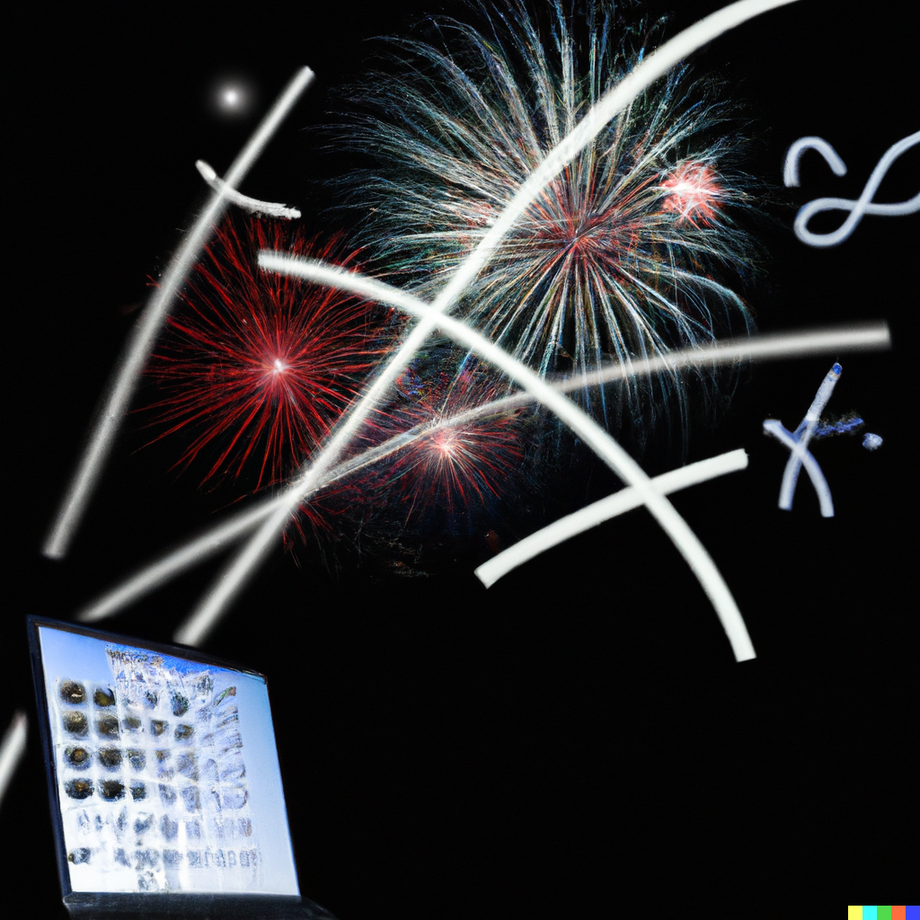
CS151
Complexity Theory
Lecture 18
June 1, 2023

Slide 2
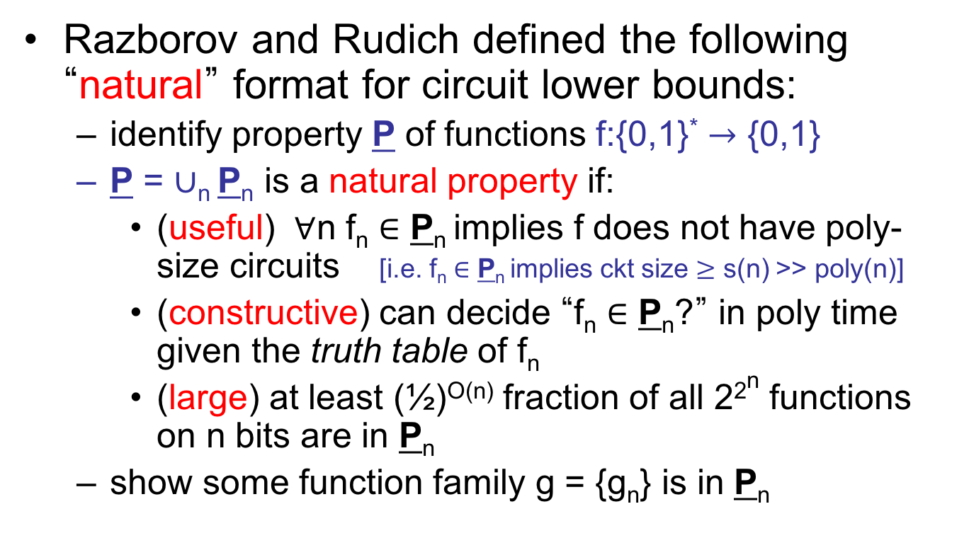
Natural Proofs
Razborov and Rudich defined the following “natural” format for circuit lower bounds:
  identify property P of functions f:{0,1}* $→$ {0,1}
  P = $∪$_{n} P_{n} is a natural property if:
    (useful) $∀$n f_{n} $∈$ P_{n} implies f does not have poly-size circuits [i.e. f_{n} $∈$ P_{n} implies ckt size $≥$ s(n) >> poly(n)]
    (constructive) can decide “f_{n} $∈$ P_{n}?” in poly time given the truth table of f_{n}
    (large) at least (½)^{O(n)} fraction of all 2^{2n} functions on n bits are in P_{n}
  show some function family g = {g_{n}} is in P_{n}

Slide 3
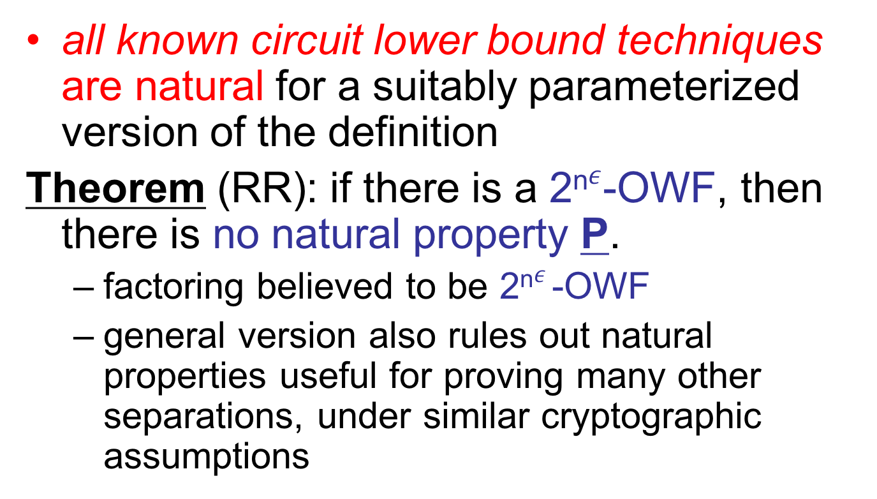
Natural Proofs
all known circuit lower bound techniques are natural for a suitably parameterized version of the definition
Theorem (RR): if there is a 2^{n}$ε$-OWF, then there is no natural property P.
  factoring believed to be 2^{n}$ε$-OWF
  general version also rules out natural properties useful for proving many other separations, under similar cryptographic assumptions

Slide 4
Natural Proofs
Proof:
  main idea: natural property P_{n} can efficiently distinguish
  pseudorandom functions
  from
  truly random functions
  but cryptographic assumption implies existence of pseudorandom functions for which this is impossible

Slide 5
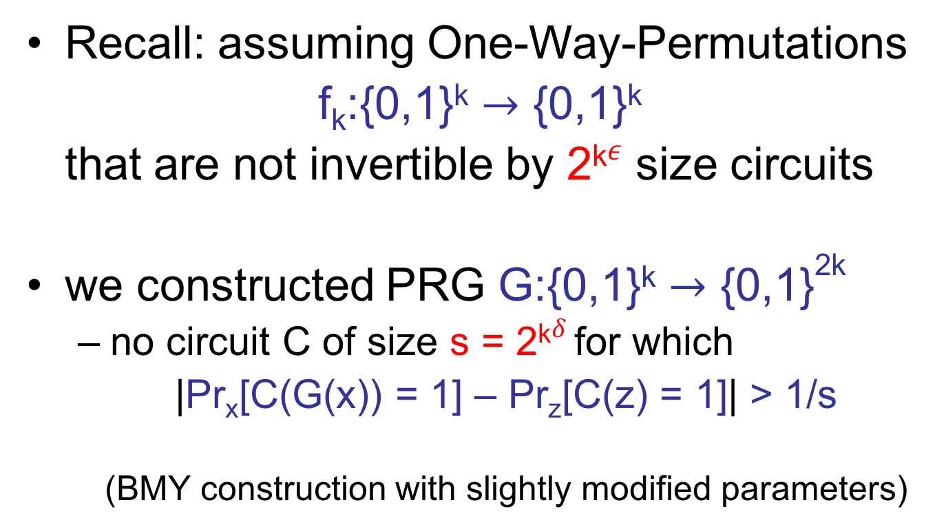
Proof (continued)
Recall: assuming One-Way-Permutations
f_{k}:{0,1}^{k} $→$ {0,1}^{k}
that are not invertible by 2^{k}$ε$ size circuits
we constructed PRG G:{0,1}^{k} $→$ {0,1}^{2k}
  no circuit C of size s = 2^{k}$δ$ for which
  |Pr_{x}[C(G(x)) = 1] – Pr_{z}[C(z) = 1]| > 1/s
  (BMY construction with slightly modified parameters)

Slide 6

Proof (continued)
Think of G as G:{0,1}^{k} $→${0,1}^{k} $×$ {0,1}^{k}
G(x) = (y₁, y₂)
Graphically:
x
G
y₁
y₂

Slide 7

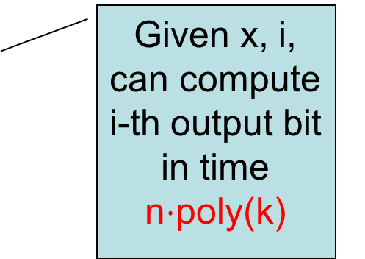
Proof (continued)
Given x, i, can compute i-th output bit in time n$⋅$poly(k)
A function F:{0,1}^{k} $→$ {0,1}^{2n}
  (set n = k$α$)
x
height n-log k
G
G
G
each x, defines a poly-time computable function f_{x}
G
G
G
G
G
G
G
G
G
G
G
G

Slide 8
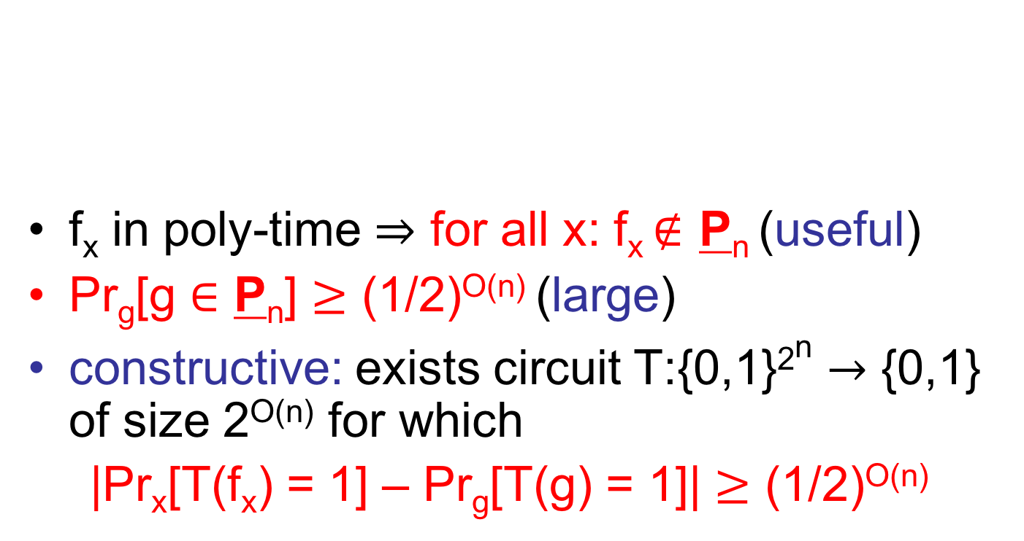
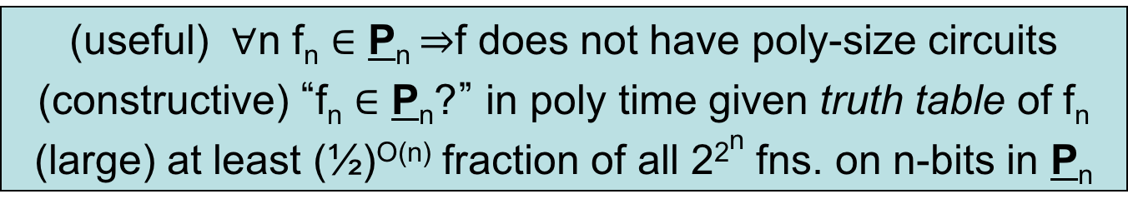
Proof (continued)
(useful) $∀$n f_{n} $∈$ P_{n} $⇒$f does not have poly-size circuits
(constructive) “f_{n} $∈$ P_{n}?” in poly time given truth table of f_{n}
(large) at least (½)^{O(n)} fraction of all 2^{2n} fns. on n-bits in P_{n}
f_{x} in poly-time $⇒$ for all x: f_{x} $∉$ P_{n} (useful)
Pr_{g}[g $∈$ P_{n}] $≥$ (1/2)^{O(n)} (large)
constructive: exists circuit T:{0,1}^{2n} $→$ {0,1} of size 2^{O(n)} for which
|Pr_{x}[T(f_{x}) = 1] – Pr_{g}[T(g) = 1]| $≥$ (1/2)^{O(n)}

Slide 9

Proof (continued)
|Pr_{x}[T(f_{x}) = 1] – Pr_{g}[T(g) = 1]| $≥$ (1/2)^{O(n)}
distribution D₀: pick roots of red subtrees independently from {0,1}^{k}
x
G
G
G
G
G
G
G
G
G
G
G
G
G
G
G
…

Slide 10
Proof (continued)
|Pr_{x}[T(f_{x}) = 1] – Pr_{g}[T(g) = 1]| $≥$ (1/2)^{O(n)}
distribution D₁: pick roots of red subtrees independently from {0,1}^{k}
x
G
G
G
G
G
G
G
G
G
G
G
G
G
G
G
…

Slide 11
Proof (continued)
|Pr_{x}[T(f_{x}) = 1] – Pr_{g}[T(g) = 1]| $≥$ (1/2)^{O(n)}
distribution D₂: pick roots of red subtrees independently from {0,1}^{k}
x
G
G
G
G
G
G
G
G
G
G
G
G
G
G
G
…

Slide 12
Proof (continued)
|Pr_{x}[T(f_{x}) = 1] – Pr_{g}[T(g) = 1]| $≥$ (1/2)^{O(n)}
distribution D₃: pick roots of red subtrees independently from {0,1}^{k}
x
G
G
G
G
G
G
G
G
G
G
G
G
G
G
G
…

Slide 13
Proof (continued)
|Pr_{x}[T(f_{x}) = 1] – Pr_{g}[T(g) = 1]| $≥$ (1/2)^{O(n)}
distribution D₄: pick roots of red subtrees independently from {0,1}^{k}
x
G
G
G
G
G
G
G
G
G
G
G
G
G
G
G
…

Slide 14
Proof (continued)
|Pr_{x}[T(f_{x}) = 1] – Pr_{g}[T(g) = 1]| $≥$ (1/2)^{O(n)}
distribution D₅: pick roots of red subtrees independently from {0,1}^{k}
x
G
G
G
G
G
G
G
G
G
G
G
G
G
G
G
…

Slide 15
Proof (continued)
|Pr_{x}[T(f_{x}) = 1] – Pr_{g}[T(g) = 1]| $≥$ (1/2)^{O(n)}
distribution D₆: pick roots of red subtrees independently from {0,1}^{k}
x
G
G
G
G
G
G
G
G
G
G
G
G
G
G
G
…

Slide 16
Proof (continued)
|Pr_{x}[T(f_{x}) = 1] – Pr_{g}[T(g) = 1]| $≥$ (1/2)^{O(n)}
distribution D₇: pick roots of red subtrees independently from {0,1}^{k}
x
G
G
G
G
G
G
G
G
G
G
G
G
G
G
G
…

Slide 17
Proof (continued)
|Pr_{x}[T(f_{x}) = 1] – Pr_{g}[T(g) = 1]| $≥$ (1/2)^{O(n)}
distribution D₂n_{/k-1}: pick roots of red subtrees independently from {0,1}^{k}
x
G
G
G
G
G
G
G
G
G
G
G
G
G
G
G
…

Slide 18

Proof (continued)
  For some i:
  |Pr[T(D_{i}) = 1] - Pr[T(D_{i-1}) = 1]| $≥$ (1/2)^{O(n)}/2^{n} = (1/2)^{O(n)}
x
G
G
G
G
G
G
G
G
G
G
G
G
G
G
G
…

Slide 19
Proof (continued)
  For some i:
  |Pr[T(D_{i}) = 1] - Pr[T(D_{i-1}) = 1]| $≥$ (1/2)^{O(n)}/2^{n} = (1/2)^{O(n)}
x
fix values at roots of all other subtrees to preserve difference
G
G
G
G
G
G
G
G
G
G
G
G
G
G
G
…

Slide 20

Proof (continued)
  For some i:
  |Pr[T( D_{i}’ ) = 1] - Pr[T( D_{i-1}’ ) = 1]| $≥$ (1/2)^{O(n)}/2^{n} = (1/2)^{O(n)}
x
D_{i}’: distribution D_{i} after fixing
G
G
G
G
G
G
G
G
G
G
G
G
G
G
G
…

Slide 21
Proof (continued)
  For some i:
  |Pr[T( D_{i}’ ) = 1] - Pr[T( D_{i-1}’ ) = 1]| $≥$ (1/2)^{O(n)}/2^{n} = (1/2)^{O(n)}
x
D_{i-1}’: distribution D_{i-1} after fixing
G
G
G
G
G
G
G
G
G
G
G
G
G
G
G
…

Slide 22

Proof (continued)
  |Pr[T( D_{i}’ ) = 1] - Pr[T( D_{i-1}’ ) = 1]| $≥$ (1/2)^{O(n)}/2^{n} = (1/2)^{O(n)}
  C(y₁,y₂)=T( )
  |Pr_{x}[C(G(x)) = 1] - Pr_{y1, y2}[C(y₁, y₂) = 1]| $≥$(1/2)^{O(n)}
y₁
y₂
G
G
G
G
G
G
G
G
G
G
G
G
☹
T( D_{i}’ )
T( D_{i-1}’ )

Slide 23
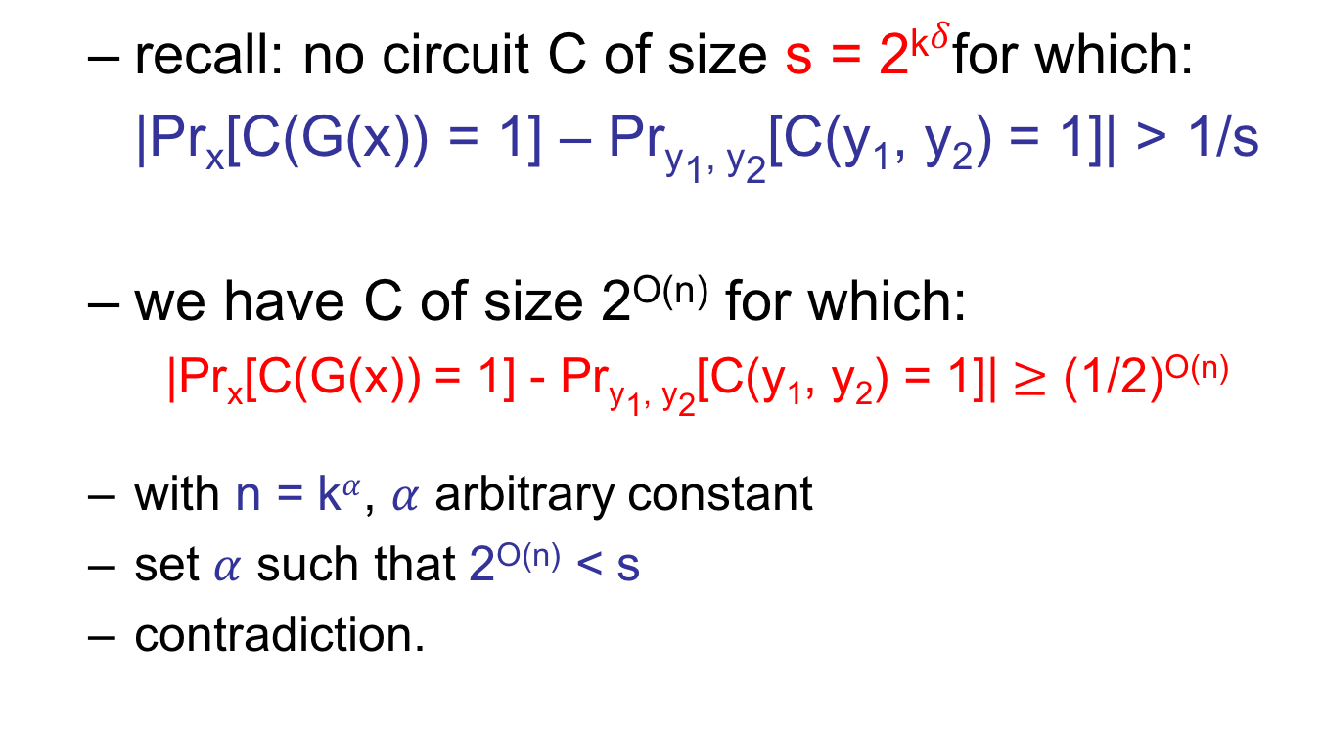
Proof (continued)
  recall: no circuit C of size s = 2^{k}$δ$for which:
  |Pr_{x}[C(G(x)) = 1] – Pr_{y1, y2}[C(y₁, y₂) = 1]| > 1/s
  we have C of size 2^{O(n)} for which:
  |Pr_{x}[C(G(x)) = 1] - Pr_{y1, y2}[C(y₁, y₂) = 1]| $≥$ (1/2)^{O(n)}
  with n = k$α$, $α$ arbitrary constant
  set $α$ such that 2^{O(n)} < s
  contradiction.

Slide 24
Natural Proofs
To prove circuit lower bounds, we must either:
  Violate largeness: seize upon an incredibly specific feature of hard functions (one not possessed by a random function ! )
  Violate constructivity: identify a feature of hard functions that cannot be computed efficiently from the truth table
no “non-natural property” known for all but the very weakest models…

Slide 25
“We do not conclude that researchers should give up on proving serious lower bounds. Quite the contrary, by classifying a large number of techniques that are unable to do the job, we hope to focus research in a more fruitful direction. Pessimism will only be warranted if a long period of time passes without the discovery of a non-naturalizing lower bound proof.”
Rudich and Razborov
1994

Slide 26
“We do not conclude that researchers should give up on proving serious lower bounds. Quite the contrary, by classifying a large number of techniques that are unable to do the job, we hope to focus research in a more fruitful direction. Pessimism will only be warranted if a long period of time passes without the discovery of a non-naturalizing lower bound proof.”
Rudich and Razborov
1994

Slide 27
“We do not conclude that researchers should give up on proving serious lower bounds. Quite the contrary, by classifying a large number of techniques that are unable to do the job, we hope to focus research in a more fruitful direction. Pessimism will only be warranted if a long period of time passes without the discovery of a non-naturalizing lower bound proof.”
Rudich and Razborov
1994

Slide 28
Moral
To resolve central questions:
  avoid relativizing arguments
    use PCP theorem and related results
    focus on circuits, etc…
  avoid constructive arguments
  avoid arguments that yield lower bounds for random functions

Slide 29
Course
Summary

Slide 30
Course summary
Time and space
  hierarchy theorems
  FVAL in L
  CVAL P-complete
  QSAT PSPACE-complete
  succinct CVAL EXP-complete

Slide 31
Course summary
Non-determinism
  NTIME hierarchy theorem
  “NP-intermediate” problems (Ladner’s Theorem)
  unary languages (likely) not NP-complete
  Savitch’s Theorem
  Immerman-Szelepcsényi Theorem
  Problem sets:
  sparse languages (likely) not NP-complete

Slide 32
Course summary
Non-uniformity
  formula lower bound (Andreev, Hastad)
  monotone circuit lower bound (Razborov)
  Problem sets:
  Barrington’s Theorem
  formula lower bound for parity

Slide 33
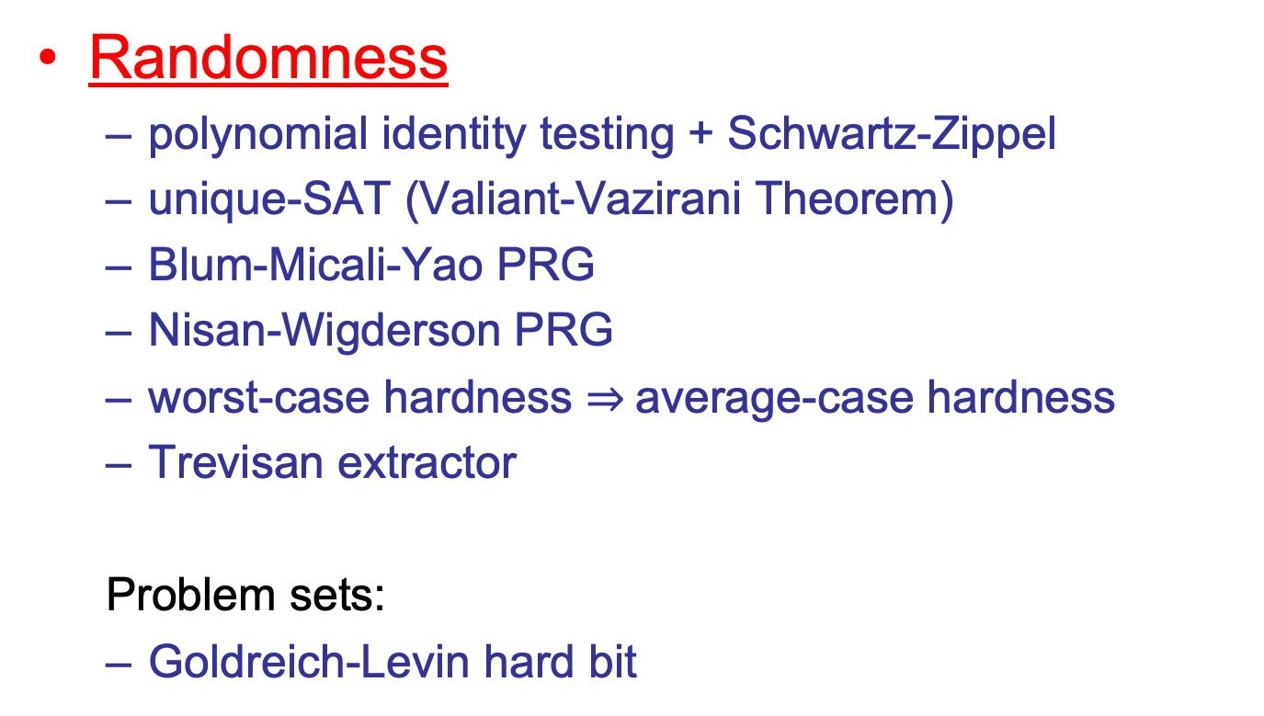
Course summary
Randomness
  polynomial identity testing + Schwartz-Zippel
  unique-SAT (Valiant-Vazirani Theorem)
  Blum-Micali-Yao PRG
  Nisan-Wigderson PRG
  worst-case hardness $⇒$average-case hardness
  Trevisan extractor
  Problem sets:
  Goldreich-Levin hard bit

Slide 34
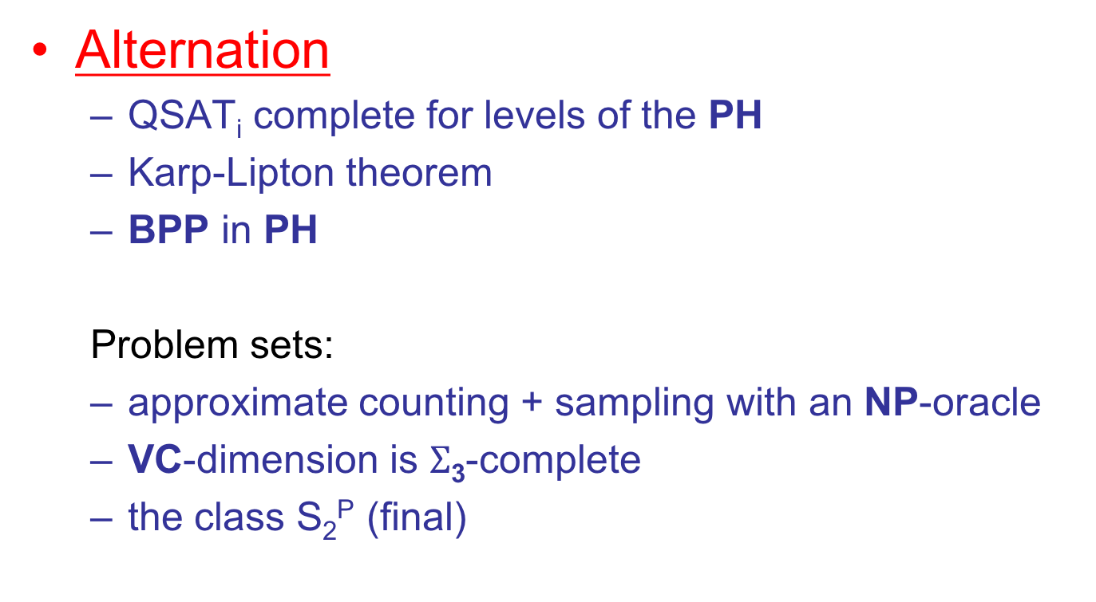
Course summary
Alternation
  QSAT_{i} complete for levels of the PH
  Karp-Lipton theorem
  BPP in PH
  Problem sets:
  approximate counting + sampling with an NP-oracle
  VC-dimension is $Σ$₃-complete
  the class S₂^{P} (final)

Slide 35
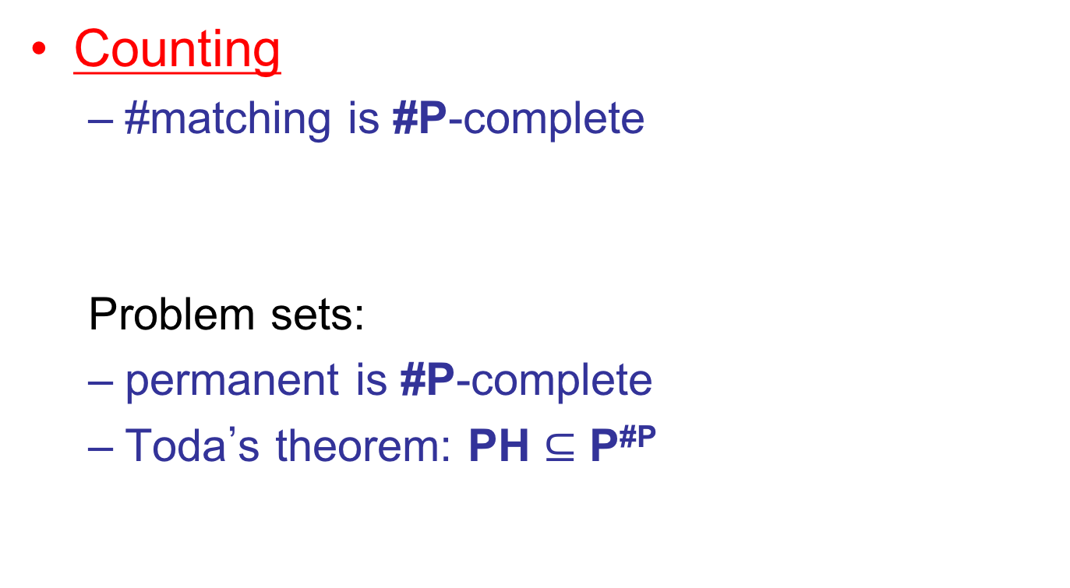
Course summary
Counting
  #matching is #P-complete
  Problem sets:
  permanent is #P-complete
  Toda’s theorem: PH $⊆$ P^{#P}

Slide 36
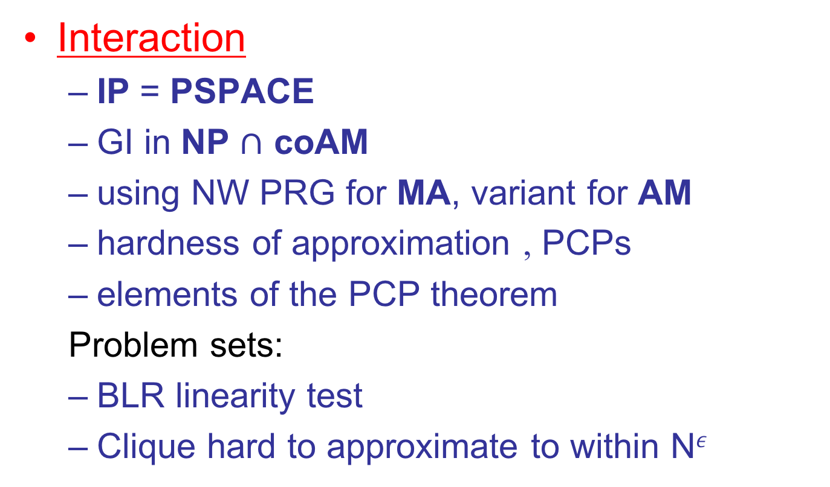
Course summary
Interaction
  IP = PSPACE
  GI in NP $∩$ coAM
  using NW PRG for MA, variant for AM
  hardness of approximation , PCPs
  elements of the PCP theorem
  Problem sets:
  BLR linearity test
  Clique hard to approximate to within N$ε$

Slide 37
Course summary
Barriers to progress
  oracles rule out relativizing proofs
  “natural proofs” rule out many circuit lower bound techniques

Slide 38
Course summary
Time and space L, P, PSPACE, EXP
Non-determinism NL, NP, coNP, NEXP
Non-uniformity NC, P/poly
Randomness RL, ZPP, RP, coRP, BPP
Alternation PH, PSPACE
Counting #P
Interaction IP, MA, AM, PCP[log n, 1]

Slide 39
The big picture
All classes on previous slide are probably distinct, except:
  P, ZPP, RP, coRP, BPP (probably all equal)
  L, RL (probably all equal; NL?)
  NP, MA, AM (probably all equal)
  IP = PSPACE
  PCP[log n, 1] = NP
Only real separations we know separate classes delimiting same resource:
  e.g. L ≠ PSPACE, NP ≠ NEXP

Slide 40
The big picture
Remember:
possible explanation for failure to prove conjectured separations…
…is that they are false

Slide 41
The big picture
Important techniques/ideas:
  simulation and diagonalization
  reductions and completeness
  self-reducibility
  encoding information using low-degree polynomials
  randomness
  others…

Slide 42
The big picture
I hope you take away:
  an ability to extract the essential features of a problem that make it hard/easy…
  knowledge and tools to connect computational problems you encounter with larger questions in complexity
  background needed to understand current research in this area

Slide 43
The big picture
  background to contribute to current research in this area
    many open problems
    young field
    try your hand…

