Slide 1
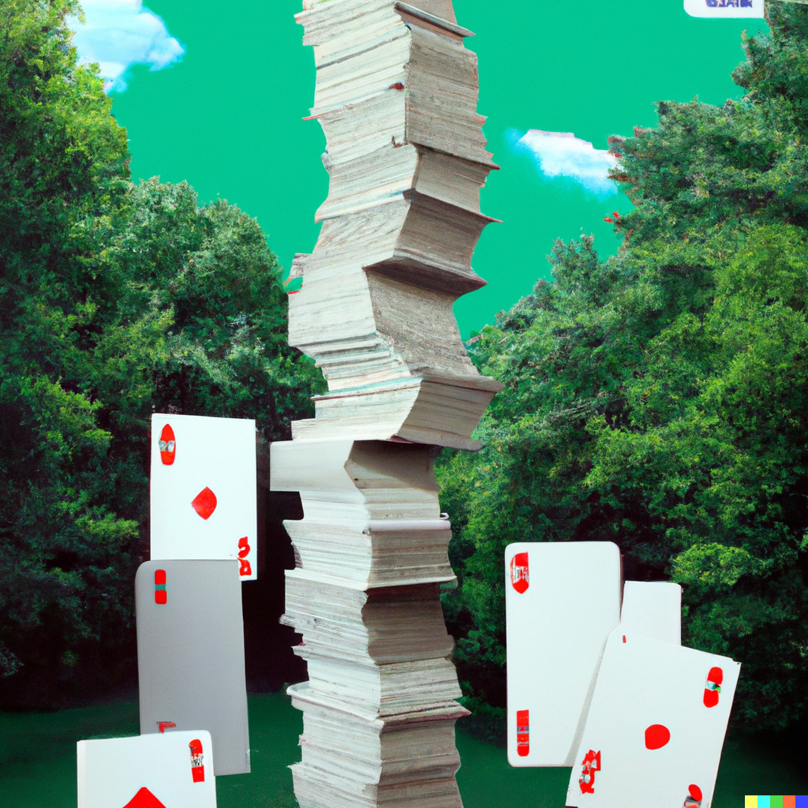
CS151 Complexity Theory
Lecture 13
May 16, 2023

Slide 2
Karp-Lipton
we know that P = NP implies SAT has polynomial-size circuits.
(showing SAT does not have poly-size circuits is one route to proving P ≠ NP)
suppose SAT has poly-size circuits
any consequences?
might hope: SAT $∈$P/poly $⇒$ PH collapses to P, same as if SAT $∈$ P

Slide 3
Karp-Lipton
Theorem (KL): if SAT has poly-size circuits then PH collapses to the second level.
Proof:
suffices to show Π₂ $⊆$ Σ₂
L $∈$ Π₂ implies L expressible as:
L = { x : $∀$y $∃$z (x, y, z) $∈$ R}
with R $∈$ P.

Slide 4
Karp-Lipton
L = { x : $∀$y $∃$z (x, y, z) $∈$ R}
given (x, y), “$∃$z (x, y, z) $∈$ R?” is in NP
pretend C solves SAT, use self-reducibility
Claim: if SAT $∈$ P/poly, then L =
{ x : $∃$C $∀$y
[use C repeatedly to find some z for which (x, y, z) $∈$ R; accept iff
(x, y, z) $∈$ R] }
poly time

Slide 5
Karp-Lipton
L = { x : $∀$y $∃$z (x, y, z) $∈$ R}
{x : $∃$C $∀$y [use C repeatedly to find some z for which (x,y,z) $∈$ R; accept iff (x,y,z) $∈$ R] }
x $∈$ L:
some C decides SAT $⇒$ $∃$C $∀$y […] accepts
x $∉$ L:
$∃$y $∀$z (x, y, z) $∉$ R $⇒$ $∀$C $∃$y […] rejects

Slide 6
BPP $⊆$ PH
Recall: don’t know BPP different from EXP
Theorem (S,L,GZ): BPP$⊆$ (Π₂$∩$Σ₂)
don’t know Π₂$∩$Σ₂ different from EXP but believe much weaker

Slide 7
BPP $⊆$ PH
Proof:
BPP language L: p.p.t. TM M:
x $∈$ L $⇒$ Pr_{y}[M(x,y) accepts] ≥ 2/3
x $∉$ L $⇒$ Pr_{y}[M(x,y) rejects] ≥ 2/3
strong error reduction: p.p.t. TM M’
use n random bits (|y’| = n)
# strings y’ for which M’(x, y’) incorrect is at most 2^{n/3}
(can’t achieve with naïve amplification)

Slide 8
BPP $⊆$ PH
so many ones, some disk is all ones
so few ones, not enough for whole disk
view y’ = (w, z), each of length n/2
consider output of M’(x, (w, z)):
w = 000…00 000…01 000…10 … 111…11
x$∈$L
1
1
1
1
1
1
0
0
1
0
1
1
1
1
1
1
…
0
1
1
1
1
1
0
1
0
1
1
0
1
0
1
1
1
1
1
1
1
1
0
0
1
1
0
1
0
1
1
1
1
1
1
1
1
1
1
1
1
0
1
0
1
1
0
1
x$∉$L
0
0
0
0
0
0
0
0
1
0
0
0
0
0
0
0
…
0
0
0
0
0
0
0
0
0
0
0
0
0
0
0
1
1
0
0
0
1
1
0
0
1
0
0
0
0
0
0
0
0
0
0
0
0
0
0
0
0
0
0
0
0
0
0
0

Slide 9
BPP $⊆$ PH
proof (continued):
strong error reduction: # bad y’ < 2^{n/3}
y’ = (w, z) with |w| = |z| = n/2
Claim: L = {x : $∃$w $∀$z M’(x, (w, z)) = 1 }
x$∈$L: suppose $∀$w$∃$z M’(x, (w, z)) = 0
implies $≥$ 2^{n/2} 0’s; contradiction
x$∉$L: suppose $∃$w$∀$z M’(x, (w, z)) = 1
implies $≥$2^{n/2} 1’s; contradiction

Slide 10
BPP $⊆$ PH
given BPP language L: p.p.t. TM M:
x $∈$ L $⇒$ Pr_{y}[M(x,y) accepts] ≥ 2/3
x $∉$ L $⇒$ Pr_{y}[M(x,y) rejects] ≥ 2/3
showed L = {x : $∃$w $∀$z M’(x, (w, z)) = 1}
thus BPP $⊆$ Σ₂
BPP closed under complement $⇒$ BPP $⊆$ Π₂
conclude: BPP$⊆$ (Π₂$∩$Σ₂)

Slide 11
New Topic
The complexity of
counting

Slide 12
Counting problems
So far, we have ignored function problems
given x, compute f(x)
important class of function problems:
counting problems
e.g. given 3-CNF φ how many satisfying assignments are there?

Slide 13
Counting problems
#P is the class of function problems expressible as:
input x f(x) = |{y : (x, y) $∈$ R}|
where R $∈$ P.
compare to NP (decision problem)
input x f(x) = $∃$y : (x, y) $∈$ R ?
where R $∈$ P.

Slide 14
Counting problems
examples
#SAT: given 3-CNF φ how many satisfying assignments are there?
#CLIQUE: given (G, k) how many cliques of size at least k are there?

Slide 15
Reductions
Reduction from function problem f₁ to function problem f₂
two efficiently computable functions Q, A
x
(prob. 1)
Q
y
(prob. 2)
f₁
f₂
A
f₁(x)
f₂(y)

Slide 16
Reductions
problem f is #P-complete if
f is in #P
every problem in #P reduces to f
“parsimonious reduction”: A is identity
many standard NP-completeness reductions are parsimonious
therefore: if #SAT is #P-complete we get lots of #P-complete problems
x
(prob. 1)
Q
y
(prob. 2)
f₁
f₂
A
f₁(x)
f₂(y)

Slide 17
#SAT
#SAT: given 3-CNF φ how many satisfying assignments are there?
Theorem: #SAT is #P-complete.
Proof:
clearly in #P: (φ, A) $∈$ R $⇔$A satisfies φ
take any f $∈$ #P defined by R $∈$ P

Slide 18
#SAT
…x… …y…
f(x) =
|{y : (x, y) $∈$ R}|
C
CVAL reduction for R
1 iff (x, y) $∈$ R
add new variables z, produce φ such that
$∃$z φ(x, y, z) = 1 $⇔$ C(x, y) = 1
for (x, y) such that C(x, y) = 1 this z is unique
hardwire x
# satisfying assignments = |{y : (x, y) $∈$ R}|

Slide 19
Relationship to other classes
To compare to classes of decision problems, usually consider
P^{#P}
which is a decision class…
easy: NP, coNP $⊆$ P^{#P}
easy: P^{#P} $⊆$ PSPACE
Toda’s Theorem (homework): PH $⊆$ P^{#P}.

Slide 20
Relationship to other classes
Question: is #P hard because it entails finding NP witnesses?
…or is counting difficult by itself?

Slide 21
Bipartite Matchings
Definition:
G = (U, V, E) bipartite graph with |U| = |V|
a perfect matching in G is a subset M $⊆$ E that touches every node, and no two edges in M share an endpoint

Slide 22
Bipartite Matchings
Definition:
G = (U, V, E) bipartite graph with |U| = |V|
a perfect matching in G is a subset M $⊆$ E that touches every node, and no two edges in M share an endpoint

Slide 23
Bipartite Matchings
#MATCHING: given a bipartite graph G = (U, V, E) how many perfect matchings does it have?
Theorem: #MATCHING is #P-complete.
But… can find a perfect matching in polynomial time!
counting itself must be difficult

Slide 24
Cycle Covers
Claim: 1-1 correspondence between cycle covers in G’ and perfect matchings in G
#MATCHING and #CYCLE-COVER parsimoniously reducible to each other
2
1
2
3
4
5
3
1
4
1
2
3
4
5
5
G = (U, V, E)
G’ = (V, E’)

Slide 25
Cycle Covers
cycle cover: collection of node-disjoint directed cycles that touch every node
#CYCLE-COVER: given directed graph G = (V, E) how many cycle covers does it have?
Theorem: #CYCLE-COVER is #P-complete.
implies #MATCHING is #P-complete

Slide 26
Cycle Cover is #P-complete
variable gadget: every cycle cover includes left cycle or right cycle
x_{i}
$¬$x_{i}
clause gadget: cycle cover cannot use all three outer edges
and each of 7 ways to exclude at least one gives exactly 1 cover using those external edges

Slide 27
Cycle Cover is #P-complete

Slide 28
Cycle Cover is #P-complete

Slide 29
Cycle Cover is #P-complete
clause gadget corresponding to (A$∨$B$∨$C) has “xor” gadget between outer 3 edges and A, B, C
$¬$A
B
$¬$B
u
v
A
xor
v’
u’
xor gadget ensures that exactly one of two edges can be in cover
C
$¬$C

Slide 30
Cycle Cover is #P-complete
Proof outline (reduce from #SAT)
($¬$x₁$∨$x₂$∨¬$x₃)$∧$($¬$x₃$∨$x₁)$∧$ … $∧$(x₃$∨¬$x₂)
xor gadgets (exactly 1 of two edges is in cover)
. . .
clause gadgets
x₁
$¬$x₁
x₂
$¬$x₂
x₃
$¬$x₃
N.B. must avoid reducing SAT to MATCHING!
variable gadgets

Slide 31
Cycle Cover is #P-complete
Introduce edge weights
cycle cover weight is product of weights of its edges
“implement” xor gadget by
weight of cycle cover that “obeys” xor multiplied by 4 (mod N)
weight of cycle cover that “violates” xor multiplied by N
large integer

Slide 32
Cycle Cover is #P-complete
N-1
Weighted xor gadget:
weight of cycle cover that “obeys” xor multiplied by 4 (mod N)
weight of cycle cover that “violates” xor multiplied by N
u
v
u
v
xor
N-1
v’
u’
v’
2
u’
N-1
3
(unlabeled weights are 1)

Slide 33
Cycle Cover is #P-complete
Simulating positive edge weights
need to handle 2, 3, 4, 5, …, N-1
2
2^{k}
k times
3

Slide 34
Cycle Cover is #P-complete
($¬$x₁$∨$x₂$∨¬$x₃)$∧$($¬$x₃$∨$x₁)$∧$ … $∧$(x₃$∨¬$x₂)
m = # xor gadgets; n = # variables; N > 4^{m}2^{n}
# covers (mod N) = (4^{m})$⋅$(#sat. assignments)
xor gadget (exactly 1 of two edges is in cover)
. . .
clause gadget
variable gadgets:
x₁
$¬$x₁
x₂
$¬$x₂
x₃
$¬$x₃

Slide 35
New Topic
proof systems
interactive proofs and their power
Arthur-Merlin games

Slide 36
Proof systems
L = { (A, 1^{k}) : A is a true mathematical assertion with a proof of length k}
What is a “proof”?
complexity insight: meaningless unless can be efficiently verified

Slide 37
Proof systems
given language L, goal is to prove x $∈$ L
proof system for L is a verification algorithm V
completeness: x $∈$ L $⇒$ $∃$ proof, V accepts (x, proof)
“true assertions have proofs”
soundness: x $∉$ L $⇒$ $∀$ proof*, V rejects (x, proof*)
“false assertions have no proofs”
efficiency: $∀$ x, proof: V(x, proof) runs in polynomial time in |x|

Slide 38
Classical Proofs
previous definition:
“classical” proof system
recall:
L $∈$ NP iff expressible as
L = { x | $∃$y, |y| < |x|^{k}, (x, y) $∈$ R } and R $∈$ P.
NP is the set of languages with classical proof systems (R is the verifier)

Slide 39
Interactive Proofs
Two new ingredients:
randomness: verifier tosses coins, errs with some small probability
interaction: rather than “reading” proof, verifier interacts with computationally unbounded prover
NP proof systems lie in this framework: prover sends proof, verifier does not use randomness

Slide 40
Interactive Proofs
interactive proof system for L is an interactive protocol (P, V)
common input: x
Prover
Verifier
. . .
# rounds = poly(|x|)
accept/reject

Slide 41
Interactive Proofs
interactive proof system for L is an interactive protocol (P, V)
completeness: x $∈$ L $⇒$
Pr[V accepts in (P, V)(x)] $≥$ 2/3
soundness: x $∉$ L $⇒$ $∀$ P*
Pr[V accepts in (P*, V)(x)] $≤$ 1/3
efficiency: V is p.p.t. machine
repetition: can reduce error to any ε

Slide 42
Interactive Proofs
IP = {L : L has an interactive proof system}
Observations/questions:
philosophically interesting: captures more broadly what it means to be convinced a statement is true
clearly NP $⊆$ IP. Potentially larger. How much larger?
if larger, randomness is essential (why?)

