Slide 1

CS151
Complexity Theory
Lecture 12
May 11, 2023

Slide 2
RL
Recall: probabilistic Turing Machine
  deterministic TM with extra tape for “coin flips”
RL (Random Logspace)
  L $∈$ RL if there is a probabilistic logspace TM M:
  x $∈$ L $⇒$ Pr_{y}[M(x,y) accepts] ≥ ½
  x $∉$ L $⇒$ Pr_{y}[M(x,y) rejects] = 1
  important detail #1: only allow one-way access to coin-flip tape
  important detail #2: explicitly require to run in polynomial time

Slide 3
RL
L $⊆$ RL $⊆$ NL $⊆$ SPACE(log² n)
Theorem (SZ) : RL $⊆$ SPACE(log^{3/2} n)
Belief: L = RL (major open problem)

Slide 4
RL
L $⊆$ RL $⊆$ NL
Natural problem:
  Undirected STCONN: given an undirected graph G = (V, E), nodes s, t, is there a path from s $→$ t?
Theorem: USTCONN $∈$ RL.
  (Recall: STCONN is NL-complete)

Slide 5
Undirected STCONN
Proof sketch: (in Papadimitriou)
  add self-loop to each vertex (technical reasons)
  start at s, random walk 2|V||E| steps, accept if see t
  Lemma: expected return time for any node i is 2|E|/d_{i}
  suppose s=v₁, v₂, …, v_{n}=t is a path
  expected time from v_{i} to v_{i+1} is (d_{i}/2)(2|E|/d_{i}) = |E|
  expected time to reach v_{n} ≤ |V||E|
  Pr[fail reach t in 2|V||E| steps] ≤ ½
Reingold 2005: USTCONN $∈$ L

Slide 7
A motivating question
Central problem in logic synthesis:
Complexity of this problem?
  NP-hard? in NP? in coNP? in PSPACE?
  complete for any of these classes?
$$∧$$
given Boolean circuit C, integer k
is there a circuit C’ of size at most k that computes the same function C does?
$$∨$$
$$∧$$
$$∧$$
$$∨$$
$$¬$$
x₁
x₂
x₃
…
x_{n}

Slide 8
Oracle Turing Machines
Oracle Turing Machine (OTM):
  multitape TM M with special “query” tape
  special states q?, q_{yes}, q_{no}
  on input x, with oracle language A
  M^{A} runs as usual, except…
  when M^{A} enters state q?:
    y = contents of query tape
    y $∈$ A $⇒$ transition to q_{yes}
    y $∉$ A $⇒$ transition to q_{no}

Slide 9
Oracle Turing Machines
Nondeterministic OTM
  defined in the same way
  (transition relation, rather than function)
oracle is like a subroutine, or function in your favorite programming language
  but each call counts as single step
  e.g.: given φ₁, φ₂, …, φ_{n} are even # satisfiable?
  poly-time OTM solves with SAT oracle

Slide 10
Oracle Turing Machines
Shorthand #1:
applying oracles to entire complexity classes:
  complexity class C
  language A
  C^{A} = {L decided by OTM M with oracle A with M “in” C}
  example: P^{SAT}

Slide 11
Oracle Turing Machines
Shorthand #2:
using complexity classes as oracles:
  OTM M
  complexity class C
  M^{C} decides language L if for some language A $∈$ C, M^{A} decides L
Both together: C^{D} = languages decided by OTM “in” C with oracle language from D
exercise: show P^{SAT} = P^{NP}

Slide 12
The Polynomial-Time Hierarchy
can define lots of complexity classes using oracles
the classes on the next slide stand out
  they have natural complete problems
  they have a natural interpretation in terms of alternating quantifiers
  they help us state certain consequences and containments (more later)

Slide 13
The Polynomial-Time Hierarchy
Σ₀ = Π₀ = P
Δ₁=P^{P} Σ₁=NP Π₁=coNP
Δ₂=P^{NP} Σ₂=NP^{NP} Π₂=coNP^{NP}
Δ_{i+1}=P^{Σi} Σ_{i+i}=NP^{Σi} Π_{i+1}=coNP^{Σi}
Polynomial Hierarchy PH = $∪$_{i} Σ_{i}

Slide 14
The Polynomial-Time Hierarchy
Σ₀ = Π₀ = P
Δ_{i+1}=P^{Σi} Σ_{i+i}=NP^{Σi} Π_{i+1}=coNP^{Σi}
Example:
  MIN CIRCUIT: given Boolean circuit C, integer k; is there a circuit C’ of size at most k that computes the same function C does?
  MIN CIRCUIT $∈$ Σ₂

Slide 15
The Polynomial-Time Hierarchy
Σ₀ = Π₀ = P
Δ_{i+1}=P^{Σi} Σ_{i+i}=NP^{Σi} Π_{i+1}=coNP^{Σi}
Example:
  EXACT TSP: given a weighted graph G, and an integer k; is the k-th bit of the length of the shortest TSP tour in G a 1?
  EXACT TSP $∈$ Δ₂

Slide 16
The PH
EXP
PSPACE
PSPACE: generalized geography, 2-person games…
3rd level: V-C dimension…
2nd level: MIN CIRCUIT, BPP…
1st level: SAT, UNSAT, factoring, etc…
PH
Σ₃
Π₃
Δ₃
Σ₂
Π₂
Δ₂
NP
coNP
P

Slide 17
Useful characterization
Recall: L $∈$ NP iff expressible as
L = { x | $∃$ y, |y| ≤ |x|^{k}, (x, y) $∈$ R }
where R $∈$ P.
Corollary: L $∈$ coNP iff expressible as
L = { x | $∀$ y, |y| ≤ |x|^{k}, (x, y) $∈$ R }
where R $∈$ P.

Slide 18
Useful characterization
Theorem: L $∈$ Σ_{i} iff expressible as
L = { x | $∃$ y, |y| ≤ |x|^{k}, (x, y) $∈$ R }
where R $∈$ Π_{i-1}.
Corollary: L $∈$ Π_{i} iff expressible as
L = { x | $∀$ y, |y| ≤ |x|^{k}, (x, y) $∈$ R }
where R $∈$ Σ_{i-1}.

Slide 19
Useful characterization
Theorem: L $∈$ Σ_{i} iff expressible as
L = { x | $∃$ y, |y| ≤ |x|^{k}, (x, y) $∈$ R }, where R $∈$ Π_{i-1}.
Proof of Theorem:
  induction on i
  base case (i =1) on previous slide
  ($⇐$)
  we know Σ_{i} = NP^{Σi-1} = NP^{Πi-1}
  guess y, ask oracle if (x, y) $∈$R

Slide 20
Useful characterization
Theorem: L $∈$ Σ_{i} iff expressible as
L = { x | $∃$ y, |y| ≤ |x|^{k}, (x, y) $∈$ R }, where R $∈$ Π_{i-1}.
  ($⇒$)
  given L $∈$ Σ_{i} = NP^{Σi-1} decided by ONTM M running in time n^{k}
  try: R = { (x, y) : y describes valid path of M’s computation leading to q_{accept} }
  but how to recognize valid computation path when it depends on result of oracle queries?

Slide 21
Useful characterization
Theorem: L $∈$ Σ_{i} iff expressible as
L = { x | $∃$ y, |y| ≤ |x|^{k}, (x, y) $∈$ R }, where R $∈$ Π_{i-1}.
  try: R = { (x, y) : y describes valid path of M’s computation leading to q_{accept} }
  valid path = step-by-step description including correct yes/no answer for each A-oracle query z_{j} (A $∈$ Σ_{i-1})
  verify “no” queries in Π_{i-1}:
  e.g: z₁$∉$A $∧$z₃$∉$A $∧$ … $∧$ z₈$∉$A
  for each “yes” query z_{j}: $∃$ w_{j}, |w_{j}| ≤ |z_{j}|^{k} with (z_{j}, w_{j}) $∈$ R’ for some R’ $∈$ Π_{i-2} by induction.
  for each “yes” query z_{j} put w_{j} in description of path y

Slide 22
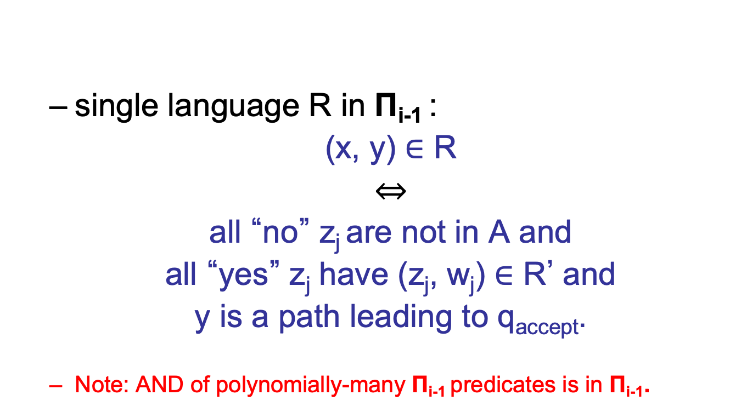
Useful characterization
Theorem: L $∈$ Σ_{i} iff expressible as
L = { x | $∃$ y, |y| ≤ |x|^{k}, (x, y) $∈$ R }, where R $∈$ Π_{i-1}.
  single language R in Π_{i-1} :
  (x, y) $∈$ R
  $⇔$
  all “no” z_{j} are not in A and
  all “yes” z_{j} have (z_{j}, w_{j}) $∈$ R’ and
  y is a path leading to q_{accept}.
  Note: AND of polynomially-many Π_{i-1} predicates is in Π_{i-1}.

Slide 23
Alternating quantifiers
Nicer, more usable version:
L$∈$Σ_{i} iff expressible as
L = { x | $∃$y₁ $∀$y₂ $∃$y₃ …Qy_{i} (x, y₁,y₂,…,y_{i})$∈$R }
where Q= $∀$/$∃$if i even/odd, and R$∈$P
L$∈$Π_{i} iff expressible as
L = { x | $∀$y₁ $∃$y₂ $∀$y₃ …Qy_{i} (x, y₁,y₂,…,y_{i})$∈$R }
where Q=$∃$/$∀$if i even/odd, and R$∈$P

Slide 24
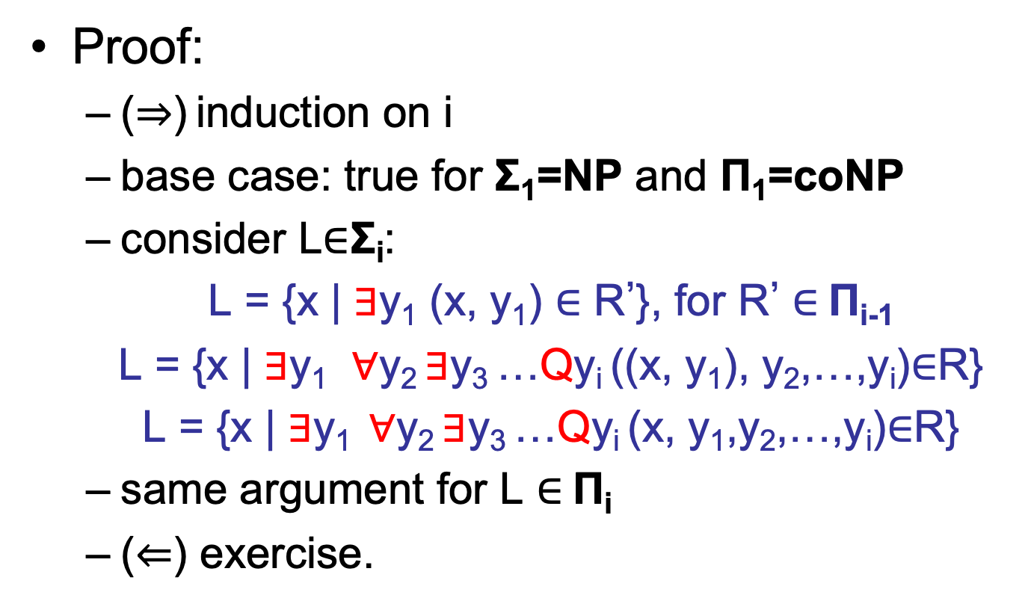
Alternating quantifiers
Proof:
  ($⇒$) induction on i
  base case: true for Σ₁=NP and Π₁=coNP
  consider L$∈$Σ_{i}:
  L = {x | $∃$y₁ (x, y₁) $∈$ R’}, for R’ $∈$Π_{i-1}
  L = {x | $∃$y₁ $∀$y₂ $∃$y₃ …Qy_{i} ((x, y₁), y₂,…,y_{i})$∈$R}
  L = {x | $∃$y₁ $∀$y₂ $∃$y₃ …Qy_{i} (x, y₁,y₂,…,y_{i})$∈$R}
  same argument for L $∈$Π_{i}
  ($⇐$) exercise.

Slide 25
Alternating quantifiers
Pleasing viewpoint:
“$∃∀∃∀∃∀∃$…”
PSPACE
const. # of alternations
Δ₃
poly(n) alternations
PH
“$∃∀$”
Σ₂
“$∀∃$”
Π₂
“$∃∀∃$…”
Σ_{i}
Π_{i}
“$∀∃∀$…”
Δ₂
“$∃∀∃$”
Σ₃
“$∀∃∀$”
Π₃
“$∃$”
NP
“$∀$”
coNP
P

Slide 26
Complete problems
three variants of SAT:
  QSAT_{i} (i odd) =
  {3-CNFs φ(x₁, x₂, …, x_{i}) for which
  $∃$x₁$∀$x₂ $∃$x₃ … $∃$x_{i} φ(x₁, x₂, …, x_{i}) = 1}
  QSAT_{i} (i even) =
  {3-DNFs φ(x₁, x₂, …, x_{i}) for which
  $∃$x₁ $∀$x₂ $∃$x₃ … $∀$x_{i} φ(x₁, x₂, …, x_{i}) = 1}
  QSAT = {3-CNFs φ for which
  $∃$x₁ $∀$x₂ $∃$x₃ … Qx_{n} φ(x₁, x₂, …, x_{n}) = 1}

Slide 27
QSAT_{i} is Σ_{i}-complete
Theorem: QSAT_{i} is Σ_{i}-complete.
Proof: (clearly in Σ_{i})
  assume i odd; given L $∈$ Σ_{i} in form
{ x | $∃$y₁ $∀$y₂ $∃$y₃ … $∃$y_{i} (x, y₁,y₂,…,y_{i}) $∈$ R }
…x… …y₁… …y₂… …y₃… … …y_{i}…
C
CVAL reduction for R
1 iff (x, y₁,y₂,…,y_{i}) $∈$ R

Slide 28
QSAT_{i} is Σ_{i}-complete
…x… …y₁… …y₂… …y₃… … …y_{i}…
C
1 iff (x, y₁,y₂,…,y_{i}) $∈$ R
CVAL reduction for R
  Problem set: can construct 3-CNF φ from C:
  $∃$z φ(x,y₁,…,y_{i}, z) = 1 $⇔$ C(x,y₁,…,y_{i}) = 1
  we get:
  $∃$y₁ $∀$y₂… $∃$y_{i} $∃$z φ(x,y₁,…,y_{i}, z) = 1
  $⇔ ∃$y₁ $∀$y₂… $∃$y_{i} C(x,y₁,…,y_{i}) = 1 $⇔$ x $∈$ L

Slide 29
QSAT_{i} is Σ_{i}-complete
Proof (continued)
  assume i even; given L $∈$ Σ_{i} in form
{ x | $∃$y₁ $∀$y₂ $∃$y₃ … $∀$y_{i} (x, y₁,y₂,…,y_{i}) $∈$ R }
…x… …y₁… …y₂… …y₃… … …y_{i}…
C
CVAL reduction for R
1 iff (x, y₁,y₂,…,y_{i}) $∈$ R

Slide 30
QSAT_{i} is Σ_{i}-complete
…x… …y₁… …y₂… …y₃… … …y_{i}…
C
1 iff (x, y₁,y₂,…,y_{i}) $∈$ R
CVAL reduction for R
  Problem set: can construct 3-DNF φ from C:
  $∀$z φ(x,y₁,…,y_{i}, z) = 1 $⇔$C(x,y₁,…,y_{i}) = 1
  we get:
  $∃$y₁ $∀$y₂… $∀$y_{i} $∀$z φ(x,y₁,y₂,…,y_{i}, z) = 1
  $⇔$ $∃$y₁ $∀$y₂… $∀$y_{i} C(x,y₁,y₂,…,y_{i}) = 1 $⇔$ x $∈$ L

Slide 31
QSAT is PSPACE-complete
Theorem: QSAT is PSPACE-complete.
Proof: $∀$x₁ $∃$x₂ $∀$x₃ … Qx_{n} φ(x₁, x₂, …, x_{n})?
  in PSPACE: $∃$x₁ $∀$x₂ $∃$x₃ … Qx_{n} φ(x₁, x₂, …, x_{n})?
  “$∃$x₁”: for each x₁, recursively solve
  $∀$x₂ $∃$x₃ … Qx_{n} φ(x₁, x₂, …, x_{n})?
    if encounter “yes”, return “yes”
  “$∀$x₁”: for each x₁, recursively solve
  $∃$x₂ $∀$x₃ … Qx_{n} φ(x₁, x₂, …, x_{n})?
    if encounter “no”, return “no”
  base case: evaluating a 3-CNF expression
  poly(n) recursion depth
  poly(n) bits of state at each level

Slide 32
QSAT is PSPACE-complete
  given TM M deciding L $∈$ PSPACE; input x
  2^{nk} possible configurations
  single START configuration
  assume single ACCEPT configuration
  define:
  REACH(X, Y, i) $⇔$ configuration Y reachable from configuration X in at most 2^{i} steps.

Slide 33
QSAT is PSPACE-complete
  REACH(X, Y, i) $⇔$ configuration Y reachable from configuration X in at most 2^{i} steps.
  Goal: produce 3-CNF φ(w₁,w₂,w₃,…,w_{m}) such that
  $∃$w₁ $∀$w₂…Qw_{m} φ(w₁,…,w_{m})
  REACH(START, ACCEPT, n^{k})

Slide 34
QSAT is PSPACE-complete
  for i = 0, 1, … n^{k} produce quantified Boolean expressions ψ_{i}(A, B, W)
  $∃$w₁ $∀$w₂… ψ_{i}(A, B, W) $⇔$ REACH(A, B, i)
  convert ψ_{nk} to 3-CNF φ
    add variables V
    $∃$w₁ $∀$w₂… $∃$V φ(A, B, W, V) $⇔$ REACH(A, B, n^{k})
  hardwire A = START, B = ACCEPT
  $∃$w₁ $∀$w₂… $∃$V φ(W, V) $⇔$ x $∈$ L

Slide 35
QSAT is PSPACE-complete
  ψ_{o}(A, B) = true iff
    A = B or
    A yields B in one step of M
Boolean expression of size O(n^{k})
…
config. A
STEP
STEP
STEP
STEP
config. B
…

Slide 36
QSAT is PSPACE-complete
  Key observation #1:
  REACH(A, B, i+1)
  $⇔$
  $∃$Z [REACH(A, Z, i) $∧$ REACH(Z, B, i)]
  cannot define ψ_{i+1}(A, B) to be
  $∃$Z [ψ_{i}(A, Z) $∧$ψ_{i}(Z, B)]
  (why?)

Slide 37
QSAT is PSPACE-complete
  Key idea #2: use quantifiers
  couldn’t do ψ_{i+1}(A, B) = $∃$Z [ψ_{i}(A, Z)$∧$ψ_{i}(Z, B)]
  define ψ_{i+1}(A, B) to be
  $∃$Z$∀$X$∀$Y [((X=A$∧$Y=Z)$∨$(X=Z$∧$Y=B)) $⇒$ ψ_{i}(X, Y)]
  ψ_{i}(X, Y) is preceded by quantifiers
  move to front (they don’t involve X,Y,Z,A,B)

Slide 38
QSAT is PSPACE-complete
  ψ_{o}(A, B) = true iff A = B or A yields B in 1 step
  ψ_{i+1}(A, B) =
  $∃$Z$∀$X$∀$Y[((X=A$∧$Y=Z)$∨$(X=Z$∧$Y=B)) $⇒$ ψ_{i}(X, Y)]
  |ψ₀| = O(n^{k})
  |ψ_{i+1}| = O(n^{k}) + |ψ_{i}|
  total size of ψ_{nk} is O(n^{k})² = poly(n)
  logspace reduction

Slide 39
PH collapse
PH
Σ₃
Π₃
Δ₃
Theorem: if Σ_{i} = Π_{i} then for all j > i
Σ_{j} = Π_{j} = Δ_{j} = Σ_{i}
“the polynomial hierarchy collapses
to the i-th level”
Proof:
  sufficient to show Σ_{i} = Σ_{i+1}
  then Σ_{i+1}= Σ_{i} = Π_{i} = Π_{i+1}; apply theorem again
Σ₂
Π₂
Δ₂
NP
coNP
P

Slide 40
PH collapse
  recall: L $∈$ Σ_{i+1} iff expressible as
L = { x | $∃$ y (x, y) $∈$ R }
  where R $∈$ Π_{i}
  since Π_{i} = Σ_{i}, R expressible as
R = { (x,y) | $∃$ z ((x, y), z) $∈$ R’ }
  where R’ $∈$ Π_{i-1}
  together: L = { x | $∃$(y, z) (x, (y, z)) $∈$R’}
  conclude L $∈$ Σ_{i}

Slide 41
Natural complete problems
We now have versions of SAT complete for levels in PH, PSPACE
Natural complete problems?
  PSPACE: games
  PH: almost all natural problems lie in the second and third level

Slide 42
Natural complete problems in PH
  MIN CIRCUIT
    good candidate to be $Σ$₂-complete, still open
  MIN DNF: given DNF φ, integer k; is there a DNF φ’ of size at most k computing same function φ does?
Theorem (U): MIN DNF is Σ₂-complete.

Slide 43
Natural complete problems in PSPACE
General phenomenon: many 2-player games are PSPACE-complete.
  2 players I, II
  alternate pick- ing edges
  lose when no unvisited choice
pasadena
auckland
athens
san francisco
davis
oakland
GEOGRAPHY = {(G, s) : G is a directed graph and player I can win from node s}

Slide 44
Natural complete problems in PSPACE
Theorem: GEOGRAPHY is PSPACE-complete.
Proof:
  in PSPACE
    easily expressed with alternating quantifiers
  PSPACE-hard
    reduction from QSAT

Slide 45
Natural complete problems in PSPACE
  $∃$x₁$∀$x₂$∃$x₃…($¬$x₁$∨$x₂$∨¬$x₃)$∧$($¬$x₃$∨$x₁)$∧$…$∧$(x₁$∨¬$x₂)
I
true
x₁
false
alternately pick truth assignment
II
I
II
true
x₂
false
I
II
I
I
true
x₃
false
pick a clause
II
II
I
…
I
pick a true literal?

