Slide 1
Image Processing Technology and Applications:
Object Recognition and Detection in Natural Images
Katherine Bouman – MIT
November 26, 2012
Notes:
1
1

Slide 2
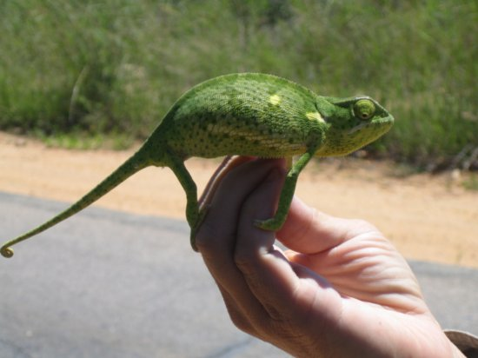
Goal
To be able to automatically understand the content of an image
Black Box
Input
Output
Chameleon
Hand
Grass
Road
Sand

Slide 3
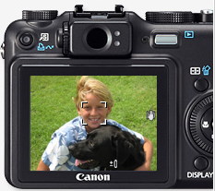
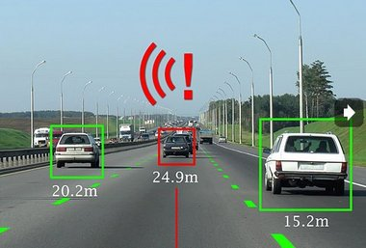
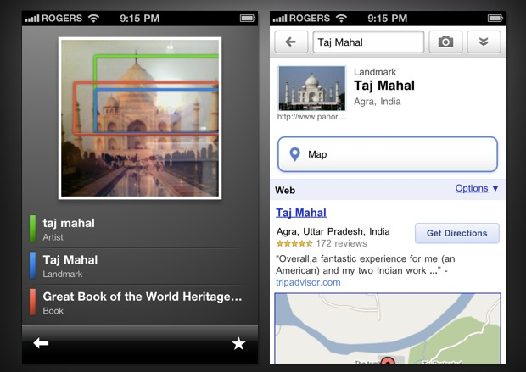
Motivation
Recently object detection in natural images is starting to have a lot of commercial success!
  Automatic Focus MobilEye
  Google Goggles

Slide 4
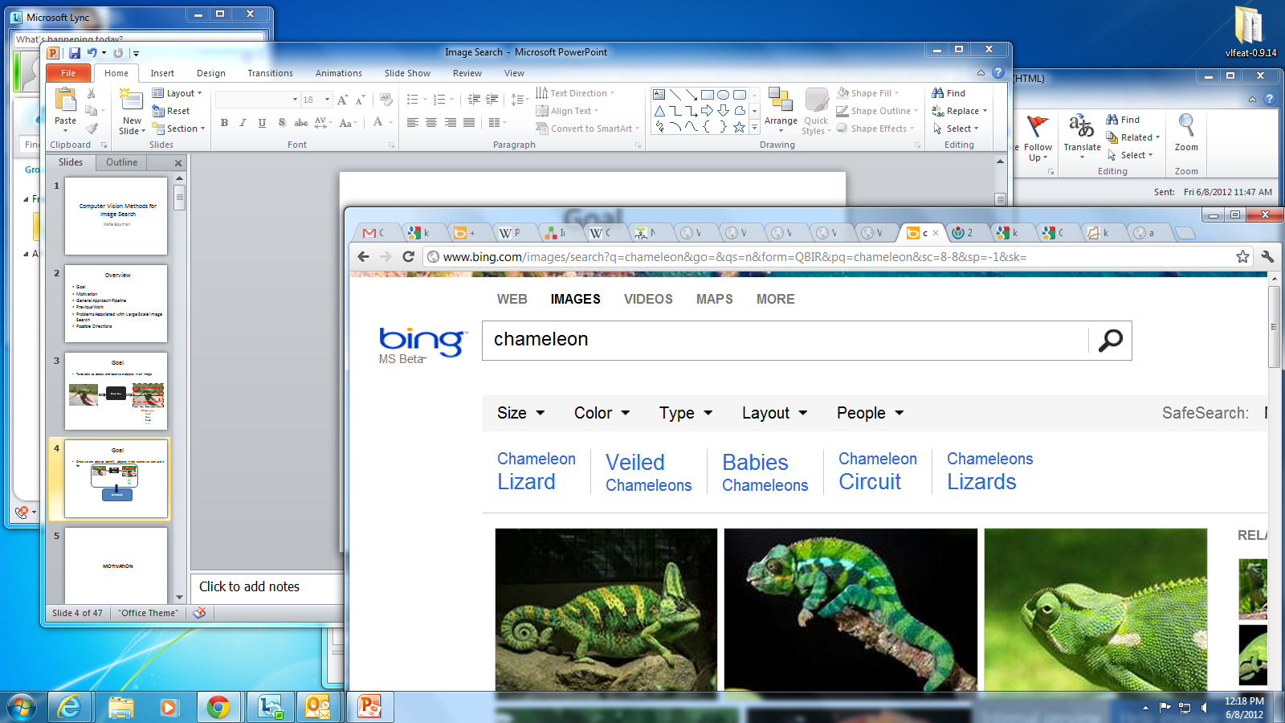
Motivation
Black Box
Chameleon
Hand
Grass
Road
Sand
INDEXING
DATABASE
RETRIEVAL
RESULT
QUERY

Slide 5
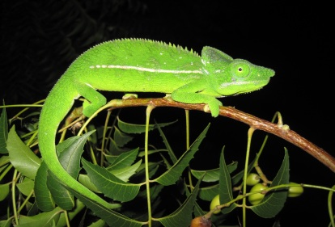
Motivation
Black Box
Chameleon
Hand
Grass
Road
Sand
INDEXING
DATABASE
RETRIEVAL
QUERY
RESULT
This image contains a chameleon

Slide 6
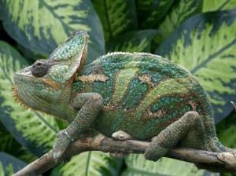
Motivation
Black Box
Chameleon
Hand
Grass
Road
Sand
INDEXING
DATABASE
RETRIEVAL
QUERY
RESULT
This image contains a chameleon

Slide 7
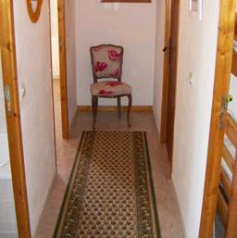
Is Object Detection Really that Hard?
This is a chair
Slide Credit: A. Torralba

Slide 8
Is Object Detection Really that Hard?
Find the chair in this image
This is a chair
Slide Credit: A. Torralba

Slide 9
Is Object Detection Really that Hard?
Find the chair in this image
This is a chair
Slide Credit: A. Torralba

Slide 10

Is Object Detection Really that Hard?
Find the chair in this image
Output of normalized correlation
This is a chair
Slide Credit: A. Torralba

Slide 11
Is Object Detection Really that Hard?
Find the chair in this image
Output of normalized correlation
This is a chair
Slide Credit: A. Torralba

Slide 12
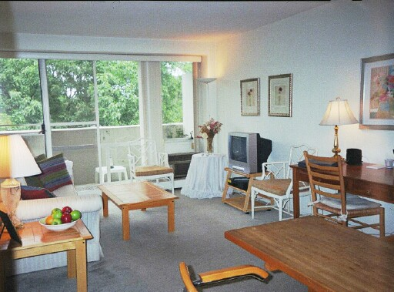
Is Object Detection Really that Hard?
Find the chairs in this image
Slide Credit: A. Torralba

Slide 13
Is Object Detection Really that Hard?
Find the chairs in this image
Slide Credit: A. Torralba

Slide 14
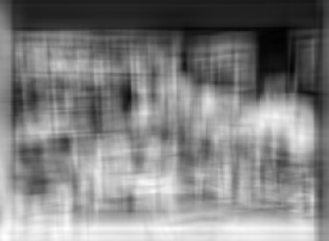
Is Object Detection Really that Hard?
Find the chairs in this image
Output of normalized correlation
Slide Credit: A. Torralba

Slide 15
Is Object Detection Really that Hard?
Find the chairs in this image
Output of normalized correlation
Garbage!
Slide Credit: A. Torralba

Slide 16


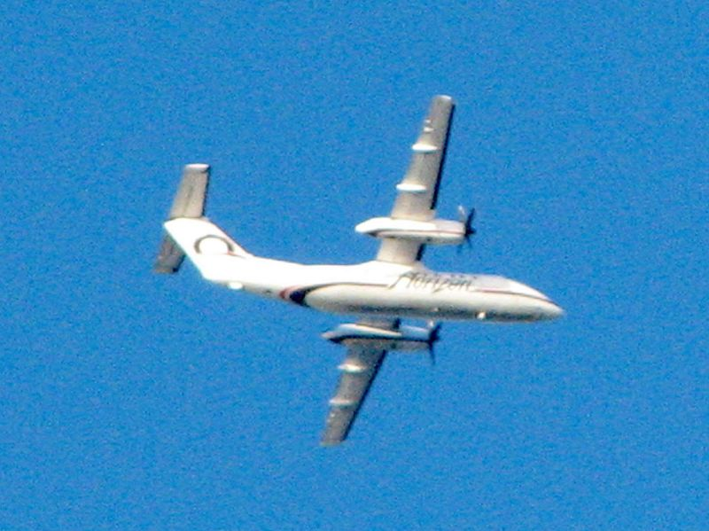


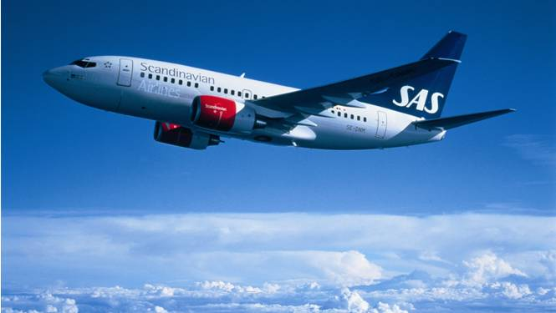
Challenges of Object Detection
View Point Variation

Slide 17
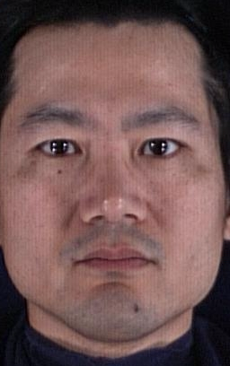
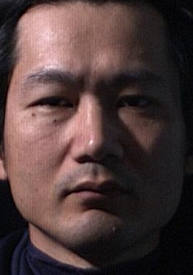
Challenges of Object Detection
View Point Variation
Illumination
Image Credit: S. Ullman

Slide 18
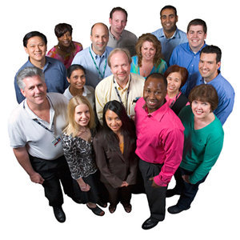
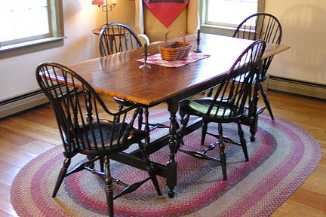
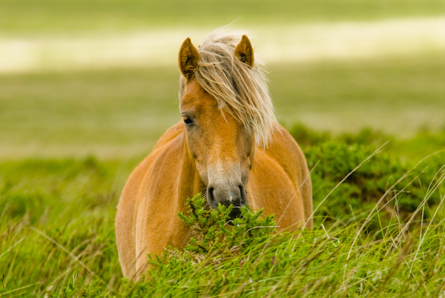
Challenges of Object Detection
View Point Variation
Illumination
Occlusion

Slide 19
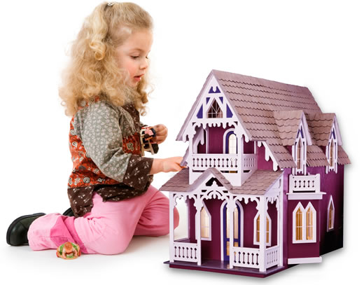
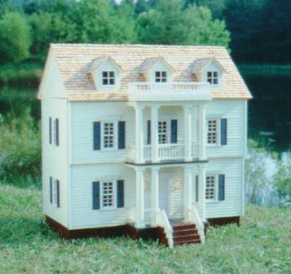
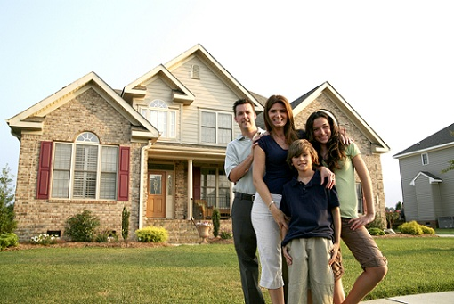
Challenges of Object Detection
View Point Variation
Illumination
Occlusion
Scale

Slide 20
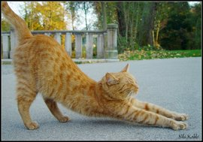
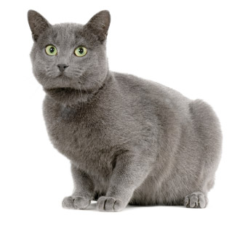
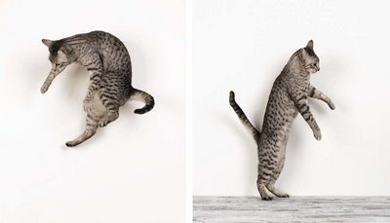
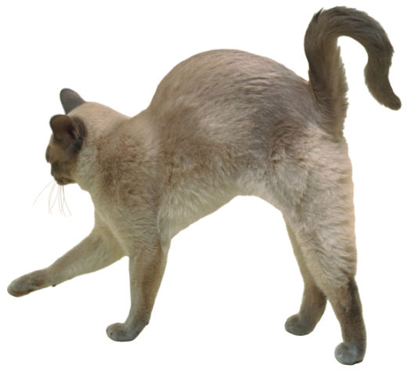
Challenges of Object Detection
View Point Variation
Illumination
Occlusion
Scale
Deformation/Articulation

Slide 21
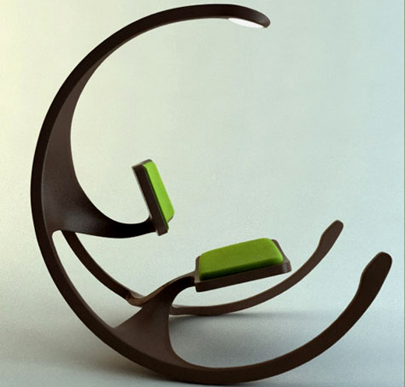
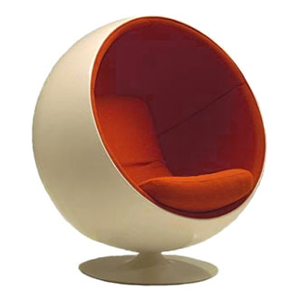
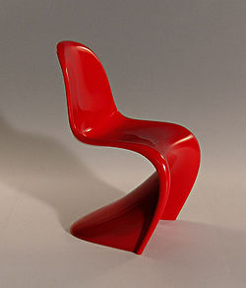
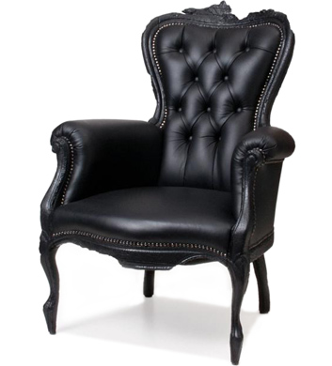
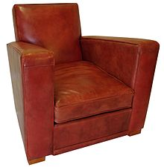
Challenges of Object Detection
View Point Variation
Illumination
Occlusion
Scale
Deformation/Articulation
Intra-Class Variation

Slide 22
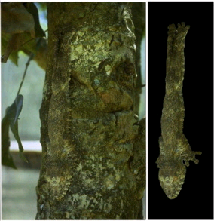
Challenges of Object Detection
View Point Variation
Illumination
Occlusion
Scale
Deformation/Articulation
Intra-Class Variation
Background Clutter
Image Credit: A. Torralba

Slide 23
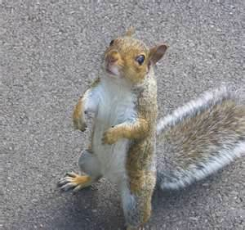
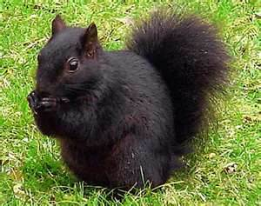
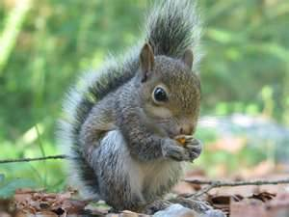
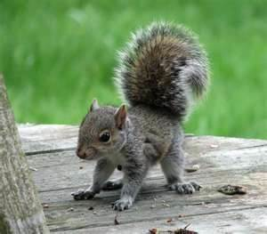
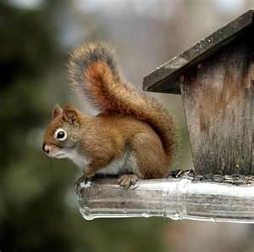
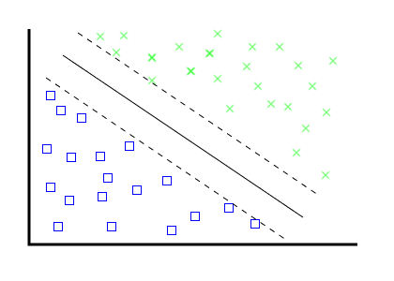
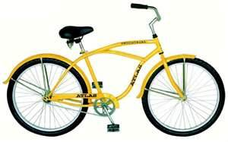
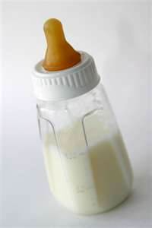
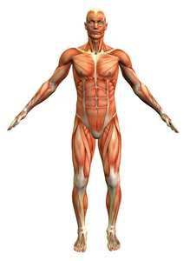
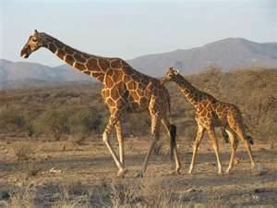
General Approach Pipeline: Learning Model
POSTIVE EXAMPLES
Feature Vector 1
Feature Vector 2
Feature Vector 3
Feature Vector 4
Feature Vector 5
EXTRACT FEATURES
LEARN CLASSIFIER
NEGATIVE EXAMPLES
Feature Vector 1
Feature Vector 2
Feature Vector 3
Feature Vector 4
Feature Vector 5

Slide 24
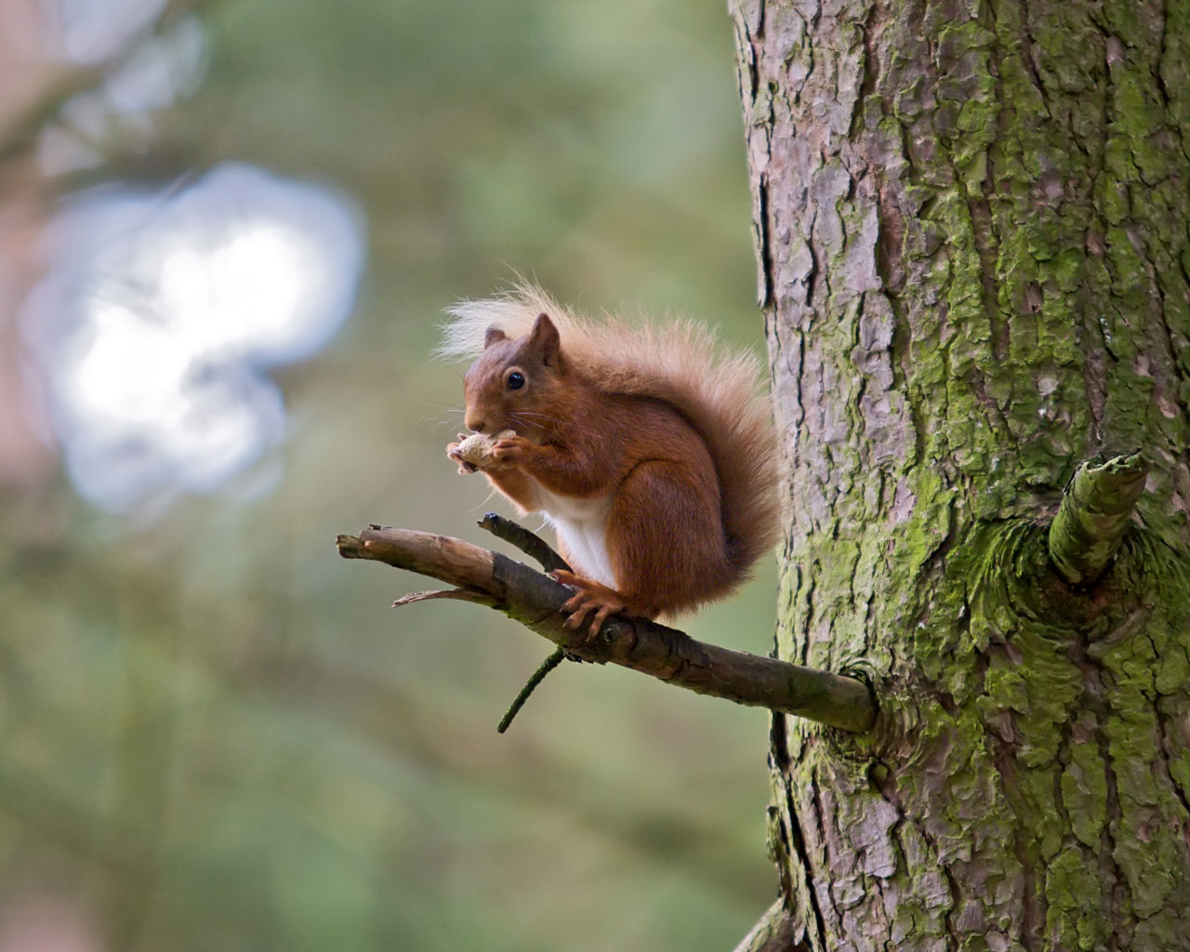
General Approach Pipeline: Detecting Objects
Input Image
Feature Vector 1
EXTRACT FEATURES
Feature Vector 2
Feature Vector 3
CLASSIFY
Is there a squirrel here?

Slide 25
Questions To Answer
What features should we use?
  Intensity, color, gradient information, etc…
What models should we use?
How can we realistically implement an algorithm?

Slide 26
What features should we use?

Slide 27
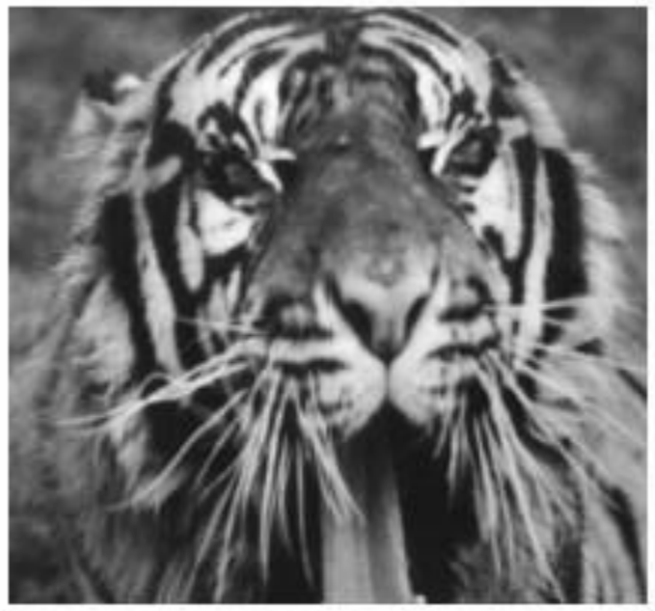

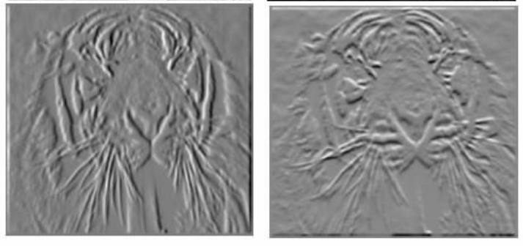
Common Image Descriptors for Detection
Descriptors encode local neighboring window around keypoints
Commonly descriptors in object detection try to capture gradient information
  Human Perception is sensitive to gradient orientation
  Invariant to changes in lighting and small deformations

Slide 28
Common Image Descriptors for Detection
Most common image descriptors currently used in object detection
  SIFT – Scale Invariant Feature Transform
  HOG – Histogram of Oriented Gradients
  and many variants of these…

Slide 29
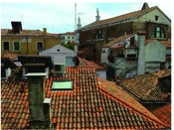
SIFT – Scale Invariant Feature Transform
Input an Image
Input Image
Image Credit: VLFeat

Slide 30
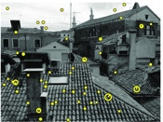
SIFT – Scale Invariant Feature Transform
Input an Image
Extract Keypoints
  Finds “corners”
  Determines scale and orientation of the keypoint
Input Image
Extract Keypoints
Image Credit: VLFeat

Slide 31
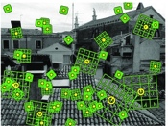
SIFT – Scale Invariant Feature Transform
Input an Image
Extract Keypoints
  Finds “corners”
  Determines scale and orientation of the keypoint
Compute Descriptor for each Keypoint
  Histogram of gradients in Gaussian window around keypoint
Input Image
Extract Keypoints
Compute Descriptors
Image Credit: VLFeat

Slide 32


SIFT – Scale Invariant Feature Transform
Compute the gradient for each pixel in local neighboring window
  Typically 8 gradient directions
  Neighboring window is determined by scale of the keypoint
Image Credit: D. Lowe

Slide 33
SIFT – Scale Invariant Feature Transform
Compute the gradient for each pixel in local neighboring window
  Typically 8 gradient directions
  Neighboring window is determined by scale of the keypoint
Pool Gradients into a 4x4 histogram
  Weight each magnitude by a Gaussian window centered around the keypoint
showing only 2x2 here but is generally 4x4
Image Credit: D. Lowe

Slide 34
SIFT – Scale Invariant Feature Transform
Compute the gradient for each pixel in local neighboring window
  Typically 8 gradient directions
  Neighboring window is determined by scale of the keypoint
Pool Gradients into a 4x4 histogram
  Weight each magnitude by a Gaussian window centered around the keypoint
8x4x4=128 dimensional output vector normalized to 1
showing only 2x2 here but is generally 4x4
Image Credit: D. Lowe

Slide 35
SIFT – Scale Invariant Feature Transform
Match groups of keypoints across images
  Invariant to scale and some changes in lighting and orientation
Great for finding the same instance of an object!
Image Credit: D. Lowe

Slide 36
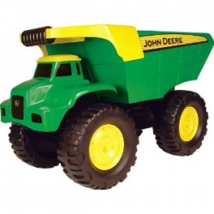
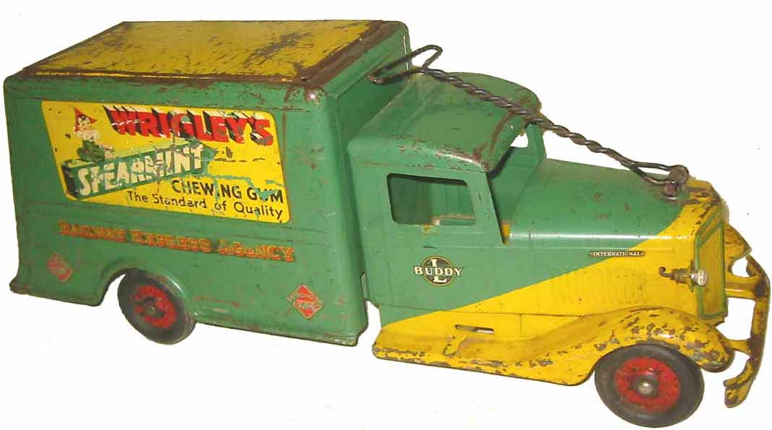
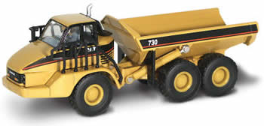
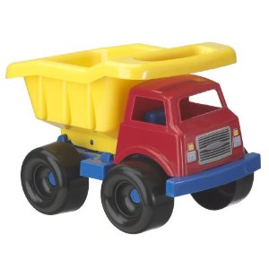

SIFT – Scale Invariant Feature Transform
Not good at finding different instances of an object
Image Credit: D. Lowe

Slide 37
SIFT – Scale Invariant Feature Transform
Input an Image
Extract Keypoints
  Finds “corners”
  Determines scale and orientation of the keypoint
Compute Descriptor for each Keypoint
  Histogram of gradients in Gaussian window around keypoint
Input Image
Extract Keypoints
Compute Descriptors
Image Credit: VLFeat

Slide 38

DSIFT – Dense Scale Invariant Feature Transform
Input an Image
Compute Descriptor for each k pixels
  Use a fixed scale to calculate each descriptor
  No longer scale invariant

Slide 39

HOG – Histogram of Oriented Gradients
Input an Image
Notes:
http://www.cs.brown.edu/courses/cs143/results/proj4/hangsu/

Slide 40
HOG – Histogram of Oriented Gradients
Input an Image
Normalize Gamma and Color
Notes:
http://www.cs.brown.edu/courses/cs143/results/proj4/hangsu/

Slide 41
HOG – Histogram of Oriented Gradients
Input an Image
Normalize Gamma and Color
Compute Gradients
Notes:
http://www.cs.brown.edu/courses/cs143/results/proj4/hangsu/

Slide 42
HOG – Histogram of Oriented Gradients
Input an Image
Normalize Gamma and Color
Compute Gradients
Accumulate weighted votes for gradient orientation over spatial bins
Notes:
http://www.cs.brown.edu/courses/cs143/results/proj4/hangsu/

Slide 43
HOG – Histogram of Oriented Gradients
Input an Image
Normalize Gamma and Color
Compute Gradients
Accumulate weighted votes for gradient orientation over spatial bins
Normalize contrast within overlapping blocks of cells
Notes:
http://www.cs.brown.edu/courses/cs143/results/proj4/hangsu/

Slide 44
HOG – Histogram of Oriented Gradients
Input an Image
Normalize Gamma and Color
Compute Gradients
Accumulate weighted votes for gradient orientation over spatial bins
Normalize contrast within overlapping blocks of cells
Collect HOGs for all blocks over image
Notes:
http://www.cs.brown.edu/courses/cs143/results/proj4/hangsu/

Slide 45

HOG – Histogram of Oriented Gradients
Notes:
http://www.cs.brown.edu/courses/cs143/results/proj4/hangsu/

Slide 46



HOG – Histogram of Oriented Gradients
?
?
?
Notes:
http://www.cs.brown.edu/courses/cs143/results/proj4/hangsu/

Slide 47


HOG – Histogram of Oriented Gradients
Notes:
http://www.cs.brown.edu/courses/cs143/results/proj4/hangsu/

Slide 48
What models should we use?

Slide 49








Families of Detection/Recognition Models
Bag of Words Models
Rigid Template Models
Csurka, Dance, Fan, Willamowski, and Bray 2004
Sivic, Russell, Freeman, Zisserman,
ICCV 2005
Sirovich and Kirby 1987
Turk, Pentland, 1991
Dalal & Triggs, 2006
Structure Models -Part and Voting Models
Viola and Jones, ICCV 2001
Heisele, Poggio, et. al., NIPS 01
Schneiderman, Kanade 2004
Vidal-Naquet, Ullman 2003
Fischler and Elschlager, 1973
Burl, Leung, and Perona, 1995
Weber, Welling, and Perona, 2000
Fergus, Perona, & Zisserman, CVPR 2003
Image Credit: A. Torralba
Notes:
Not historical order. In fact, all families co-exist and benefit from each other.

Slide 50
Families of Detection/Recognition Models
Models vectors capture varying degrees of spatial relationships between features
  Bag of Words
  Structure Models
  Rigid Template Models

Slide 51

Bag of Words
Image Credit: L. Fei Fei

Slide 52

Bag of Words
Extract local descriptors from image
Learn a “visual vocabulary” (codebook) of local descriptors
Quantize the local descriptors using the codebook
Represent images by frequencies of visual words
Slide Credit: J. Hays
Notes:
http://www.cs.brown.edu/courses/cs143/lectures/16.pdf

Slide 53

Bag of Words: Learning a Codebook
Extract Features from all images and then cluster
  SIFT, DSIFT
  K-means
How to choose vocabulary size?
  Too small: visual words not representative of all patches
  Too large: quantization artifacts and overfitting
Image Credit: J. Hays
Notes:
http://www.cs.brown.edu/courses/cs143/lectures/16.pdf

Slide 54
Bag of Words: Coding Local Descriptors
Vector Quantization Coding
  Map each feature to the index of the nearest visual word in the codebook
Locally-Constrained Linear Coding
  Write each feature as a linear combination of the visual words
Image Credit: J. Hays
Notes:
http://www.cs.brown.edu/courses/cs143/lectures/16.pdf

Slide 55

Bag of Words: Coding Local Descriptors
Original Image
Vector Quantization Coding
Locality-Constrained Linear Coding
Generated Images from the average patch associated with each visual word

Slide 56
Bag of Words: Pooling
Sum Pooling
Max Pooling

Slide 57


Learning Detection Classifiers
Extract Regions from Images
  Containing the desired object
  Containing everything other than the desired object
Compute Feature Vector for Each Region
Train SVM
  Linear vs. Non-linear Kernel
+ Thousands More
Positive Examples
+ Millions More
Negative Examples

Slide 58

Bag of Words: Where it Works
Texture Recognition
  Texture is characterized by the repetition of basic elements or textons
  For stochastic textures, it is the identify of the textons and not their spatial arrangement that matters
Image Credit: J. Malik
Notes:
http://www.talkingglasses.iblogger.org/?p=451

Slide 59




Bag of Words: Where it Fails
Slide Credit: J. Hays
Notes:
http://www.cs.brown.edu/courses/cs143/lectures/16.pdf

Slide 60

Spatial Pyramids
Slide Credit: J. Hays

Slide 61

Spatial Pyramids
Extension of the bag of words model
Locally orderless representation at several levels of resolution
  Some spatial information
Image Credit: S. Lazebnik

Slide 62

Spatial Pyramids: Learning Receptive Fields
Recent work in learning Receptive Fields rather than using a regular grid
  Example Motivation: Sunset and Highway Images
Traditional Receptive Fields
Learned Receptive Fields
Image Credit: Y. Jia

Slide 63

Rigid Template Models
Find the HOG feature vector for each image
Originally developed to used for pedestrian detection by Dalal and Triggs
HOG
Image Credit: Dalal

Slide 64

Rigid Template Models: Detecting Objects
Convolve low resolution HOG with the rigid template
Test Image
HOG
Response
x
Pedestrian Model
Image Credit: P. Felzenszwalb

Slide 65

Rigid Template Models: Mixture Models
Objects take on different appearances
  Pose
  Multiple types of the same object
For each object create a mixture model to capture the various appearances of the same object
Image Credit: P. Felzenszwalb

Slide 66






Structure Models
Part Models
Voting models
Deformable
Models
Few parts (~6)
Many patches (>100)
No parts
Slide Credit: A. Torralba

Slide 67
Structure Models
Part Models
Voting models
Deformable
Models
Few parts (~6)
Many patches (>100)
No parts
Slide Credit: A. Torralba

Slide 68

Part Based Models
Image Credit: Fischler & Elschlager

Slide 69


Part Based Model
Models an object as a number of smaller parts that are allowed to deviate slightly from “average” appearance
  Star model - coarse root and higher resolution part filters
Parts are not positioned the same in each detection
Root Filter
Part Filters
Spatial Model for location of each part relative to root
Image Credit: P. Felzenszwalb

Slide 70





Part Based Model: Training using Latent SVM
Use SVM to find classifier
START
Initialize Part Locations
Use classifier to estimate the latent variable – part locations

Slide 71
Part Based Model: Detecting Objects
Pedestrian Model
Test Image
Extract HOG Features at multiple scales
Convolve low resolution HOG with the root filter and high resolution HOG with the parts filters
Transform part responses to point to where the star’s root should be located
Add responses to find score for root locations
Image Credit: P. Felzenszwalb

Slide 72


Voting Models
Create weak detectors by using parts and voting for the object’s center location
Car model
Screen model
Slide Credit: A. Torralba
Notes:
This will be better than a full object template because it allows for some flexibility in the location of the parts. It is still easy to compute.

Slide 73








Voting Models: Collecting Parts
First we collect a set of part templates from a set of training objects.
…
Slide Credit: A. Torralba
Notes:
The simplest weak detector will be using template matching. In this case we use template matching to detect the presence of a part of the object. Once the presence is detected it will vote for the object in the center of the object coordinates frame. In this example, we are trying to detect a computer screen. We use the top left corner of the screen. The first thing we do is compute a normalize correlation between the image and the template. This will give a pick in the response near the top-left corner of the screen and, of course, many other matches that do not correspond to screen. Now we displace the output of the correlation taking into account the relative positions between the top left corner of the screen and the center of the screen. We also blur the output. Now, if we apply a threshold we can see that the center of the screen has a value above the threshold while most of the background gets suppressed. There are a lot of other locations that also are above the threshold. Therefore, this is not a good detector. But it is better than chance!

Slide 74








Voting Models: Weak Part Detectors
We now define a family of “weak detectors” as:
=
*
=
Better than chance
Slide Credit: A. Torralba
Notes:
The simplest weak detector will be using template matching. In this case we use template matching to detect the presence of a part of the object. Once the presence is detected it will vote for the object in the center of the object coordinates frame. In this example, we are trying to detect a computer screen. We use the top left corner of the screen. The first thing we do is compute a normalize correlation between the image and the template. This will give a pick in the response near the top-left corner of the screen and, of course, many other matches that do not correspond to screen. Now we displace the output of the correlation taking into account the relative positions between the top left corner of the screen and the center of the screen. We also blur the output. Now, if we apply a threshold we can see that the center of the screen has a value above the threshold while most of the background gets suppressed. There are a lot of other locations that also are above the threshold. Therefore, this is not a good detector. But it is better than chance!

Slide 75















Voting Models: Weak Part Detectors
We can do a better job using filtered images
*
=
=
*
=
Still a weak detector
but better than before
Slide Credit: A. Torralba

Slide 76
Voting Model Example: Screen Detection
Feature
output
Slide Credit: A. Torralba

Slide 77
Voting Model Example: Screen Detection
Feature
output
Thresholded
output
Weak ‘detector’
Produces many false alarms.
Slide Credit: A. Torralba

Slide 78
Voting Model Example: Screen Detection
Feature
output
Thresholded
output
Strong classifier
at iteration 1
Slide Credit: A. Torralba

Slide 79
Voting Model Example: Screen Detection
Feature
output
Thresholded
output
Strong
classifier
Second weak ‘detector’
Produces a different set of false alarms.
Slide Credit: A. Torralba

Slide 80
Voting Model Example: Screen Detection
Feature
output
Thresholded
output
Strong
classifier
+
Strong classifier
at iteration 2
Slide Credit: A. Torralba

Slide 81
Voting Model Example: Screen Detection
Feature
output
Thresholded
output
Strong
classifier
+
…
Strong classifier
at iteration 10
Slide Credit: A. Torralba

Slide 82
Voting Model Example: Screen Detection
Feature
output
Thresholded
output
Strong
classifier
+
…
Adding
features
Strong classifier
at iteration 200
Slide Credit: A. Torralba

Slide 83
Voting Model Example: Screen Detection
Feature
output
Thresholded
output
Strong
classifier
+
…
Adding
features
Strong classifier
at iteration 200
Slide Credit: A. Torralba

Slide 84
Boosting
Defines a classifier using an additive model
Strong
classifier
Weak classifier
Weight
Features
vector
Slide Credit: A. Torralba

Slide 85
Boosting Example
It is a sequential procedure:
Each data point has a class label:
+1 ( )
y_{t} =
-1 ( )
and a weight:
w_{t} =1
Slide Credit: A. Torralba

Slide 86
Boosting Example
Each data point has a class label:
+1 ( )
y_{t} =
-1 ( )
and a weight:
w_{t} =1
This classifier seems to be the best
Slide Credit: A. Torralba

Slide 87
Boosting Example
Each data point has a class label:
+1 ( )
y_{t} =
-1 ( )
We update the weights
We set a new problem for which the previous weak classifier performs at chance again
Slide Credit: A. Torralba

Slide 88
Boosting Example
Each data point has a class label:
+1 ( )
y_{t} =
-1 ( )
We set a new problem for which the previous weak classifier performs at chance again
Slide Credit: A. Torralba

Slide 89
Boosting Example
Each data point has a class label:
+1 ( )
y_{t} =
-1 ( )
We update the weights
We set a new problem for which the previous weak classifier performs at chance again
Slide Credit: A. Torralba

Slide 90
Boosting Example
Each data point has a class label:
+1 ( )
y_{t} =
-1 ( )
We set a new problem for which the previous weak classifier performs at chance again
Slide Credit: A. Torralba

Slide 91
Boosting Example
f₁
f₂
f₄
f₃
The strong (non- linear) classifier is built as the combination of all the weak (linear) classifiers.
Slide Credit: A. Torralba

Slide 92


Learning Detection Classifiers: Exemplar SVMs
Learns a separate classifier for EVERY positive example (and millions of negative examples)
At test time each classifier is applied to the image
Image Credit: A. Malisiewicz

Slide 93

Learning Detection Classifiers: Exemplar SVMs
Allows for more accurate correspondence and information transfer
Image Credit: T. Malisiewicz

Slide 94
How can we realistically implement an algorithm?

Slide 95
Learning Detection Classifiers
Extract Regions from Images
  Containing the desired object
  Containing everything other than the desired object
Compute Feature Vector for Each Region
Train SVM
  Linear vs. Non-linear Kernel
+ Thousands More
Positive Examples
+ Millions More
Negative Examples

Slide 96
Training SVMs using Hard Negative Mining
Too many negatives examples to train against all of them
  Time and Memory Constraints
Be smart about how you choose what negatives to train against
Positives
Negatives
…

Slide 97
Training SVMs using Hard Negative Mining
Too many negatives examples to train against all of them
  Time and Memory Constraints
Be smart about how you choose what negatives to train against
Positives
Negatives
…

Slide 98
Training SVMs using Hard Negative Mining
Too many negatives examples to train against all of them
  Time and Memory Constraints
Be smart about how you choose what negatives to train against
Positives
Negatives
…

Slide 99
Training SVMs using Hard Negative Mining
Too many negatives examples to train against all of them
  Time and Memory Constraints
Be smart about how you choose what negatives to train against
Positives
Negatives
…
Classifies these points incorrectly

Slide 100
Training SVMs using Hard Negative Mining
Too many negatives examples to train against all of them
  Time and Memory Constraints
Be smart about how you choose what negatives to train against
Positives
Negatives
…

Slide 101

Detecting Objects
Must run a classifier at every position at every scale in order to detect object

Slide 102
Detecting Objects

Slide 103
Detecting Objects

Slide 104
Detecting Objects

Slide 105


Generating Potential Object Regions
Most algorithms rely on an exhaustive search to find object detections
  Number of Pixels X Number of Scales
Quickly find a smaller number of potential object bounding boxes to search in
Reduce
Search Space
Exhaustive Search
Selective Search
Image Credit: K. Van de Sande

Slide 106

Generating Potential Object Regions
Segmentation Algorithm
  Start with oversegmentation in a variety of color spaces
  Group regions for each color space in a greedy fashion until the image is a single region
    Size and Texture
Image Credit: K. Van de Sande

Slide 107









Generating Potential Object Regions

Slide 108
Generating Potential Object Regions

Slide 109
Datasets for Object Classification/Detection
Caltech101
Caltech256
PASCAL
ImageNET
LabelMe

Slide 110
Questions?

