Slide 1

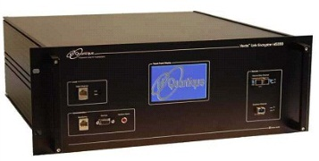
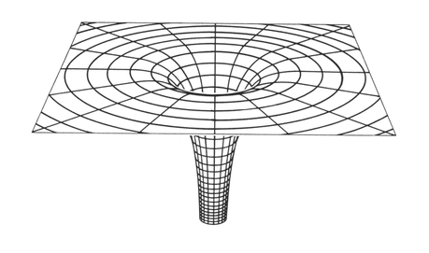
What are the minimal assumptions needed for infinite randomness expansion?
0
1
1
1
1
1
0
0
0
Henry Yuen (MIT)
Stellenbosch, South Africa
27 October 2015
1
0
1
1
0
1
0
1
0
0
0
1
1
0
0
0
0
1
1
1
0
0
1
0
0
1
1

Slide 2
Certified randomness expansion is an answer to the following question:
How do we know we have seen randomness?

Slide 3

Like all non-trivial epistemological questions, the answer must rely on some underlying assumptions.
“I think, therefore I am
(… but that’s about it)”

Slide 4
Certified randomness expansion is an answer to the following question:
How do we know we have seen randomness?
Goal: derive the most interesting answers to this, while minimizing our assumptions.

Slide 5

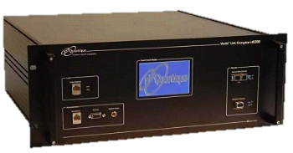

The hierarchy of randomness expansion
Assumptions
∞
Infinite randomness expansion
?
Strong security against eavesdroppers
?
?
Exponential expansion
?
Nothing.

Slide 6

0 1 1 0 1 1 1 0
. . . .

Slide 7
1 0 1 0 0 1 0 1
. . . .

Slide 8
1 1 1 1 1 1 1 1
. . . .

Slide 9
0 0 0 0 0 0 0 0
. . . .

Slide 10
Cannot a priori certify whether outputs are random or not.
Need additional assumptions!
0 0 0 0 0 0 0 0
. . . .

Slide 11

If we assume:
  Initial seed randomness
  Boxes are not able to communicate.
Then randomness certification becomes possible.
1101001

Slide 12
Clauser-Horne-Shimony-Holt game:
Experimenter chooses random bits x, y
Sends x to 1st box and y to 2nd box simultaneously
1st box answers with bit a,
2nd box answers with bit b
Experimenter checks if
a + b = x ∧ y
1101001
Optimal deterministic success probability: 75%
Suppose boxes win CHSH with
> 75% chance.
Conclusion: a, b must be random!

Slide 13
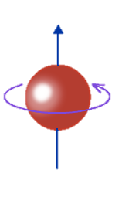
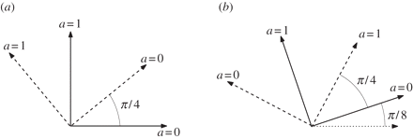
Spooky action at a distance
Boxes with success
probability > 75% exist
in a world governed by
(at least) QM.
Optimal quantum strategy: ≈ 85.4%

Slide 14
Expanding randomness
Use m-bit seed to generate CHSH inputs (x₁,y₁), …, (x_{N},y_{N}), with N >> m.
Play CHSH N times, getting outputs (a₁,b₁), …, (a_{N},b_{N}).
Accept if boxes win ≥ 85% of games.
Post-process outputs using randomness extractor to produce (z₁,..,z_{N’})
1 1 1 0 0 0 0 0 1 0 1
x₁,x₂,..,x_{N}
0 0 1 1 1 0 1 0 0 1 1 01 0 0 10 10 0 10 01
1101001
y₁,y₂,..,y_{N}
Theorem: If Pr[boxes pass] > ε,
then (z₁,…,z_{N’}) is ε-close to uniform on N’ bits.
1 0 0 0 1 1 1 0 1 0 1

Slide 15
Theorem: If Pr[boxes pass] > ε,
then (z₁,…,z_{N’}) is ε-close to uniform on N’ bits.
Roger Colbeck
PhD thesis, 2009
Obtained N = Θ(m)
Linear expansion
Pironio, Acin, Massar, et al.
Nature 2010
Obtained N = Ω(m²)
Quadratic expansion
Vazirani, Vidick
STOC 2012
Obtained N = exp(Ω(m^{1/3}))
Exponential expansion
1101001
Assumptions:
Seed randomness
Boxes cannot communicate

Slide 16
The hierarchy of randomness expansion
Assumptions
1. Initial randomness
2. No signaling
Exponential expansion
Nothing.
No assumptions

Slide 17
Security against eavesdroppers

Slide 18

Security against eavesdroppers
Device-independent paradigm: can certify randomness even if RNG devices are adversarial!
Next goal: Certify randomness that is secure against eavesdroppers.

Slide 19
Security against eavesdroppers
Possible if we assume quantum mechanics!
Assume there is an underlying quantum state, and outcome probabilities are described by local measurements on the state.

Slide 20
Security against eavesdroppers
Possible if we assume quantum mechanics!
[Vazirani, Vidick STOC 2012]: Exponential randomness expansion with quantum security.
[Miller, Shi STOC 2014]:
Simpler, robust protocol,
and with much stronger parameters.

Slide 21
Security against eavesdroppers
Key enabler of quantum security:
“monogamy of entanglement”
Basic idea:
Optimal quantum strategy for CHSH
Outputs are independent of the rest of the universe!
Assumption:

Slide 22
Strong security against eavesdroppers
Outputs are secure even when inputs are prepared by adversary!
[Coudron, Y. STOC 2014]: Gave a strong randomness expansion protocol.
[Chung, Shi, Wu QIP 2014]:
Equivalence Lemma shows all secure expansion protocols are automatically strongly secure!
Note: not possible with classical randomness extractors!
Assumption:

Slide 23
Strong security against eavesdroppers
Assumptions:
Initial seed is uncorrelated with boxes
Boxes and adversary are mutually
non-signaling
Boxes and adversary obey quantum
mechanics.
Do we really
need this?

Slide 24
Strong security against eavesdroppers
Can we only assume non-signaling?
Not known yet. It’s plausible that this is impossible: there are limitations on, e.g. privacy amplification in the non-signaling model
[Arnon-Friedman, Hanggi, Ta-Shma]

Slide 25
The hierarchy of randomness expansion
Assumptions
Strong security against eavesdroppers
1. Initial randomness
2. No signaling
3. Quantum mechanics
1. Initial randomness
2. No signaling
Exponential expansion
Nothing.
No assumptions

Slide 26
Infinite randomness expansion

Slide 27
The infinite randomness expansion question
Is there a protocol P involving a fixed number of boxes, using m ≥ m₀ bits of seed, that can certify N bits of (approximately) uniform randomness, for any N?

Slide 28
P
=
e.g. Vazirani-Vidick or Miller-Shi exponential expansion protocol
…..
P
P
P
P
P
m-bit seed
2^{m}
2^{m}
2^{m}
Output
length
2^{m}
2
2
2
2^{m}
…..
2
2
2
2
2
2
2

Slide 29
Can we do it non-adaptively?
Unlikely [Coudron-Vidick-Y. 2013]:
For a wide class of protocols, there is a limit f(m) = exp(exp(m)) in the amount of certifiable randomness!
Limitation applies to all non-adaptive protocols we know of!
m-bit seed
P
N-bit output
Idea: if seed is too small, after too many rounds, the input patterns become predictable and the players can recycle answers, producing no additional randomness.

Slide 30
Adaptive protocols, take #1
m-bit seed
P
f(m)-bit output
P
= randomness expansion protocol

Slide 31
Adaptive protocols, take #1
f(m)-bit seed
P
Unclear this works. The boxes in P could memorize their outputs and take advantage of that in the next iteration!
f(f(m))-bit output
…ad infinitum
P
= randomness expansion protocol

Slide 32
Adaptive protocols, take #2
m-bit seed
P
P
f(m)-bit output
f(f(m))-bit output
P
= randomness expansion protocol

Slide 33
Adaptive protocols, take #2
P
P
f(f(f(m)))-bit output
f(f(m))-bit output
This output is
secure against 1st
because of strong security!
P
P
= randomness expansion protocol

Slide 34
Adaptive protocols, take #2
After i iterations, conditioned on not aborting, the output of this protocol is
f^{(i)}(m) bits
that is
ε₁ + ε₂ + ε₃ + … ≤ ε
close to uniform in statistical distance.
Number of boxes: 4
P
P
f(f(f(m)))-bit output
…
[Coudron-Y, Miller-Shi, Chung-Shi-Wu 2014] Infinite randomness expansion is possible!
P
= randomness expansion protocol

Slide 35
m₀
[Gross, Aaronson 2014]: Using the Miller-Shi expansion protocol,

Slide 36
m₀
[Gross, Aaronson 2014]: Using the Miller-Shi expansion protocol,
715,000
bits of uniform seed are sufficient to “jump start” infinite randomness expansion, to get output within distance ε = 10⁻⁶ to uniform.
[arxiv:1410.8019]

Slide 37
Revisiting the non-signaling assumption
Adaptivity means we can’t rely on spatial separation to enforce non-signaling.
P
P
By triangle inequality, distance from P1 → P2 is less than
P1 → Experimenter → P2.
So if the protocol is adaptive, P1 could signal to P2, in principle!

Slide 38
Revisiting the non-signaling assumption
This was also a problem for “non-adaptive” randomness expansion, because the experimenter wanted to use the randomness for e.g., cryptography.
P
E
Maybe we should just assume Faraday cages suffice for enforcing non-signaling…

Slide 39
Revisiting the non-signaling assumption
This was also a problem for “non-adaptive” randomness expansion, because the experimenter wanted to use the randomness for e.g., cryptography.
P
E
Maybe we should just assume Faraday cages suffice for enforcing non-signaling…
I’m not ready to call it quits just yet…

Slide 40
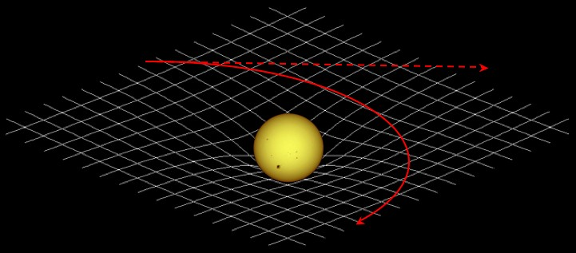
Crazy Idea No. 1
Let’s assume General Relativity!
Can we manipulate the geometry of space and time to control the propagation of information?
  i.e. can we simulate “secure lines of communication”?

Slide 41
Crazy Idea No. 1
P
P

Slide 42
Crazy Idea No. 1
P
P

Slide 43
Crazy Idea No. 1
P
P

Slide 44



Crazy Idea No. 2
Use ideas from relativistic bit commitment?
Commit phase

Slide 45
Crazy Idea No. 2
Use ideas from relativistic bit commitment?
Sustain phase

Slide 46

Crazy Idea No. 2
Use ideas from relativistic bit commitment?
Open phase

Slide 47
The hierarchy of randomness expansion
Assumptions
∞
Infinite randomness expansion
1. Initial randomness
2. (Enforced) No signaling
3. Quantum mechanics
Strong security against eavesdroppers
1. Initial randomness
2. No signaling
3. Quantum mechanics
1. Initial randomness
2. No signaling
Exponential expansion
Nothing.
No assumptions

Slide 48
The hierarchy of randomness expansion
Assumptions
∞
Infinite randomness expansion
1. Initial randomness
2. General relativity?
3. Quantum mechanics
Strong security against eavesdroppers
1. Initial randomness
2. No signaling
3. Quantum mechanics
1. Initial randomness
2. No signaling
Exponential expansion
Nothing.
No assumptions

Slide 49
Open questions
Can we prove non-signaling security of randomness expansion protocols?
Can we replace “enforced no-signaling” with assuming General Relativity, or use some scheme like sustained relativistic bit commitment?
Minimum requirements on initial seed randomness?

Slide 50
Open questions
Can we prove non-signaling security of randomness expansion protocols?
Can we replace “enforced no-signaling” with assuming General Relativity, or use some scheme like sustained relativistic bit commitment?
Minimum requirements on initial seed randomness?
Thanks!

